Slide 1

Unpacking & Wiring
CNT360

Slide 2

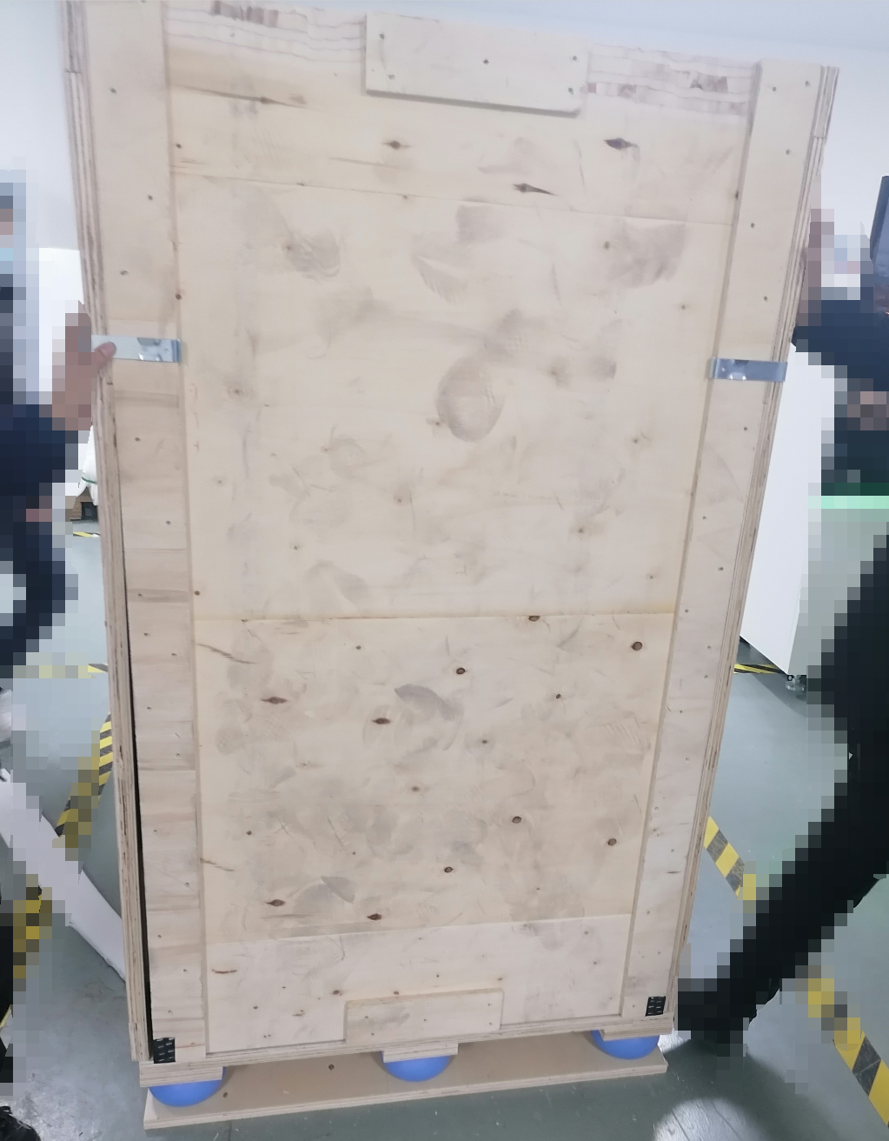
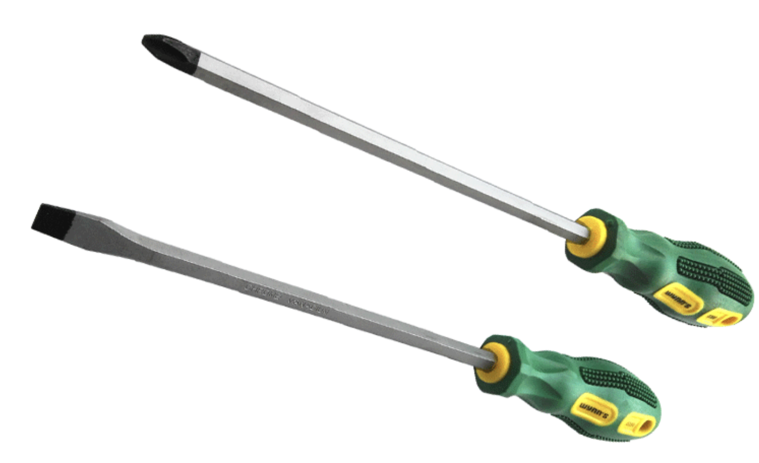
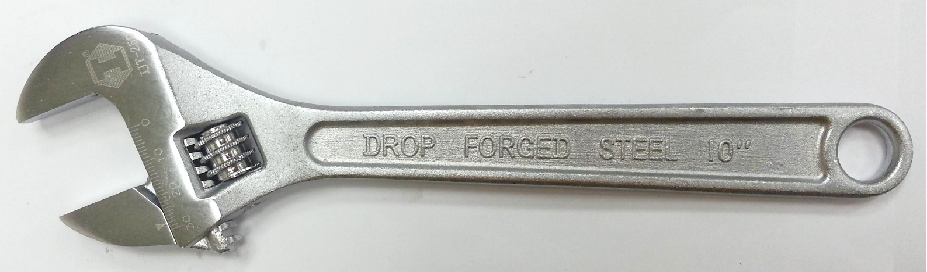
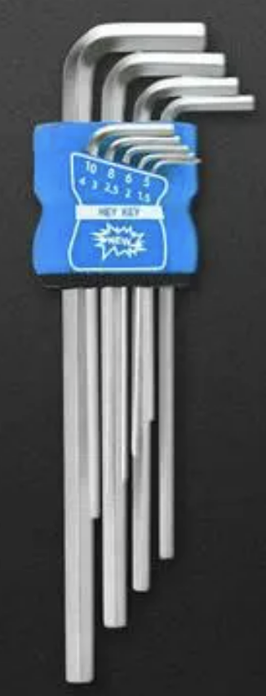
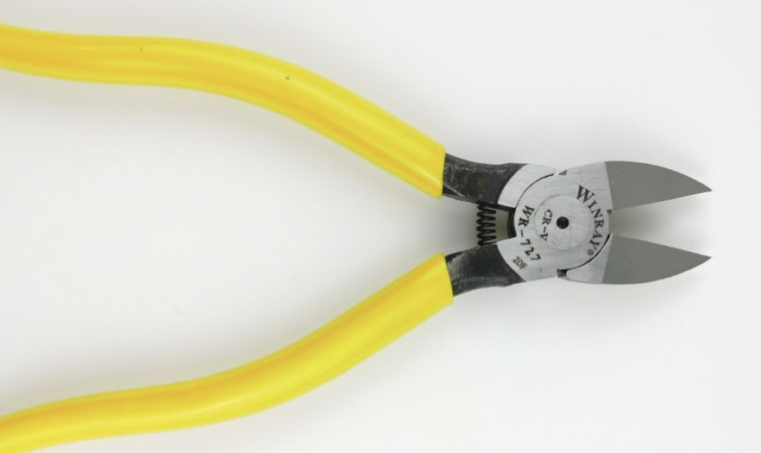
Step1. Move the CNT360 device on the front of the laboratory door
Manpower and tools:
Manpower：at least four workers
Tools；
Cross screwdriver: 1 pc
Flathead screwdriver: 1 pc
Adjustable spanner:10” or 12”
Diagonal cutting plier：1 pc
Hex key：1 set
Notes:
确保操作空间足够。
1，电梯，过道等能容纳将设备运到实验室，建议在实验室内或实验室门口来拆木箱包装；
2，若电梯或过道等空间不够，可以在进楼梯前来拆木箱，再通过CNT360M1自带滚轮推到实验室设计的位置。
Ensure the unpacking operating space is sufficient.
1, if the space of the elevator or corridor is enough to carry the device on the front of the laboratory door, please do the unpacking in the laboratory or on the front of the laboratory door.
2, if the space of the elevator or corridor is not enough, please firstly dismantle the wooden case ,then push the CNT360 into the laboratory through the rollers itself.

Slide 3
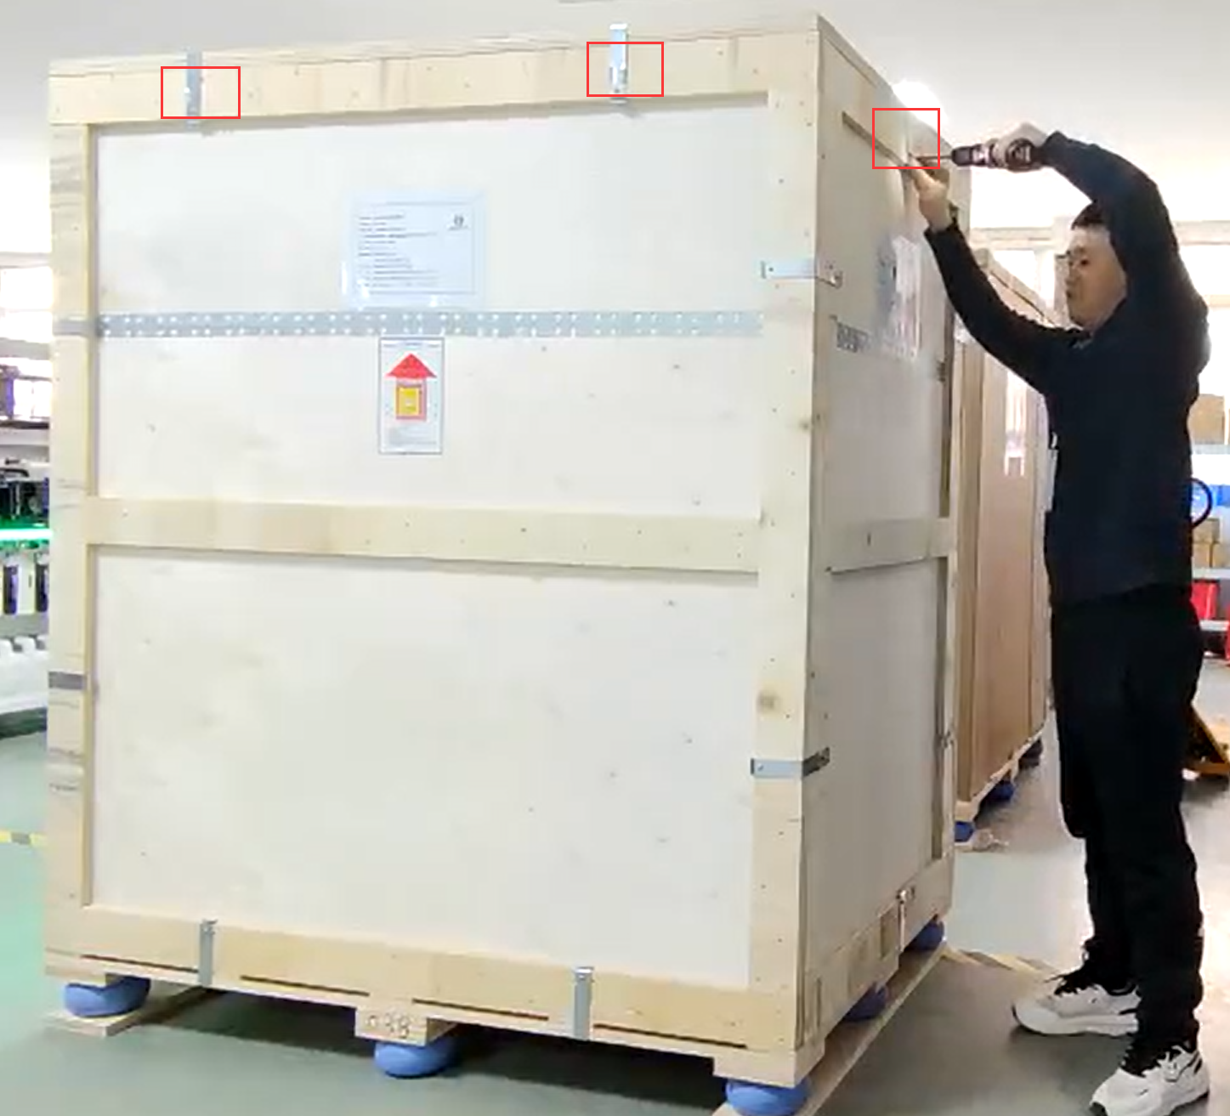
Step2. Remove the cover from wooden case
1. Use the cross screwdriver to unfasten the screws on the fixing clamp of the upper cover and remove the cover of the wooden case.

Slide 4
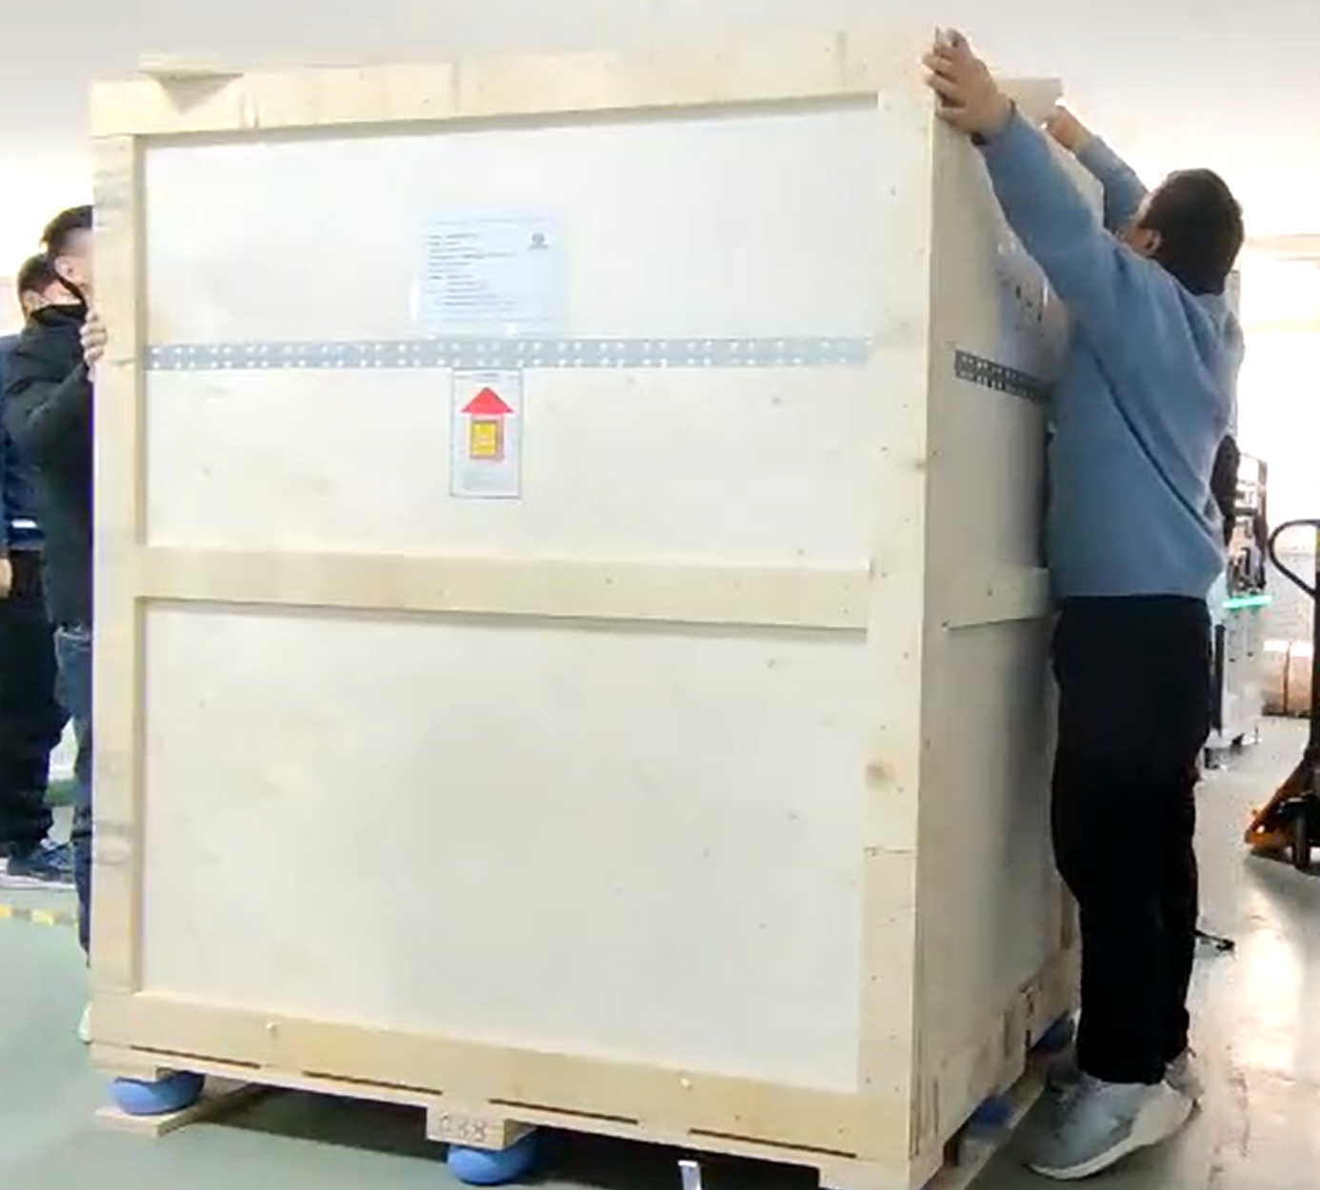
Step2. Remove the cover of the wooden case
2. lift the cover of the wooden case and remove it.

Slide 5
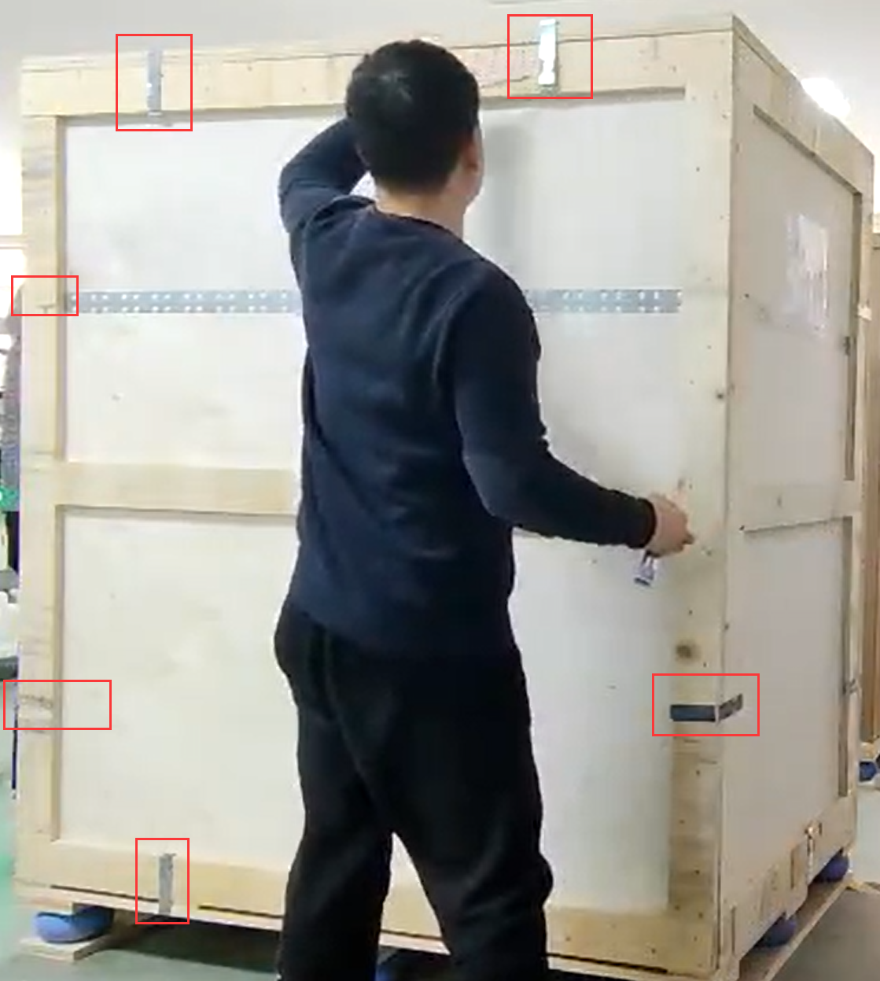
Step3. Remove the side panels of the wooden case
Refer to the left picture, use the cross screwdriver to unfasten the screws of the fixing clamps, then remove the fixing clamps by the flat-head screwdriver, then remove the side panel.
Notes: please remove the side panels in turn, front, right ,left ,then back, in case the wooden case falls apart.

Slide 6
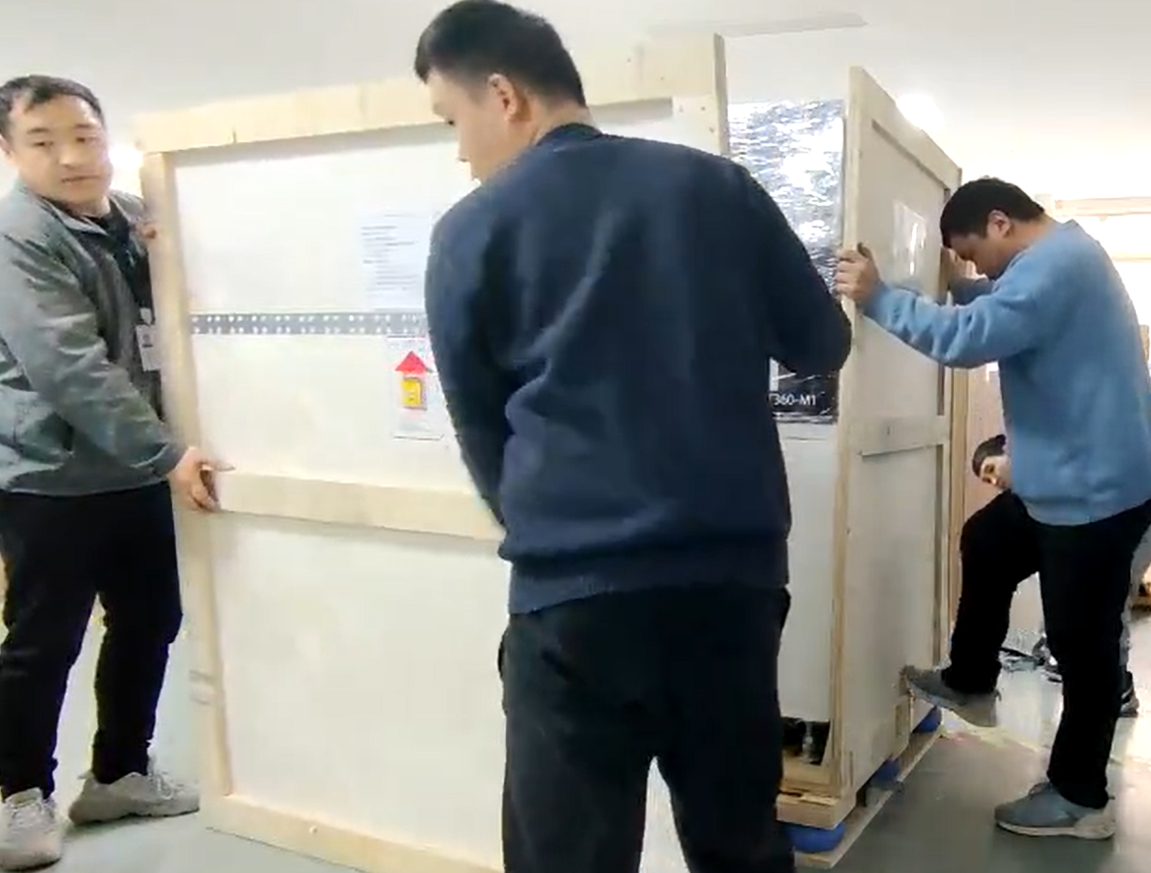
Step3. Remove the side panels of the wooden case
Remove the side panels of the wooden case in turn.

Slide 7
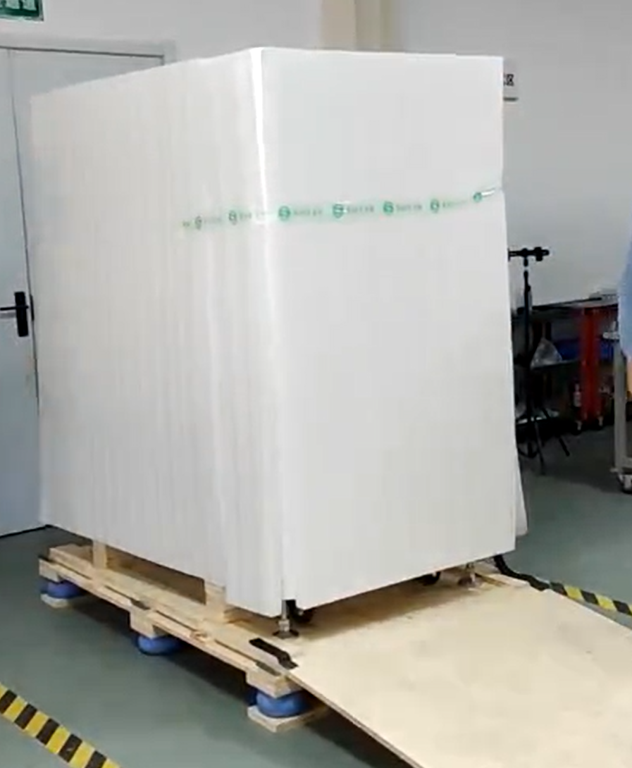
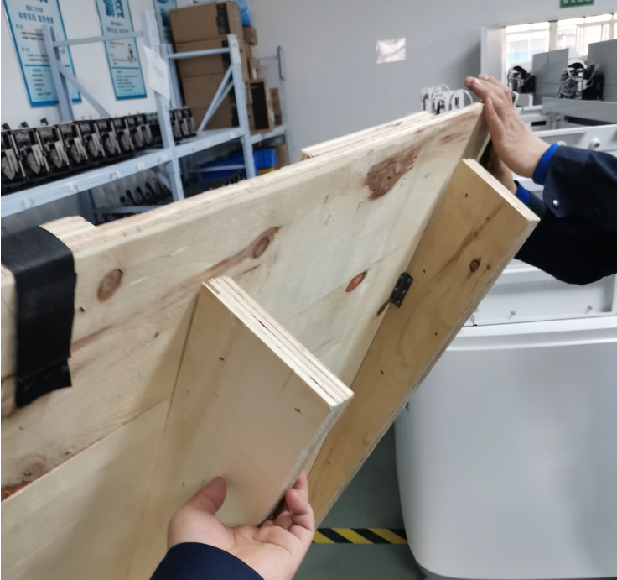
Step4. Put down the canted tie plate, remove the pearl-cotton foam
put down the canted tie plate, then remove the pearl-cotton foam on sides.
Note: the pedal support block must be fully open in order to act as a support.
Notes:
canted tie plate Pearl-cotton foam

Slide 8
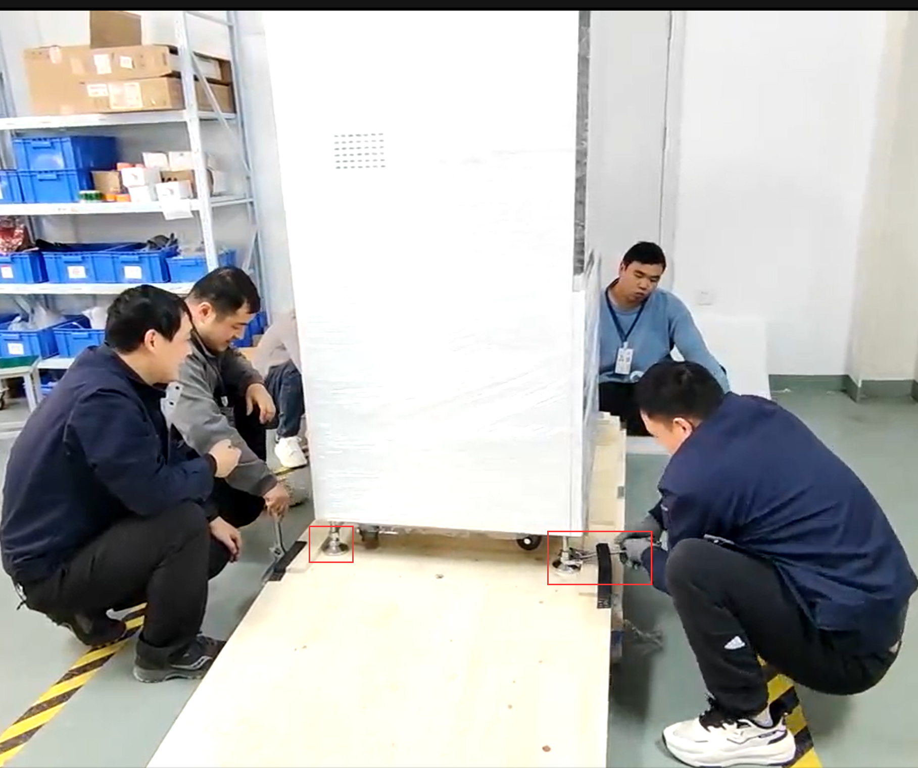
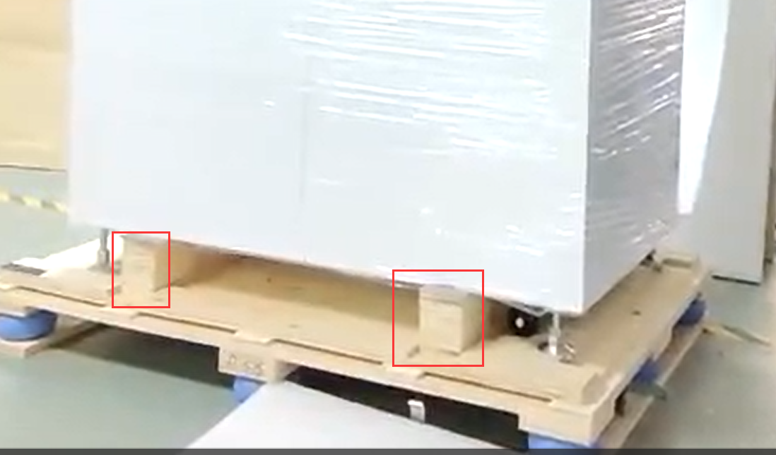
Step5. Raise the support feet and remove the batten pads
Use the adjustable spanner to lift the four supporting feet and remove the two batten pads.
Notes:
Adjustable spanner

Slide 9
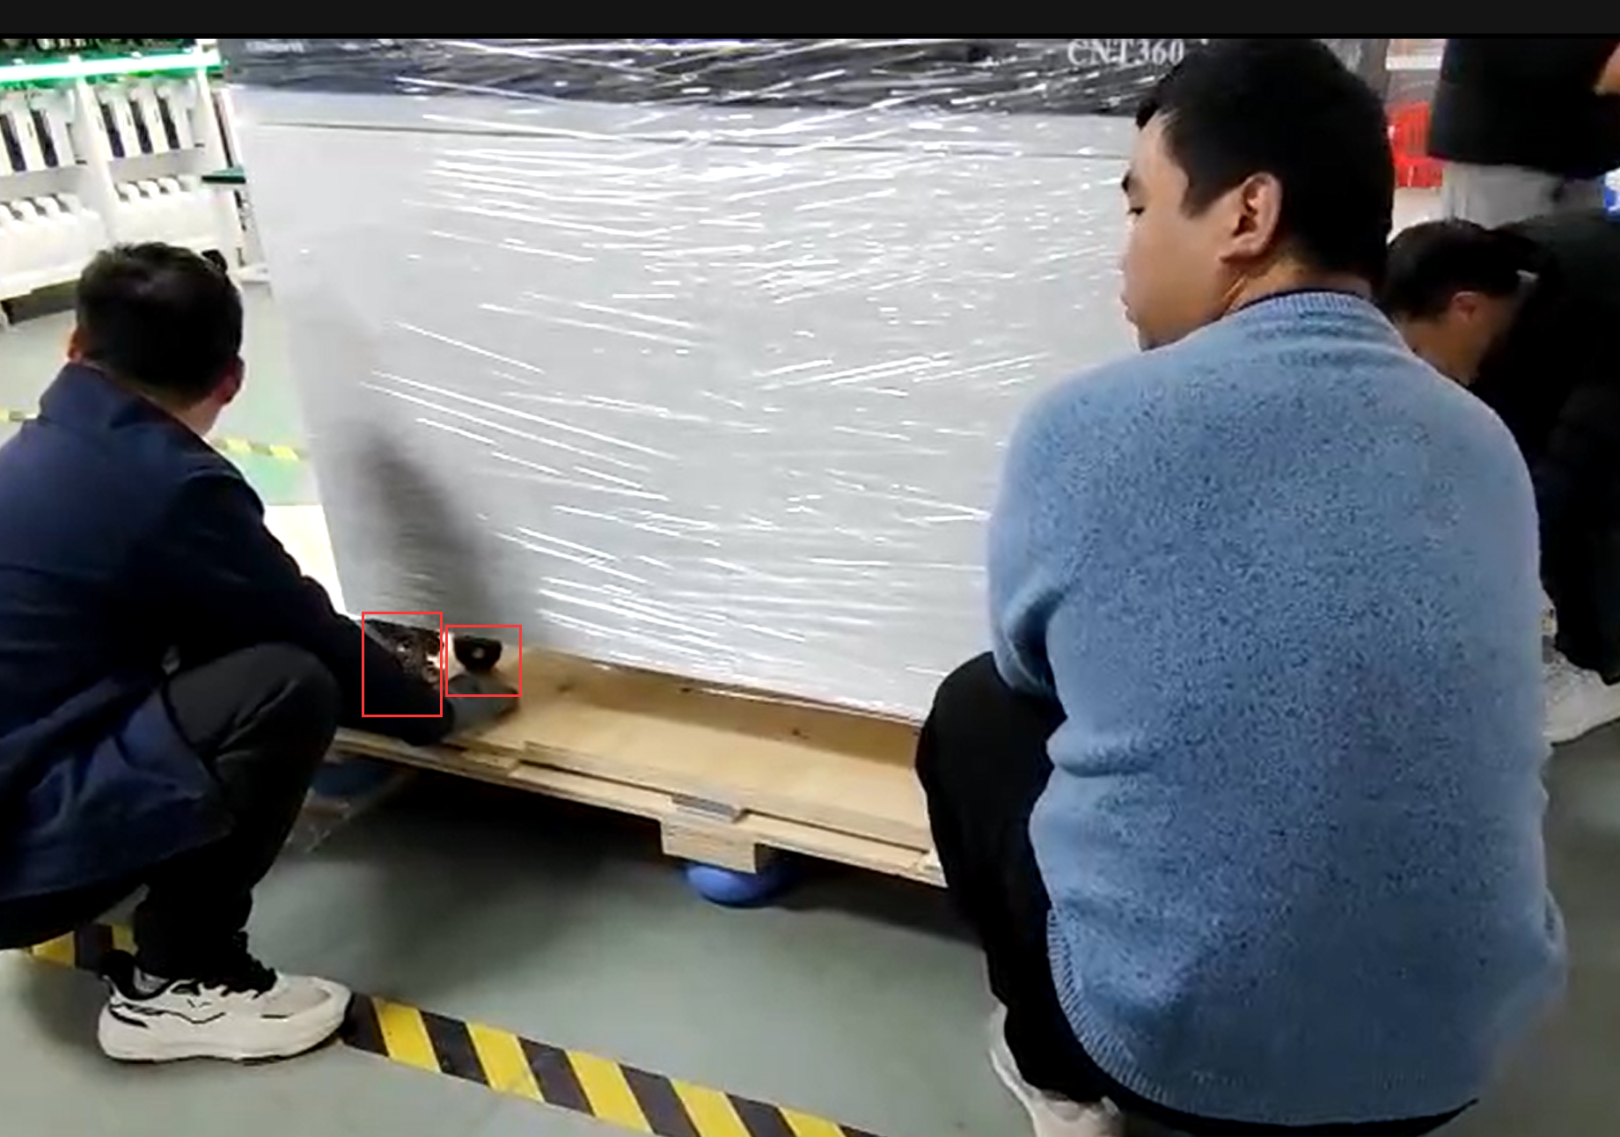
Step6. Lower the support feet and allow the rollers to support
Lower the support feet and allow the rollers to support.

Slide 10
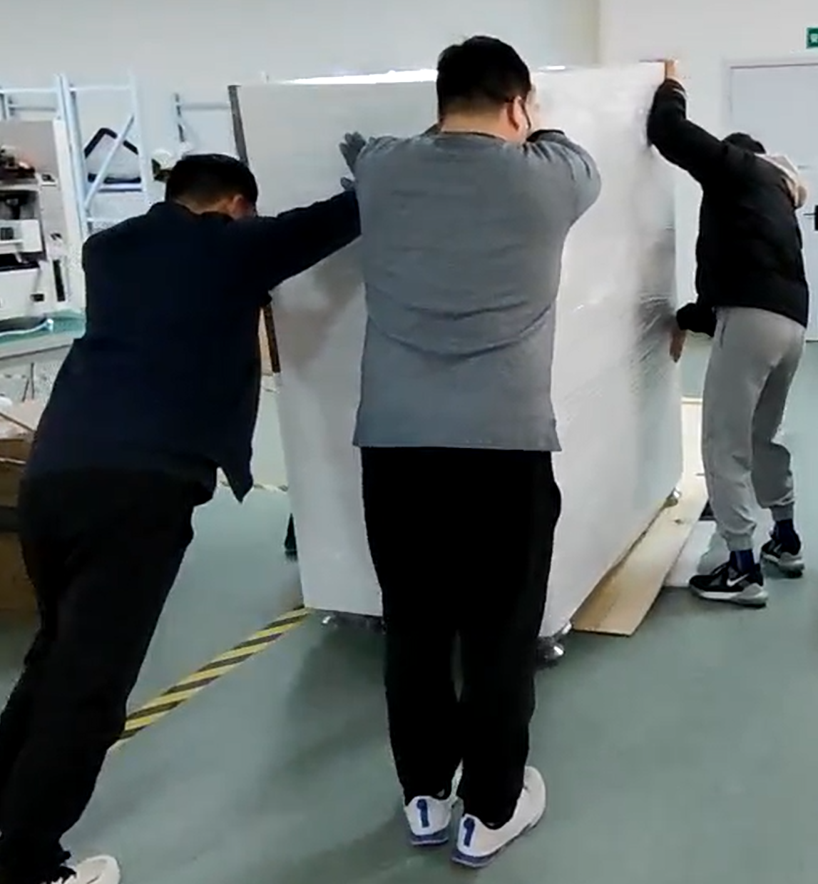
Step7. Push the device down through the rollers along the canted tie plate.
Note：check that the canted tie plate is properly supported before pushing.

Slide 11
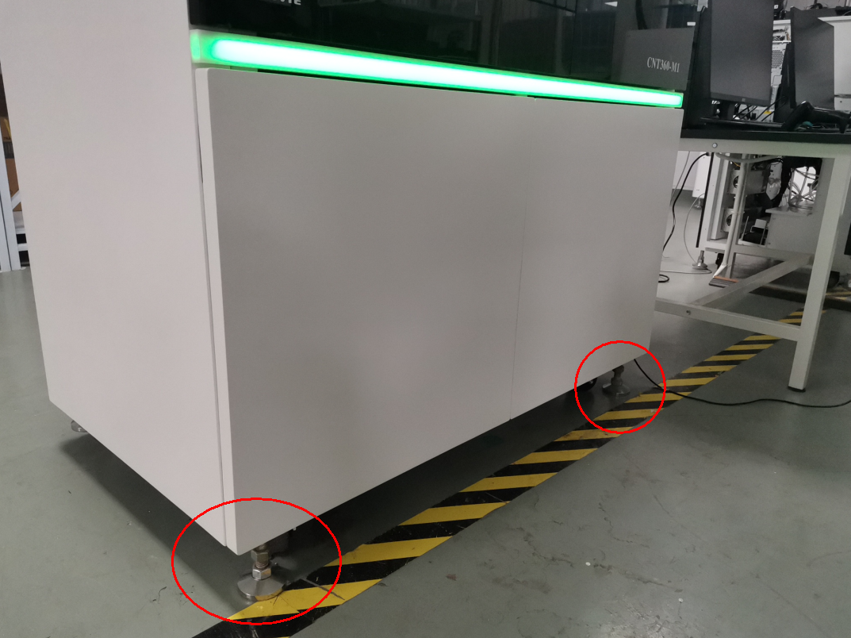
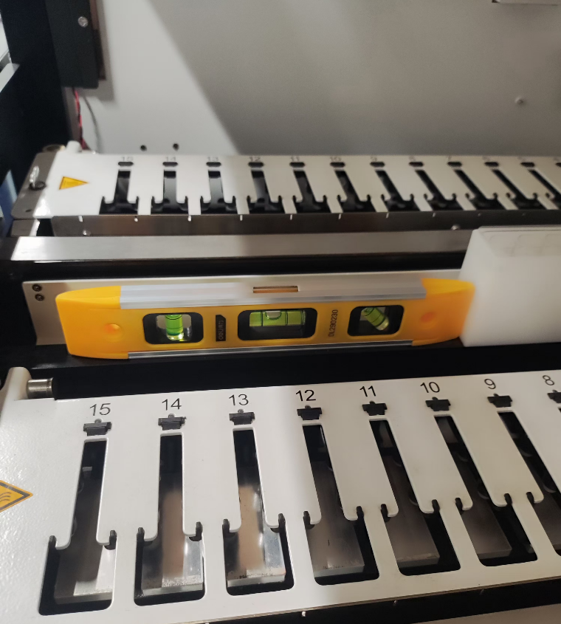
Step8. Push it to the designed installation position and adjust the support feet so that they support the device.
Please refer to the right picture, place a level ruler on the washing area support to check.
Notes:
Push to the designed installation position and adjust the support foot so that it supports the device.

Slide 12
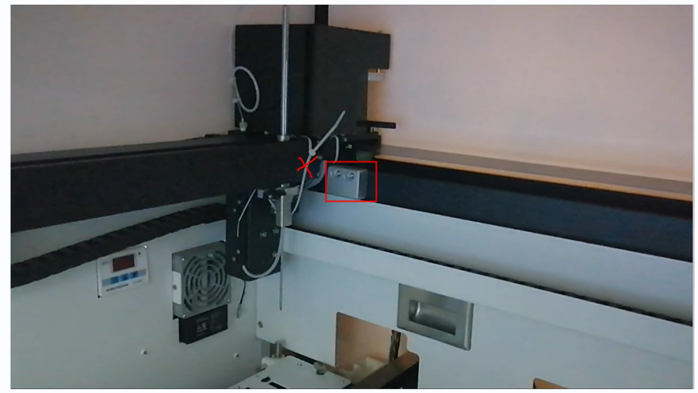
Step9. Open the instrument door and remove the cable ties and the fixed part
Remove the two fixed parts of the robotic arms with the hex key and cut off the cable ties of the aspirating probes. Note, do not cut the cables of the device, when cutting the cable ties, hold the cable ties with the other hand to avoid them falling into the device.
The left picture displays the No.1 robotic arm, please refer it to remove the cable tie and fixed part of the No.2 robotic arm.

Slide 13
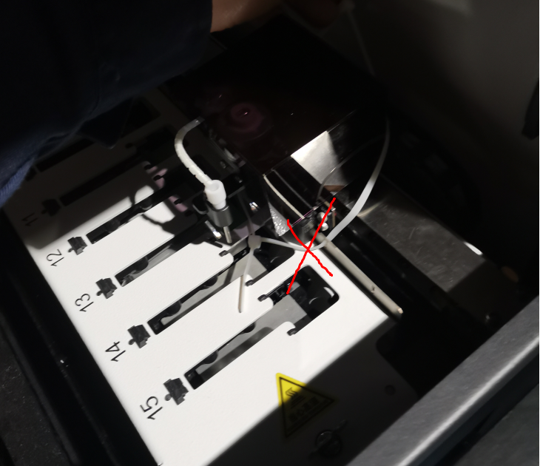
Step10. Remove the cable ties of the liquid cars
Refer the the left picture to cut off and remove all cable ties of the four liquid cars.（For CNT360E,please ignore this step）
Notes:
Remove the cable ties holding the liquid flow trolley

Slide 14
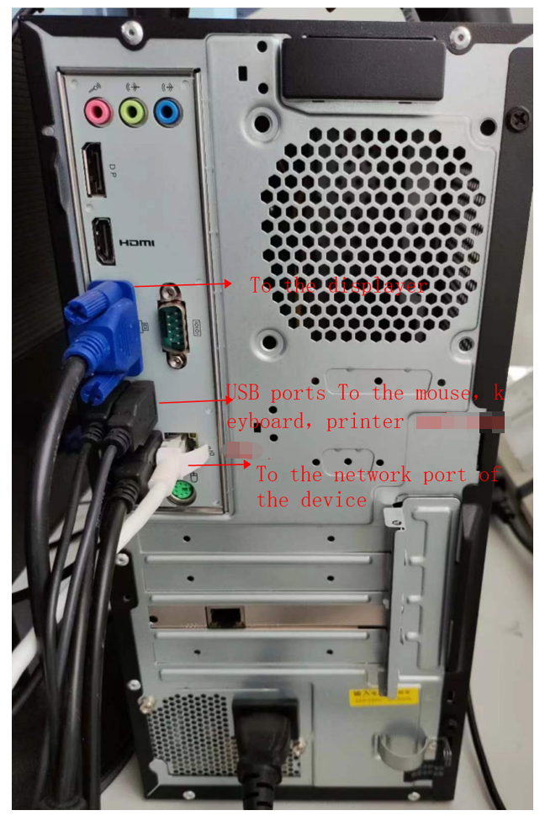
Step11. Connect the host computer, monitor, printer and scanner.
USB interfaces: to connect the slide label printer, the mouse, the keyboard.
Network connection port: directly connect to the processing module.
Power cable connection.
VGA port：connect to the monitor
WIFI connection: Connect with your local router after powerig on the PC when needing to access the internet. The computer has a WIFI module.

Slide 15
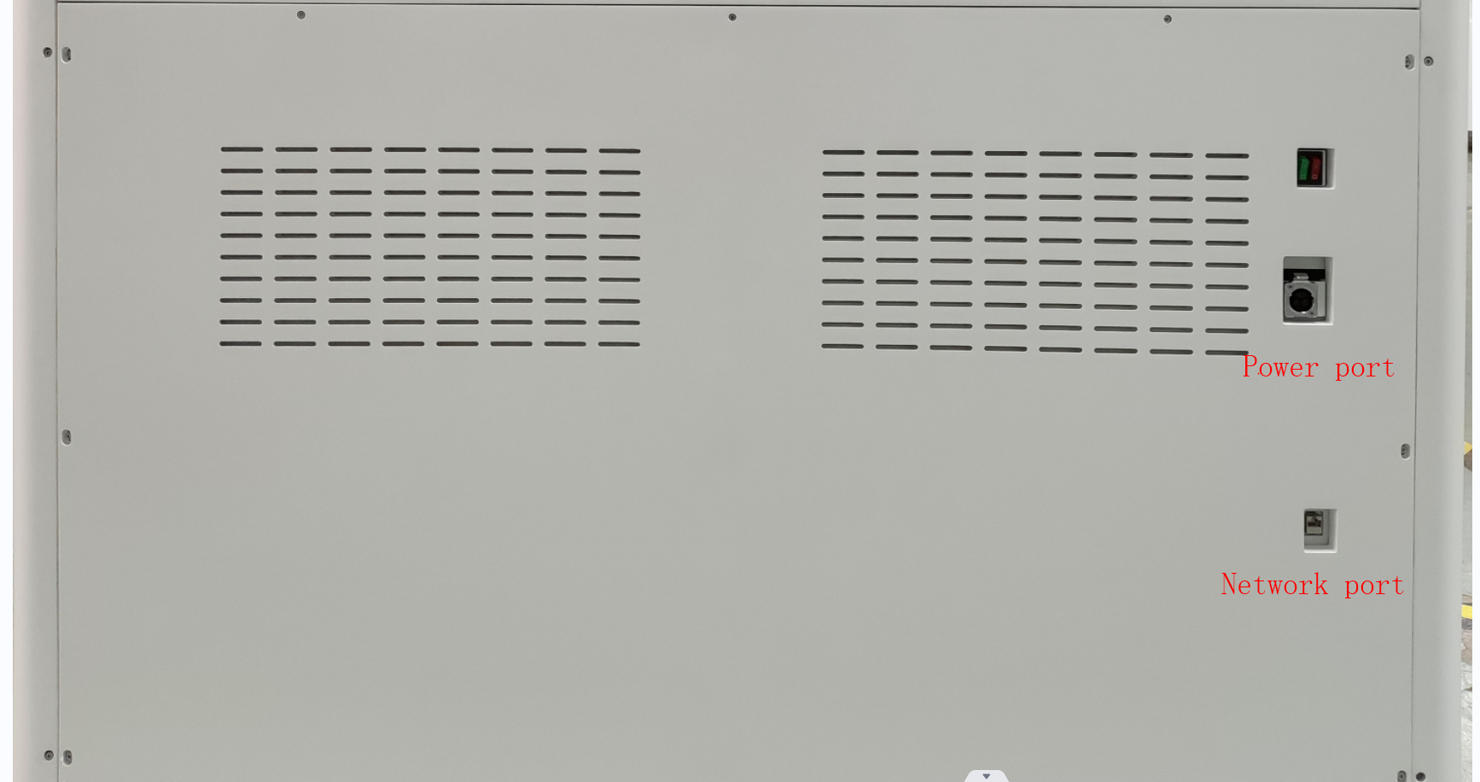
Step12. Connect the power cable and network cable.
Refer to the left picture, connect the power cable and network to the instrument.

Slide 16
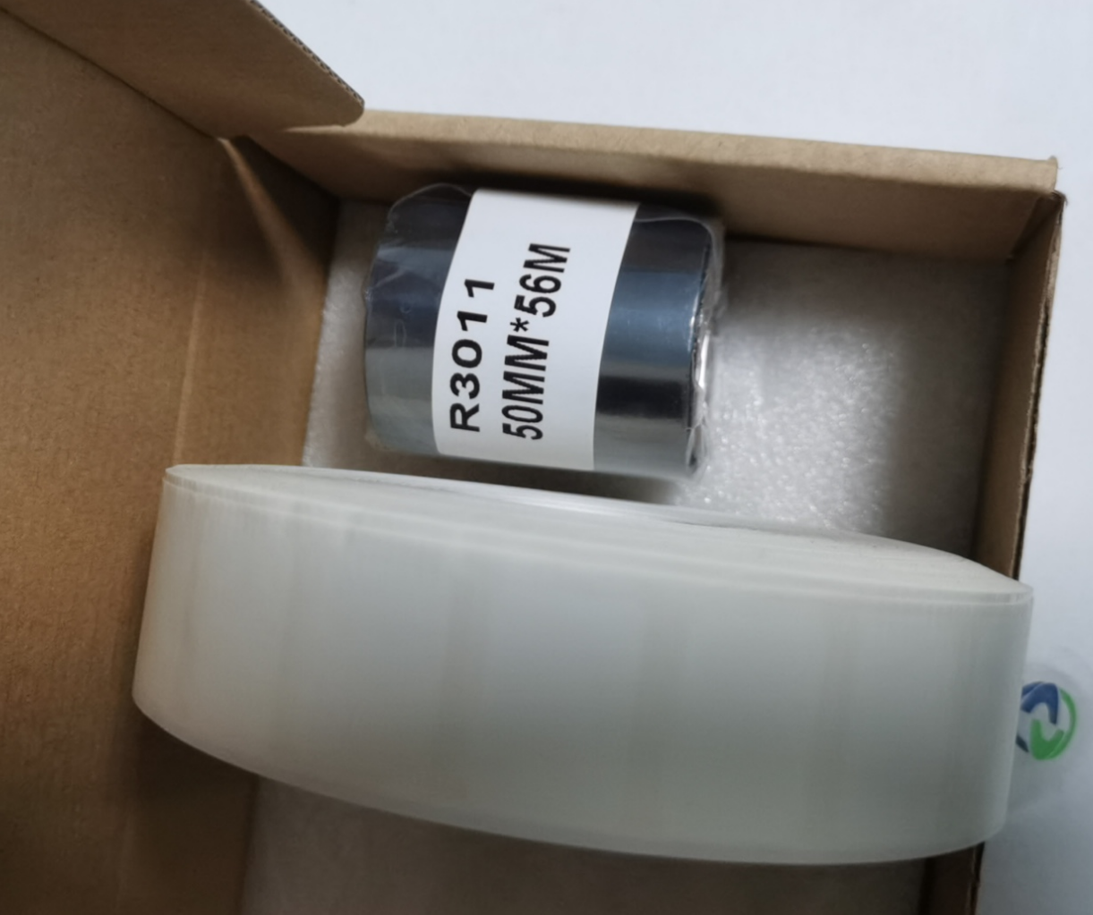
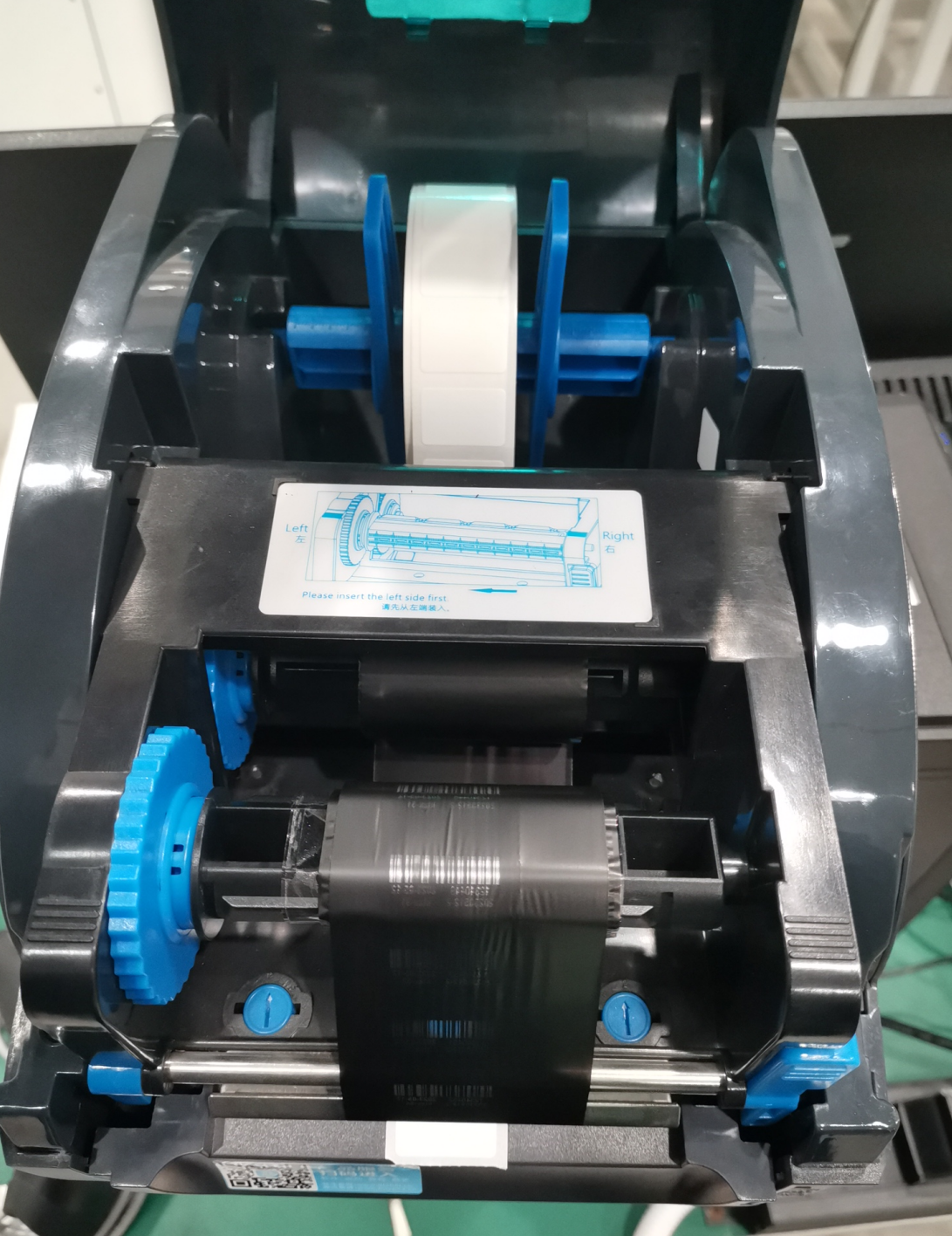
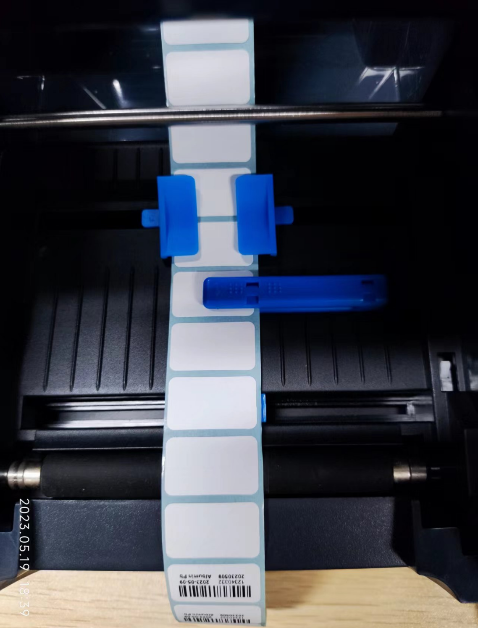
Step13. install the label and ribbon
Note:must use this ribbon and label.
Refer to the above pictures to install the ribbon and label into the printer. Then power on the printer and the PC, running the CNT360 software, login with “Admin” account（default password is 123), then goto “system management” page to open “BarcodeTemplate” , click “Print” to check if printing is normal. if any issues, please contact Celnovte support.

