Slide 1

CNT360M1
Basic Operation

Slide 2

1. Check before operation and startup
Steps
2. Check the reagent and protocol
3. Setting up slides
4. Loading reagents
5. Loading slides
6. Start the experiment
7. Finish the experiment
8. How to refill the primary antibody
9. Operation cautions
10. Preventive maintenance

Slide 3
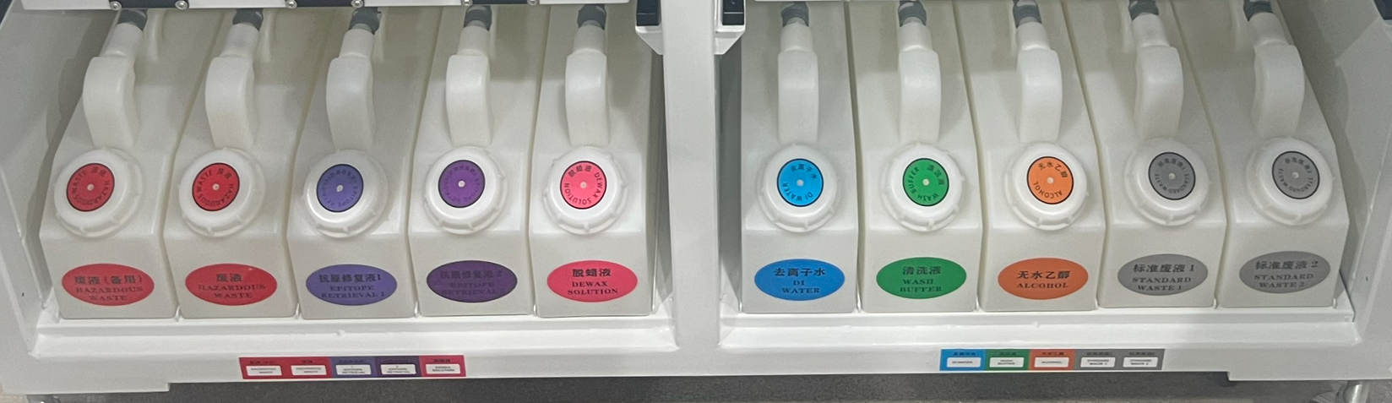
1. Check before operation and startup
1.1 check the waste containers (standard & hazardous) are no more than half full (empty if required).
1.2 check the large reagent containers are sufficient, more than half full, with correct reagent (fill if required).
Please note: for the first usage or re-use in more than 1 week, before starting a run, please fill the pipe system with the large reagent solutions. Access it with “Service”account, click in turn “System management”--“Maintenance”--“Test”--“NewTest”, select “ALL” for “Arm1” or “Arm 2” under “Washing Initialization”,then click “Start” to fill the system. After filling, please continue the below steps.

Slide 4
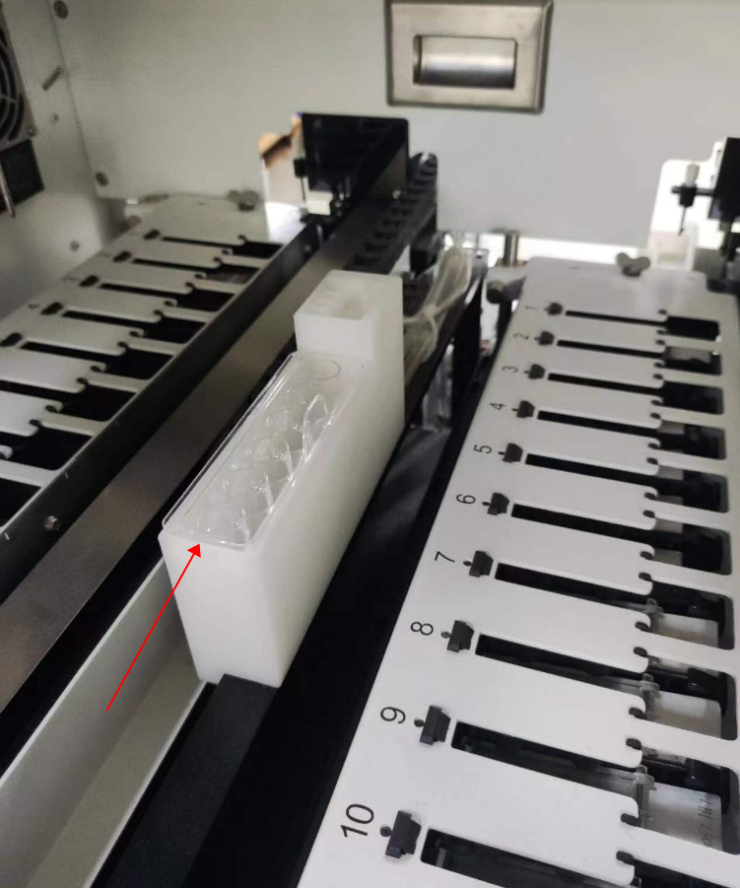
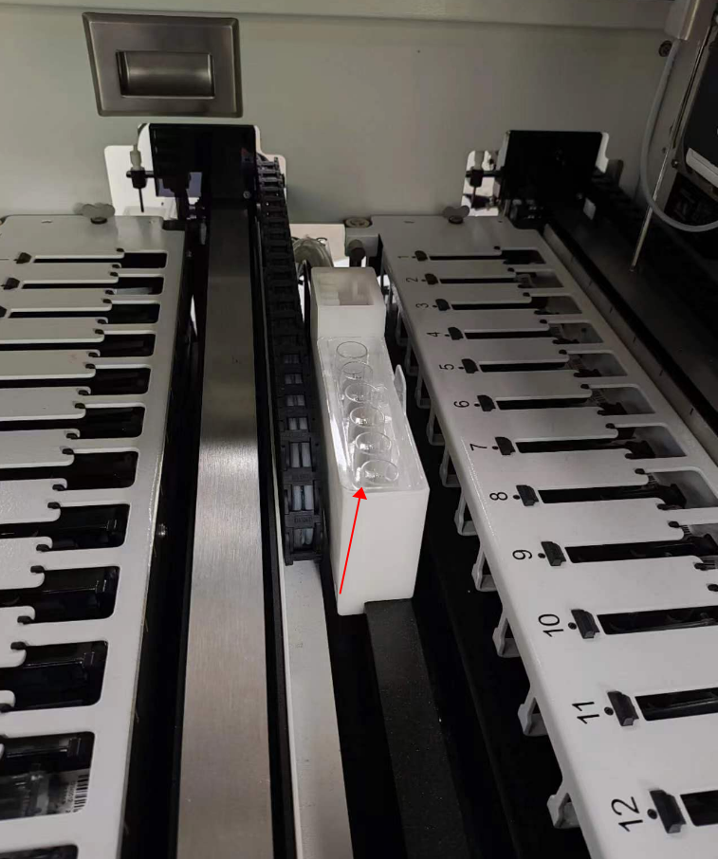
1. Check before operation and startup
1.3 check the washing area and mixing station, clean or replace if necessary. Check and empty when there is liquid in the six plastic vials of the mixing station when last process ends abnormally. Ensure the mixing stations are empty before loading a new experiment.
Left washing area and mixing station
Right washing area and mixing station
Notice：please ensure the mixing station is placed in position, push it down to the bottom.

Slide 5

1. Check before operation and startup
1.4 Check the slide lable printer, ensure the lable paper is enough.
1.5 If the processing module and the host computer are off, please turn them on.
suggest you check if all slide trays are in position, or take out all slide trays before powering on the processing module.
1.6 Start the client software when the host computer is running. ( For the first run,strongly recommand you check if the computer time is right before opening the client software. If not, please adjust the time zone)
1.7 Once the software has started, check the “Status” screen to ensure there are no processing module notifications. Rectify before attempting to run any slides.
1.8 Power on the slide lable printer.

Slide 6

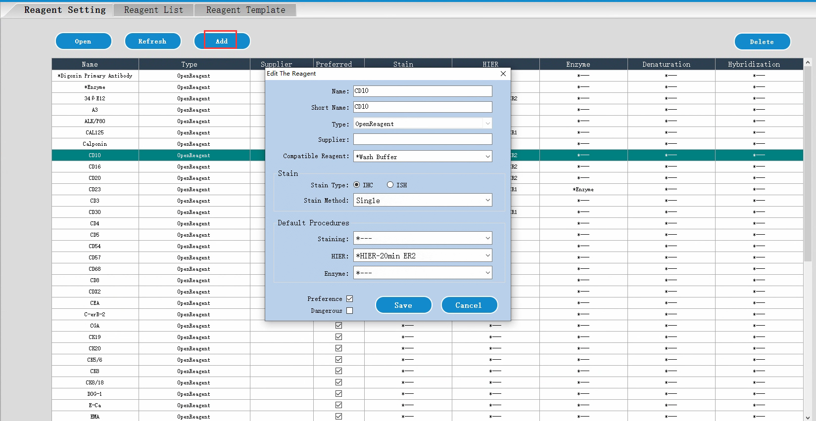
2. Protocol and reagent check
Check that the protocols and reagents you are going to use in the run are set up in the software.
Check the reagents:
2.1 Login the software with “Admin” account, the default password is 123. Goto “Reagent management ” page.
2.2 Click “Add” to set the name of the primary antibody reagent into the system if the antibody does not display under the list.

Slide 7
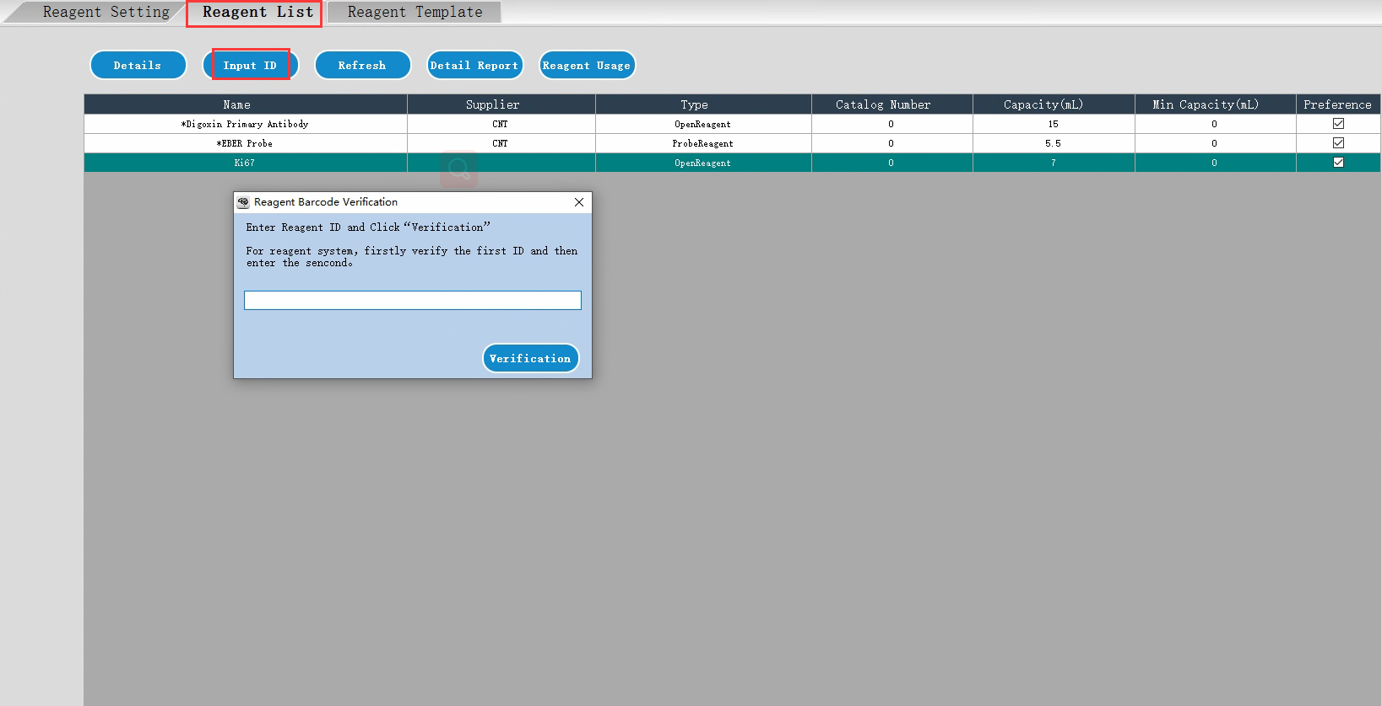
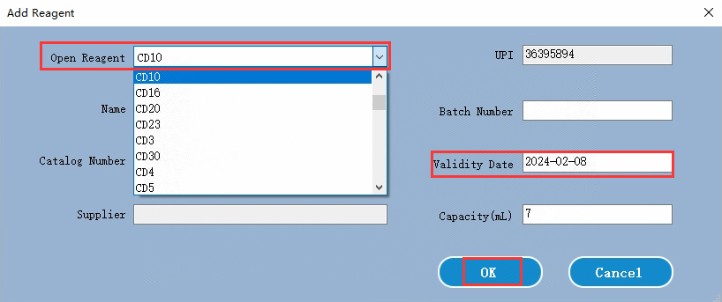
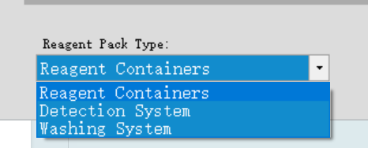
2. Protocol and reagent check
2.3 Goto “Reagent List”, Click “Input ID”, manually input the ID number which is located on the open container. Then under “Add Reagent” dialog box, select the corresponding name of the primary antibody from the option of “Open Reagent”, set the validity date. then click “OK” to bind the primary antibody and open container into the system. And please mark the primary antibody name on the open container.
2.4 Check if there is a detection system kit in the system (refer to the below picture). if no, Click “Input ID”, then manually input the two long bar codes of the detection system kit to add the detection system into the system. Please get the two long bar codes on the detection system reagent kit package box.

Slide 8
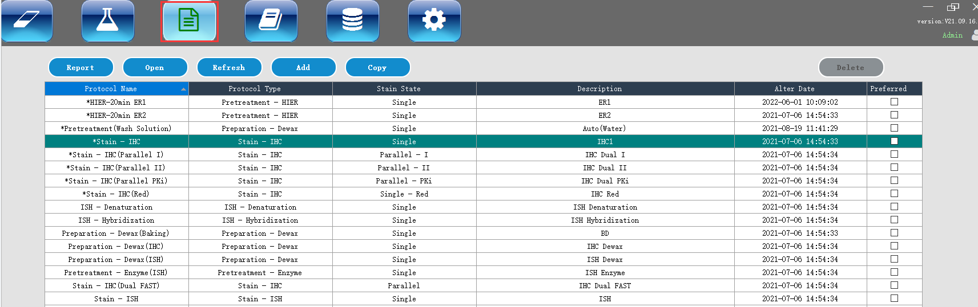
2. Protocol and reagent check
Check that the protocols and reagents you are going to use in the run are set up in the software.
To check the protocols:
2.5 Goto “Protocol management ” page. check if the built-in protocol whose name start with a asterisk(*) is suitable for the experiment you are going to use. If not, you can click “Add” to set a new protocol or click “Copy” to adjust the built-in protocol to generate a new protocol.

Slide 9
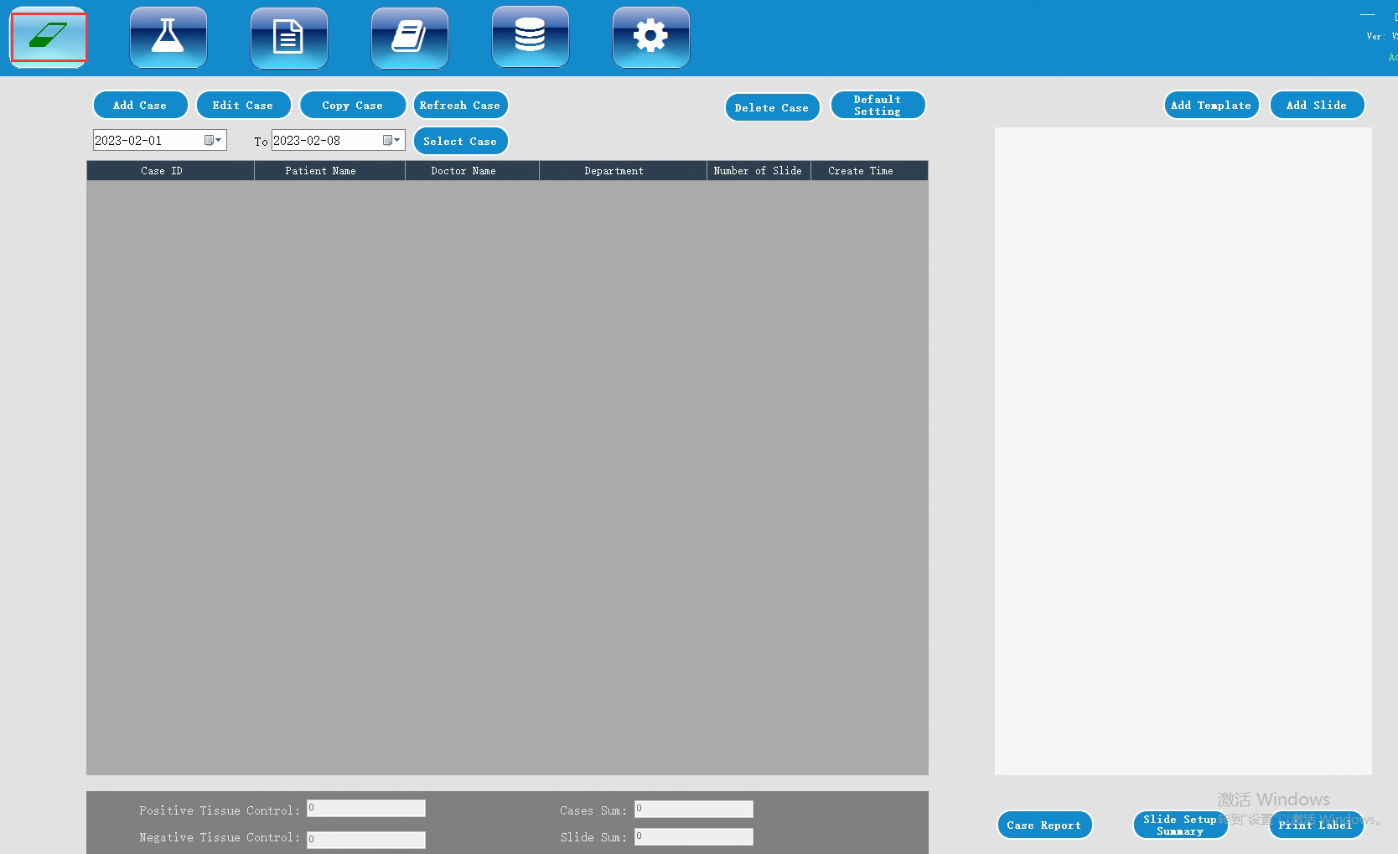
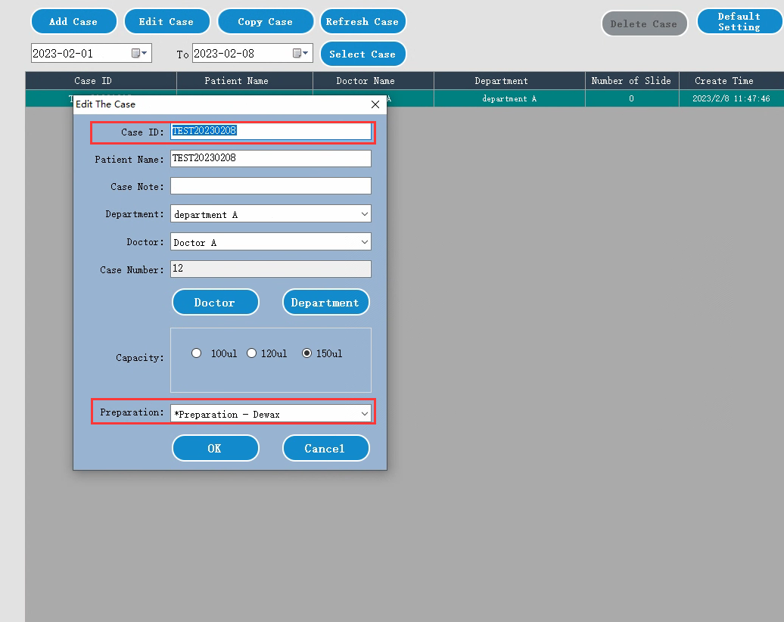
3. Setting up slides
3.1 Goto “Slide Management ” page. Click “Add Case” to create a new case. Then input the “Case ID” and set the “ Preparation” and other details, Click “OK” .

Slide 10
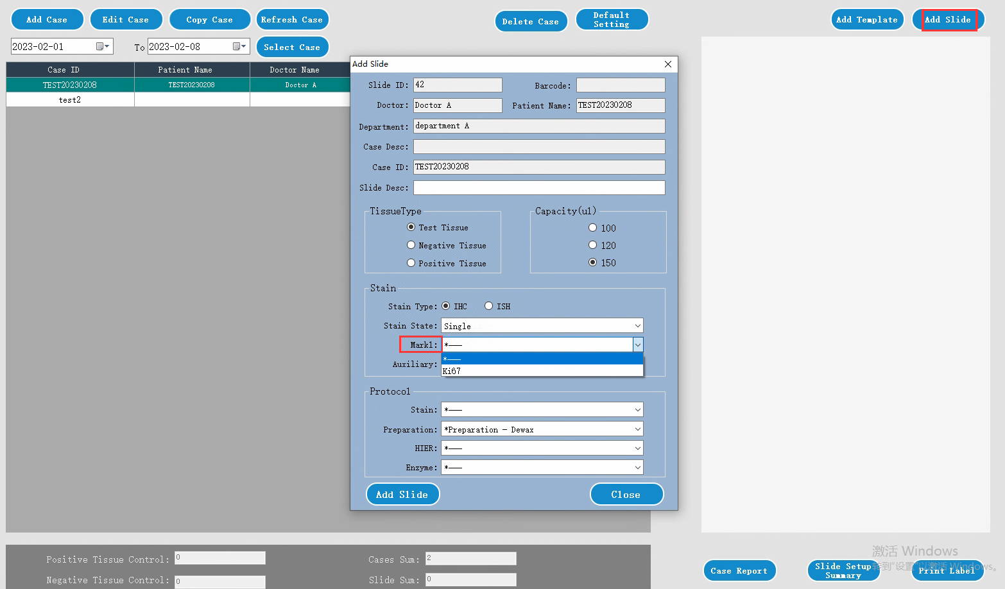
3. Setting up slides
3.2 Select one case added, then click “Add Slide” on the upper right. Select primary antibody from the “Mark1”option and set other parameters according to the protocol you are going to use. Click “Add Slide” to create a slide. Repeart to add more.

Slide 11
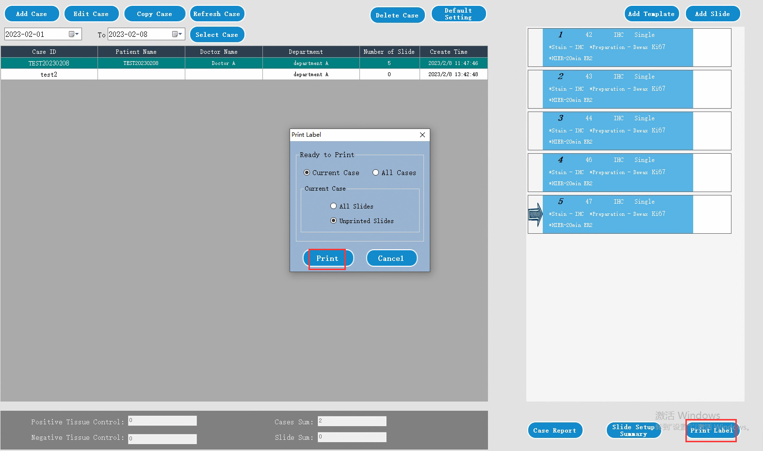
3. Setting up slides
3.3 Click “Print Label” to open a dialog, then click “Print”. The labels are printed. Then apply the labels with the slides.

Slide 12
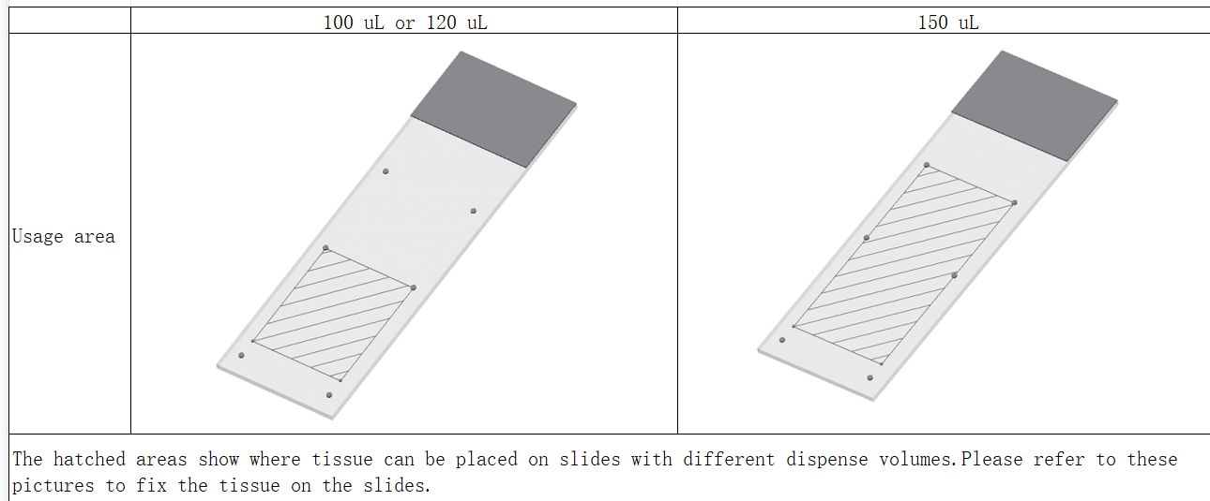
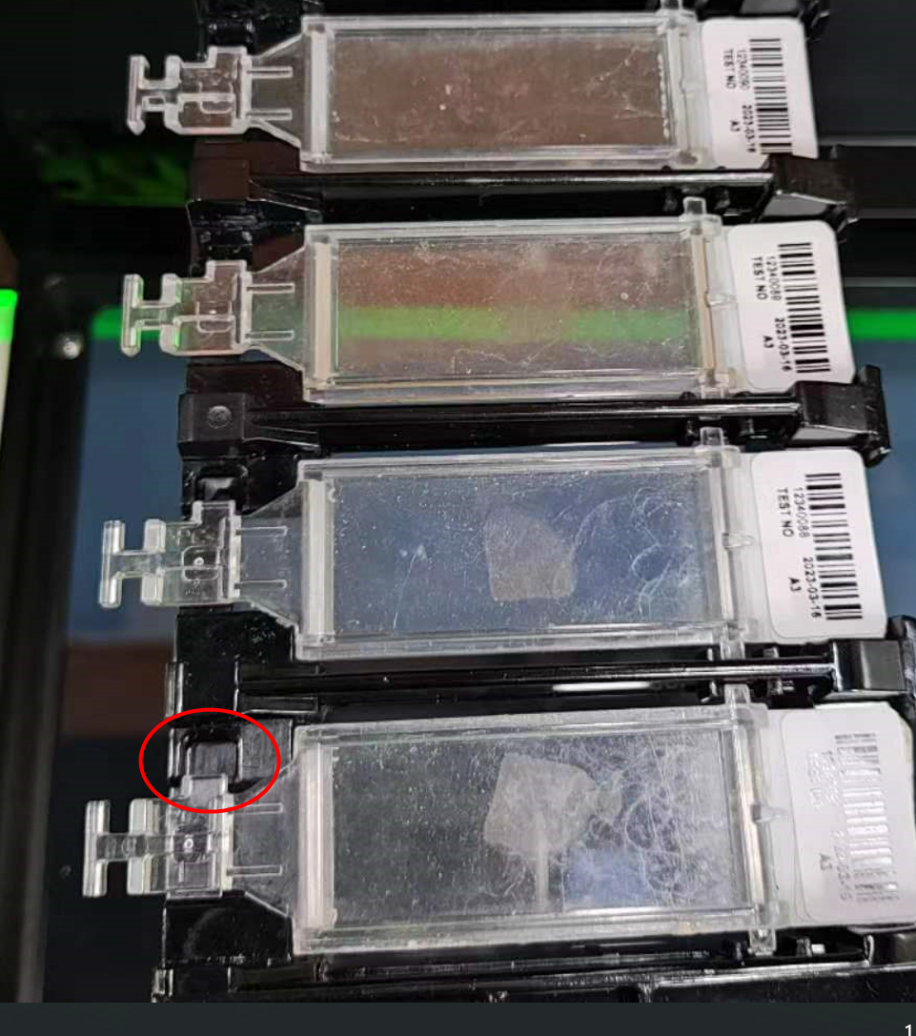
4. Loading slides
4.1 Place the slides onto the slide tray, cover them with liquid covers.
Strongly recommend you use the 150uL dispense volume, and fix the tissue section on the usage area.
See the picture, the key in the neck of the liquid cover should match the slot postion of the slide tray.

Slide 13
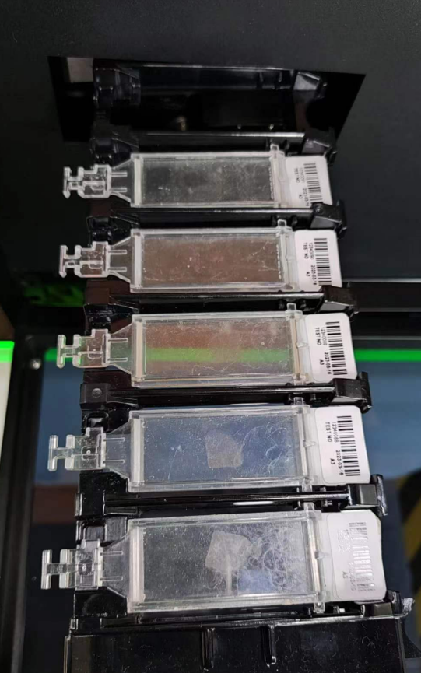
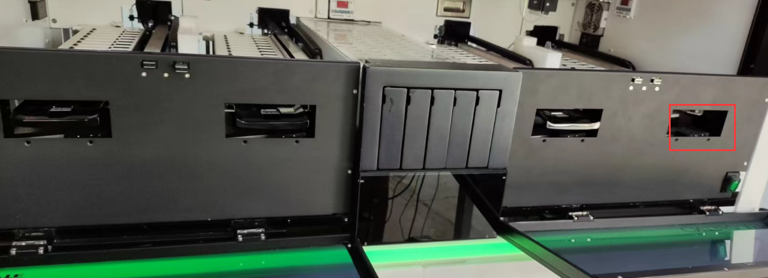
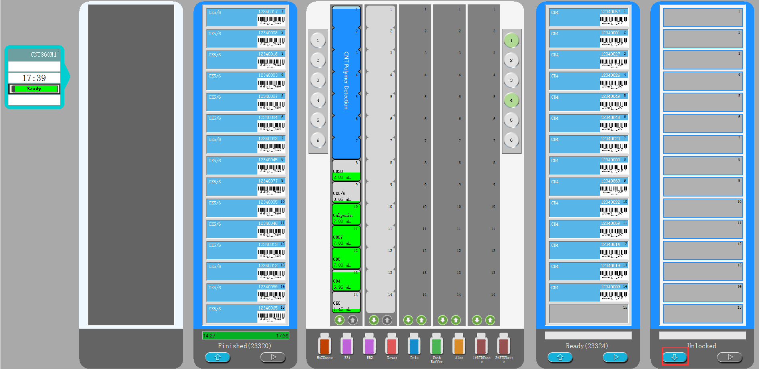
4. Loading slides
4.2 Gently insert the slide tray into an unused slide staining unit，then click the “load” button on status screen of the client software. The system will move the robotic arm to scan and recognize the slide IDs.

Slide 14
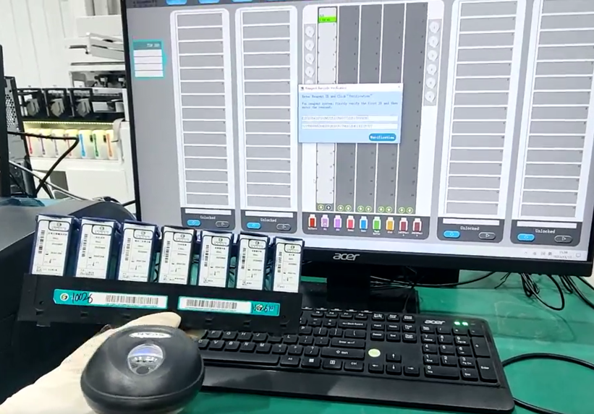
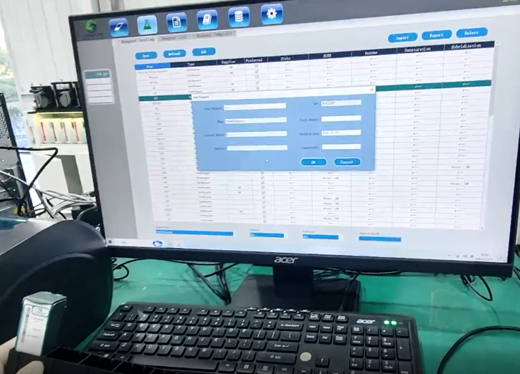
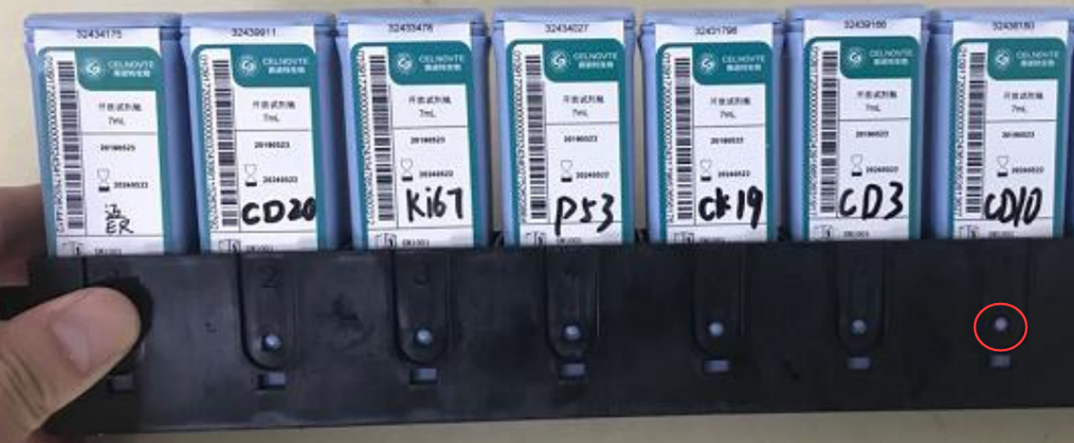
5. Loading reagents
5.1 Register the detection system reagent kit into the client software, scan the two codes on the package box to bind the reagent kit into the system.
5.2 Register the antibody into the system,scan the code of a open container, bind the antibody with a open container, fill the antibody into the open container, and mark it with a marker pen.Suggest you add the primary antibody more than 1mL into the opening container, if less than 1 mL,please refill it ( refer to “How to refill the primary antibody” )
Notice: please ensure the reagent containers are placed in position, push them down into the bottom of the reagent tray.

Slide 15

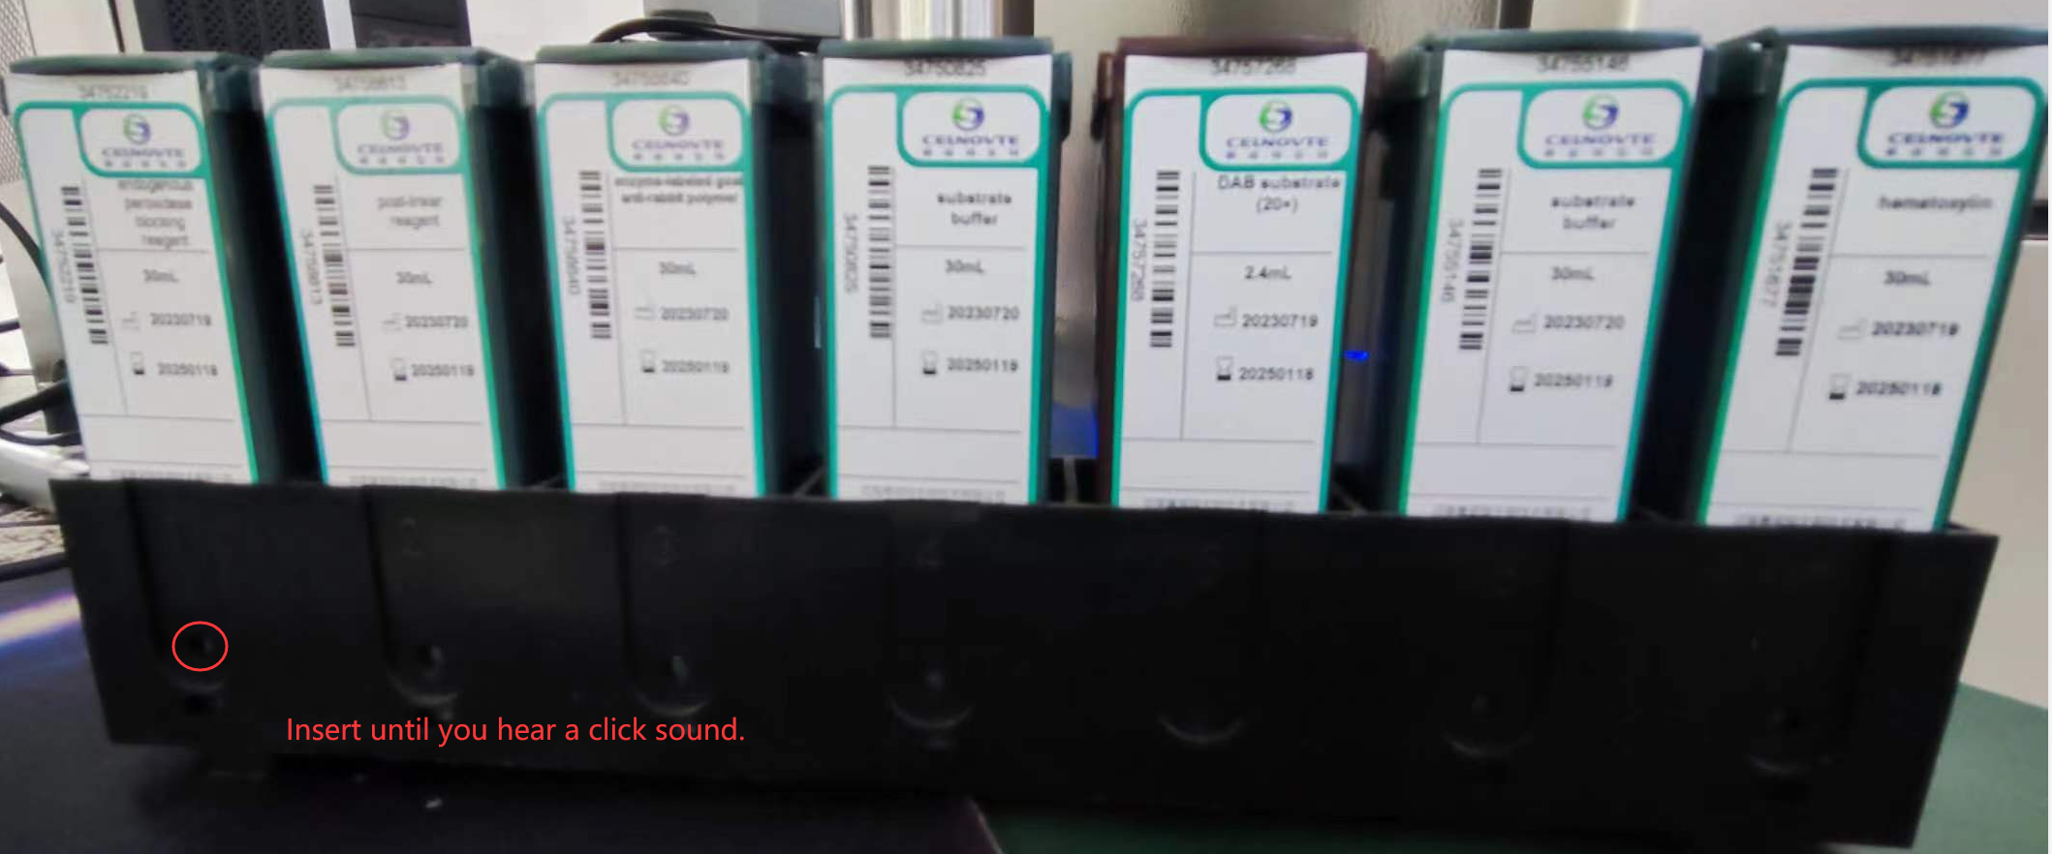
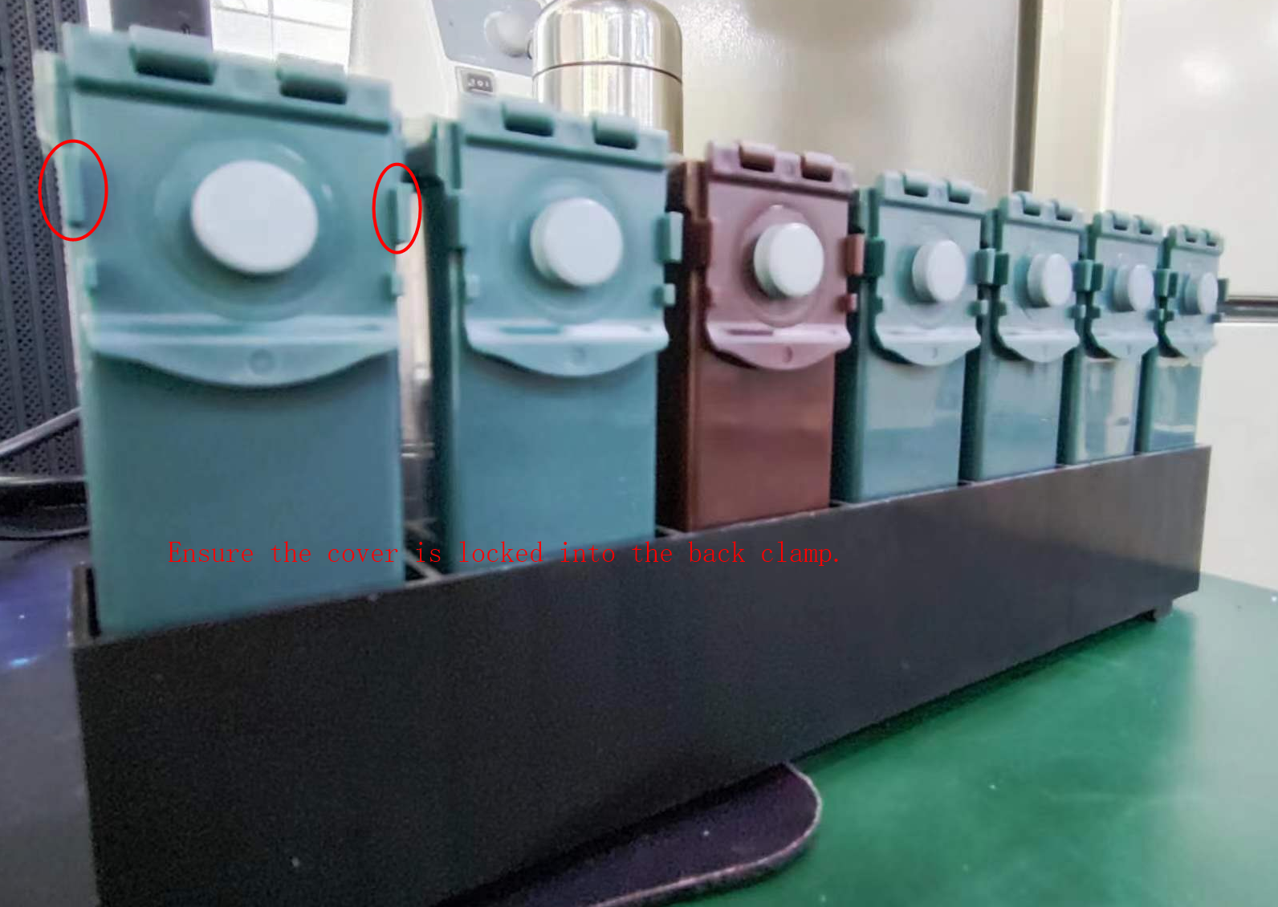
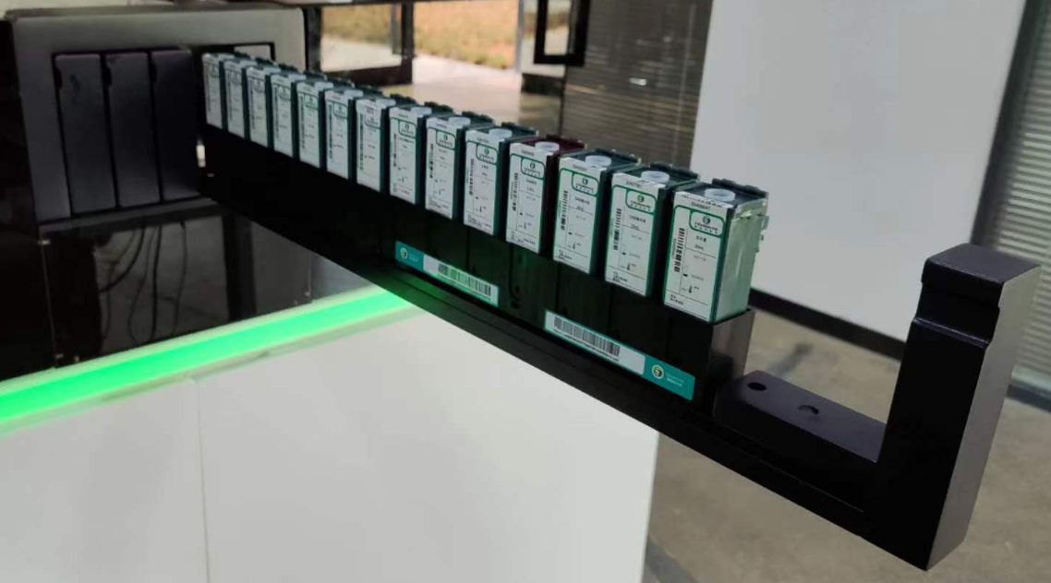
5. Loading reagents
5.3 Place the reagent containers into the reagent tray with correct direction. Press down until the containers click into place. Open the cover of the containers which the experiment will use, then click pop-up out button (left button)on the status screen of the client software, then install the reagent tray to reagent stript. then click in button (right button)on the status screen of the client software.
The system will move the robotic arm to scan and recognize them.
Note:
1. Ensure all reagnt containers have been installed into place. Insert the bottle into the reagent tray until you hear a click sound.
2. Ensure all reagent container covers have been locked into the back clamps of the reagent containers.

Slide 16

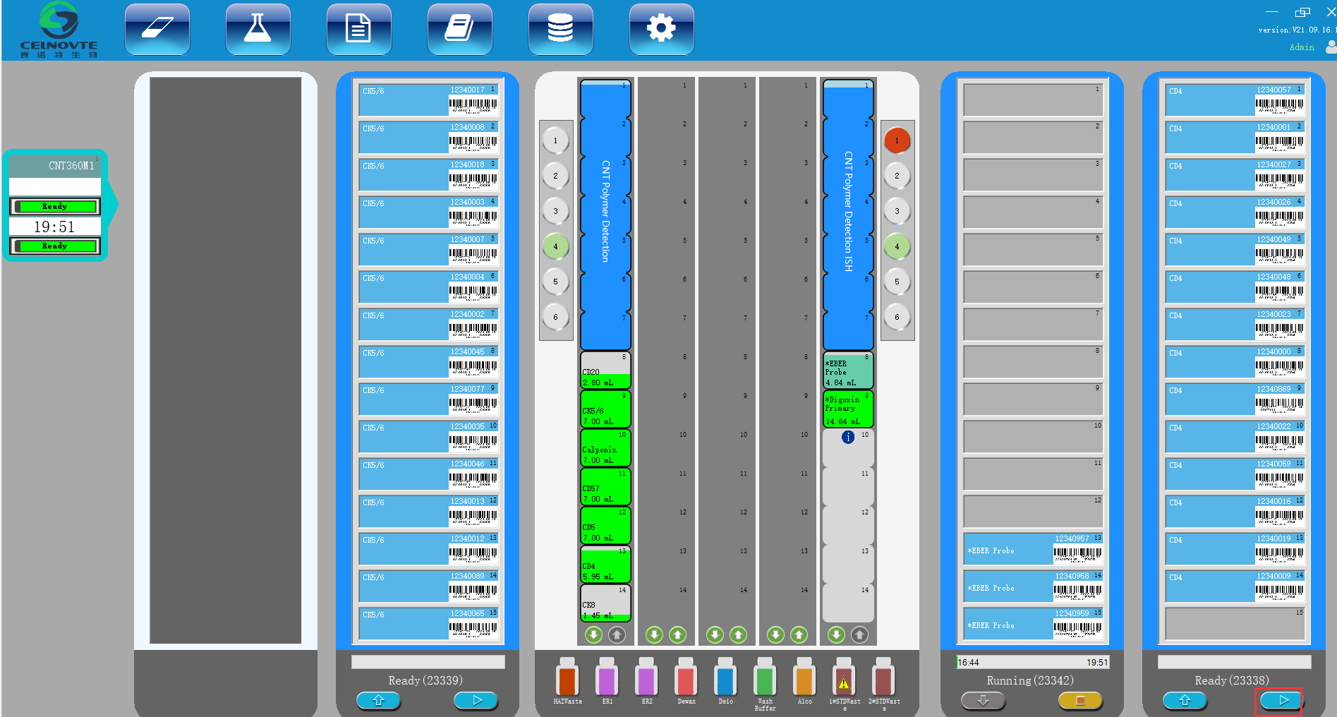
6. Start the experiment
Goto the Status Screen, when the slide staining unit displays “Ready” status, click to begin running the experiment.

Slide 17
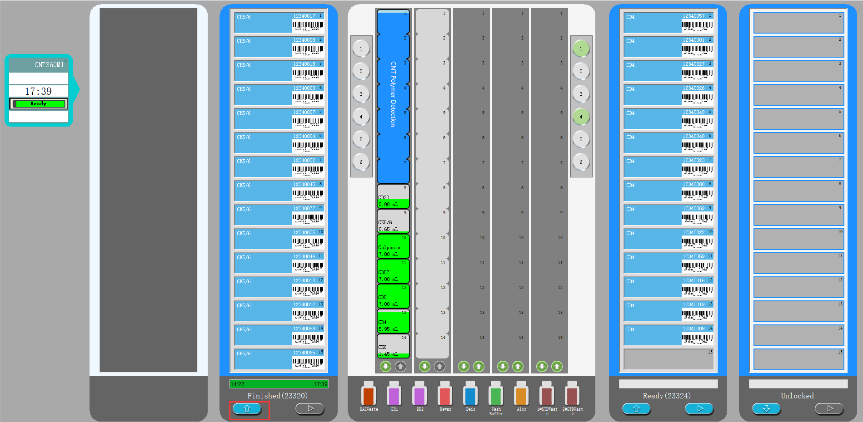
7. Finishing
Goto the Status Screen, when the slide staining unit displays “Finish” status, Press the “load/unload” button on the status screen to unload the slides. Remove the slide tray from the slide staining unit.

Slide 18
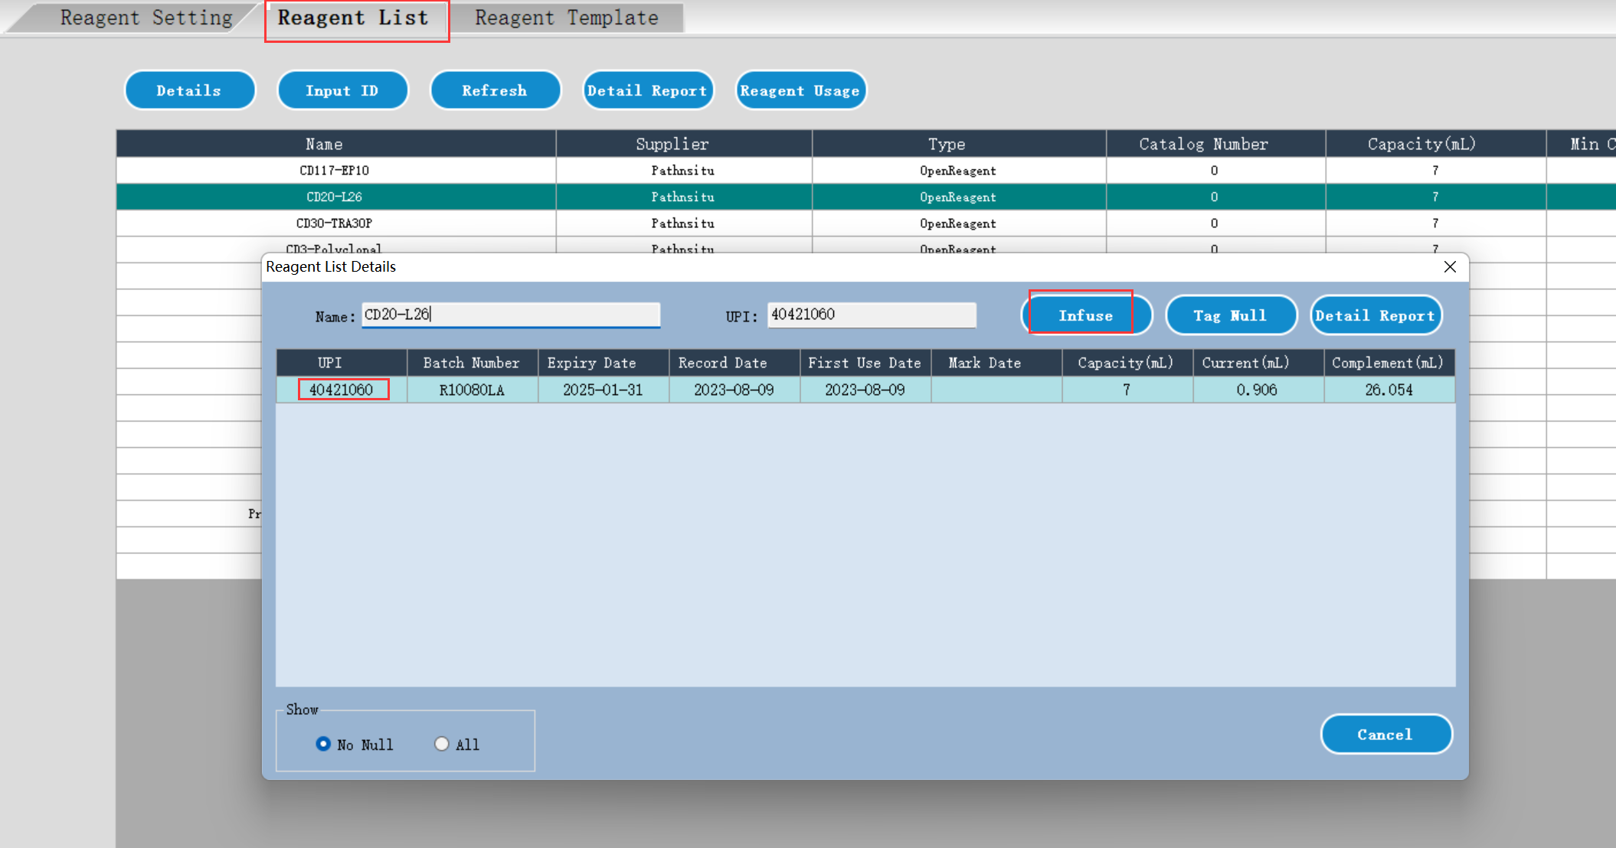
8. How to refill the primary antibody
The open container supports to cumulative add up to 30mL of a special antibody. Once the display volume is less than 1 mL, strongly suggest you refill the antibody.
Follow the below steps to refill:
1. Under “reagent list” page, double click the antibody which you need to add.
2. Select the open container, click “Infuse”.
3. Before starting a run or during the incubation when running, remove the reagent tray.
4. Add the antibody into the open container.
5. Load the reagent tray into the reagent platform, the system will move the probe to detect the volume and update the display volume.
Note that when infusing an open container, the system assumes that the container is
filled to the maximum available for that container. The reported volume will be updated after
a dip test is carried out. This may not occur until the container is used.
Notes:
1. 用新配制的 5% 漂白剂浸泡 10 分钟。
2. 用流水浸洗 10 分钟。
3. 将 Covertile 浸入 100% 乙醇中，共浸洗 10 min。
4. 干燥：
用无绒布擦干，或者
风干，或者
在 60°C 烘箱中干燥 10 分钟
5.仔细检查 Covertile 上是否有碎屑、裂纹或变形。若有任
何受损则将其丢弃。

Slide 19
9. Operation cautions
1. Correctly place the slides and liquid covers on the slide tray.
2. Ensure the system successfully recognizes all reagents after you insert the reagent tray. If failed to recognize the reagents, please check and clean the reagents’ lables and reinsert the tray.
3. When the reagent volume of the open container is less than 1mL, please refill it with correct reagent.
4. Check and confirm the mixing station is clean before starting the experiment.
5. Different staining procedures cannot be performed simultaneously in the same staining unit. please separete them into different staining units.
6. After setting the delayed start, do not do other settings or pull out the reagent tray. otherwise please reset the delayed start operation.
7. Do not open the instrument cover and do not close the client software during the experiment. do not use the control computer to run other softwares.

Slide 20
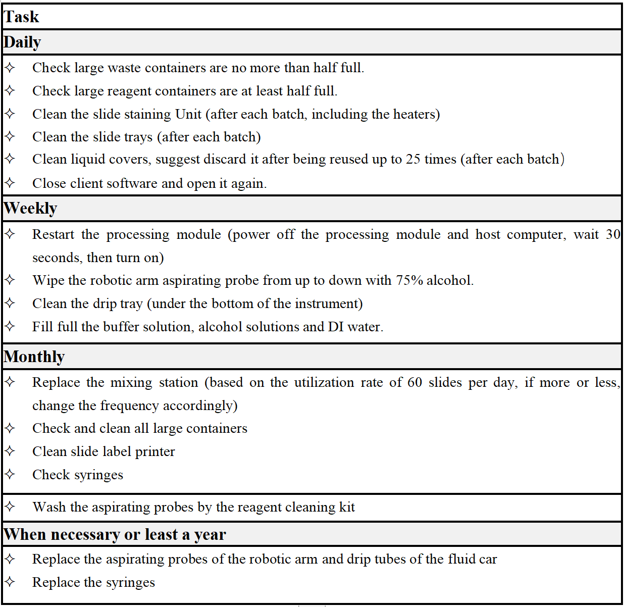
10. Preventive maintenance
The users should perform the regularly clean and maintenance according to this table.

Slide 21
THANKS!
汇报人： ####
部 门：###

