Slide 1

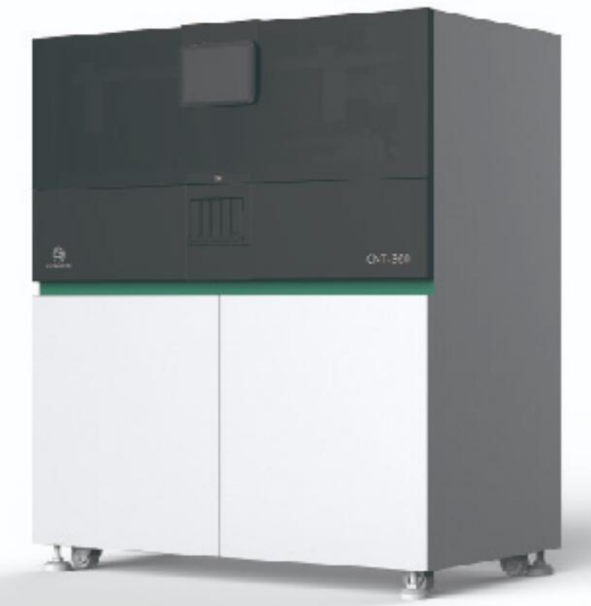
CNT360 Position calibration

Slide 2

01
Hardware structure
CONTENTS
02
Materials for calibration
03
Position calibration
04
Regularly clean and
maintenance

Slide 3
PART 1
Hardware structure

Slide 4
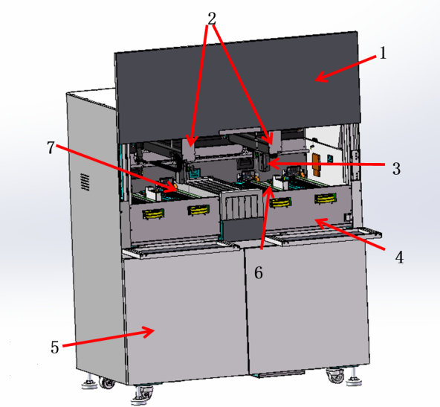
Hardware structure
No. | Name
1 | instrument cover
2 | robotic arm
3 | scanning module
4 | front panel
5 | large container cabinet
6 | liquid car
7 | slide staining unit( CM1, CM2, CM3,CM4 from left to right)
somewhere, use “CM” or “ Core module” to represent “slide staining unit” for short.

Slide 5
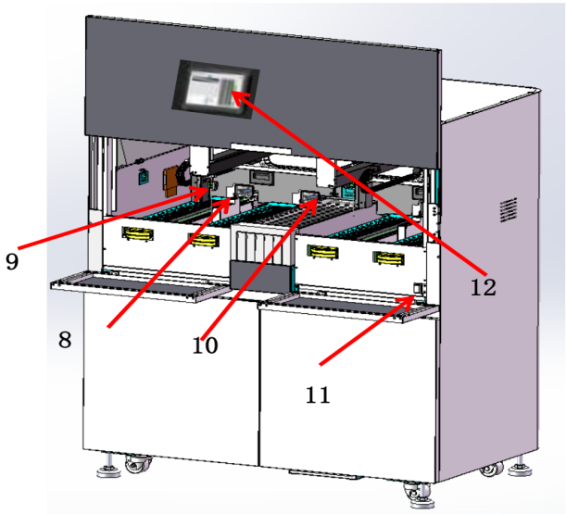
Hardware structure
No. | Name
8 | Washing area and mixing station
9 | Aspirating probe
10 | Reagent platform. From left to right, RS1,RS2,RS3,RS4,RS5
11 | Power switch
12 | Control panel
somewhere, use “RS” to represent “reagent strip” or “reagent tray” for short.

Slide 6
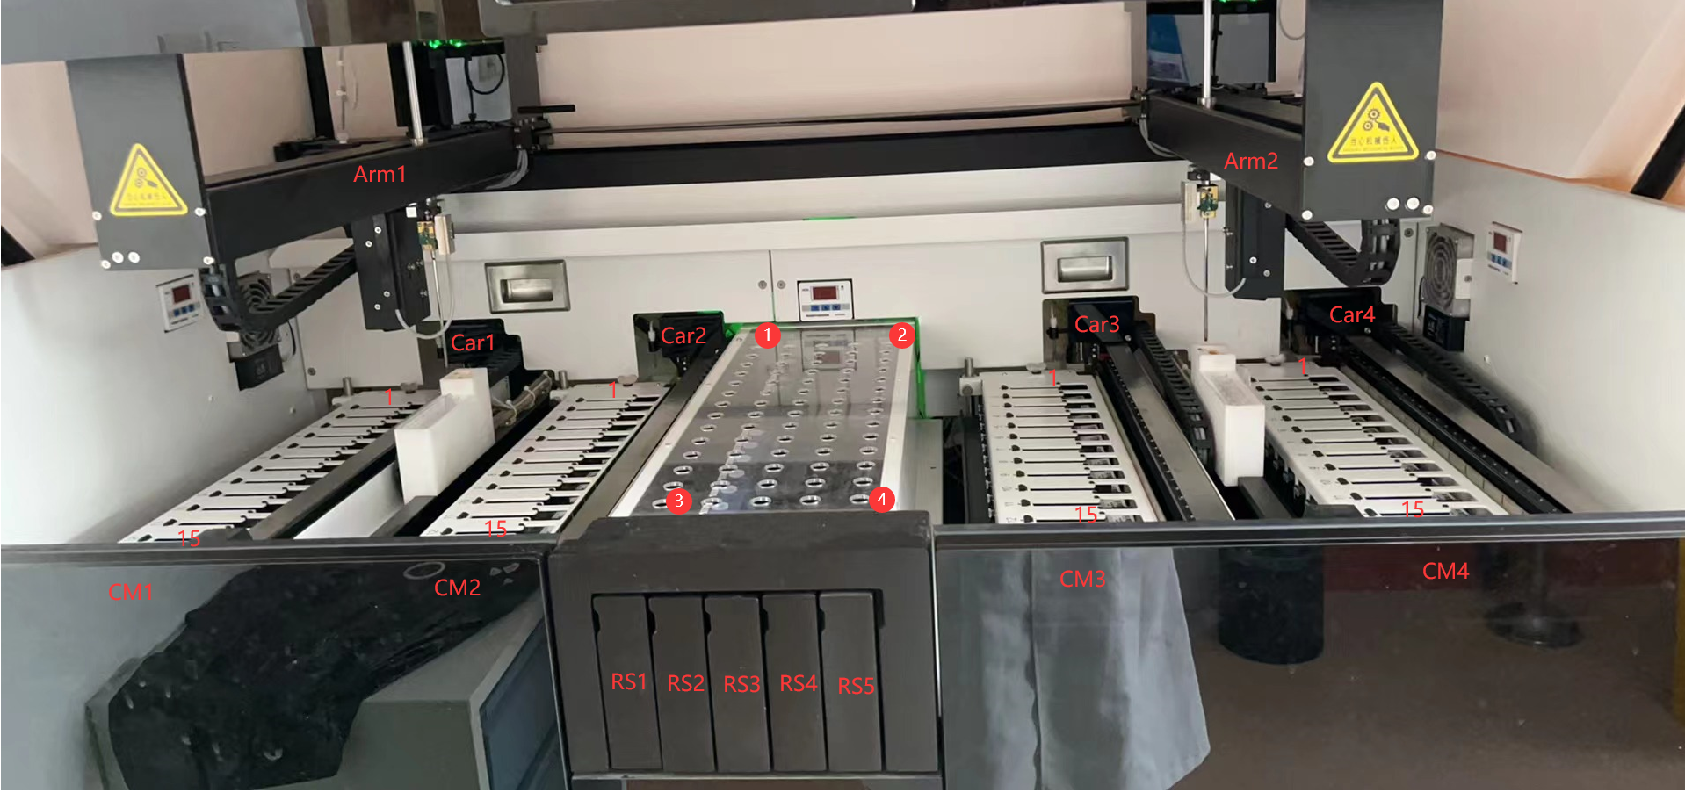
Hardware structure

Slide 7
PART 2
Materials for calibration

Slide 8
Materials for calibration
No. | Name | Quantity
1 | slide | 15
2 | liquid cover | 15
3 | open reagent container | 4
4 | reagent tray | 2
Please confirm before performing the position calibration :
There is no experiment running.
There are no slides to be processed on the slide tray.
Remove the reagents from the reagent platform.
When need to do the position calibration?
Position checking after first installation. To ensure the positions are right. such as the probe to washing area position, the probe to reagent platform position, the probe to dispensing position.
After replacing related parts. such as replacing some one part of the reaction chamber, or replacing some one part of the robotic arm, or replacing a aspirating probe.
Maybe need to check the position when the staining is not good.
Notes:
during the transportation，due to the mechanical feature, the position may have a slight jitter or offset.

Slide 9
PART 3
Position calibration

Slide 10

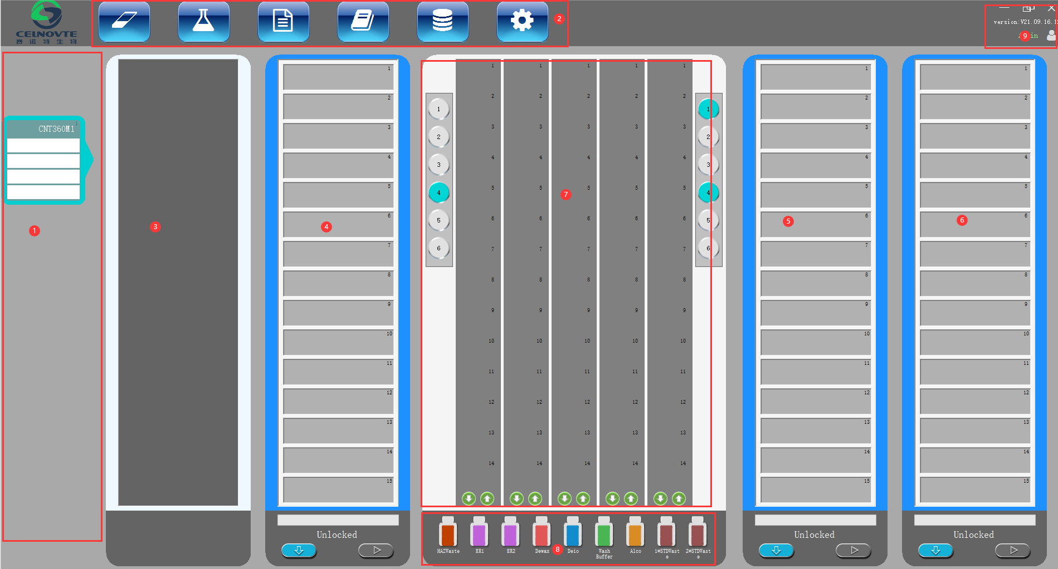
1. Know the client software
Click the icon on the desktop of the host computer to open the client software.
(For the first run,strongly recommand you check if the computer time is right before openning the client software. If no, please adjust the time zone of the computer system)
1 | Instrument list
2 | Menu bar
3 | CM1
4 | CM2
5 | CM3
6 | CM4
7 | Reagent platform
8 | Large reagent container status
9 | User login and software version display
Notes:
1，display the connection status between host computer and processing module，also display the relevant instrument alarm information，right-click to deal with the alarm when alarm sign displays here. One client software supports max 2 CNT360 instruments.

Slide 11







2. Client software_page menu bar
 | Slide management | Add case, edit case ,delete case, copy case Add slide, print slide label.
 | Reagent management | Add/edit/delete reagent, view reagent, register reagent, reagent report.
 | Operating protocol | Add/Copy/edit/delete protocol, view protocol, protocol report.
 | History of slide | View slide history.
 | Running information | View real-time running information, display key step running log.
 | System management | Set system parameters and perform maintenance operation.

Slide 12
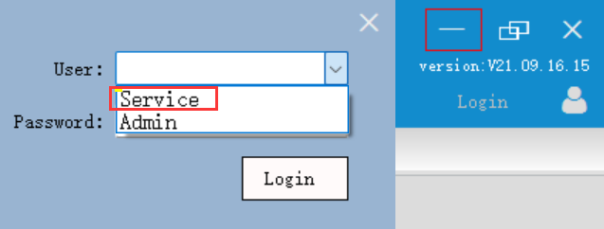
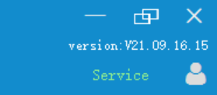
3. Client software_user login
Click “Login” on the right top corner to open the user login window.
Select the “Service” from the user list, input the password（default password：123）, then click “Login” button

Slide 13
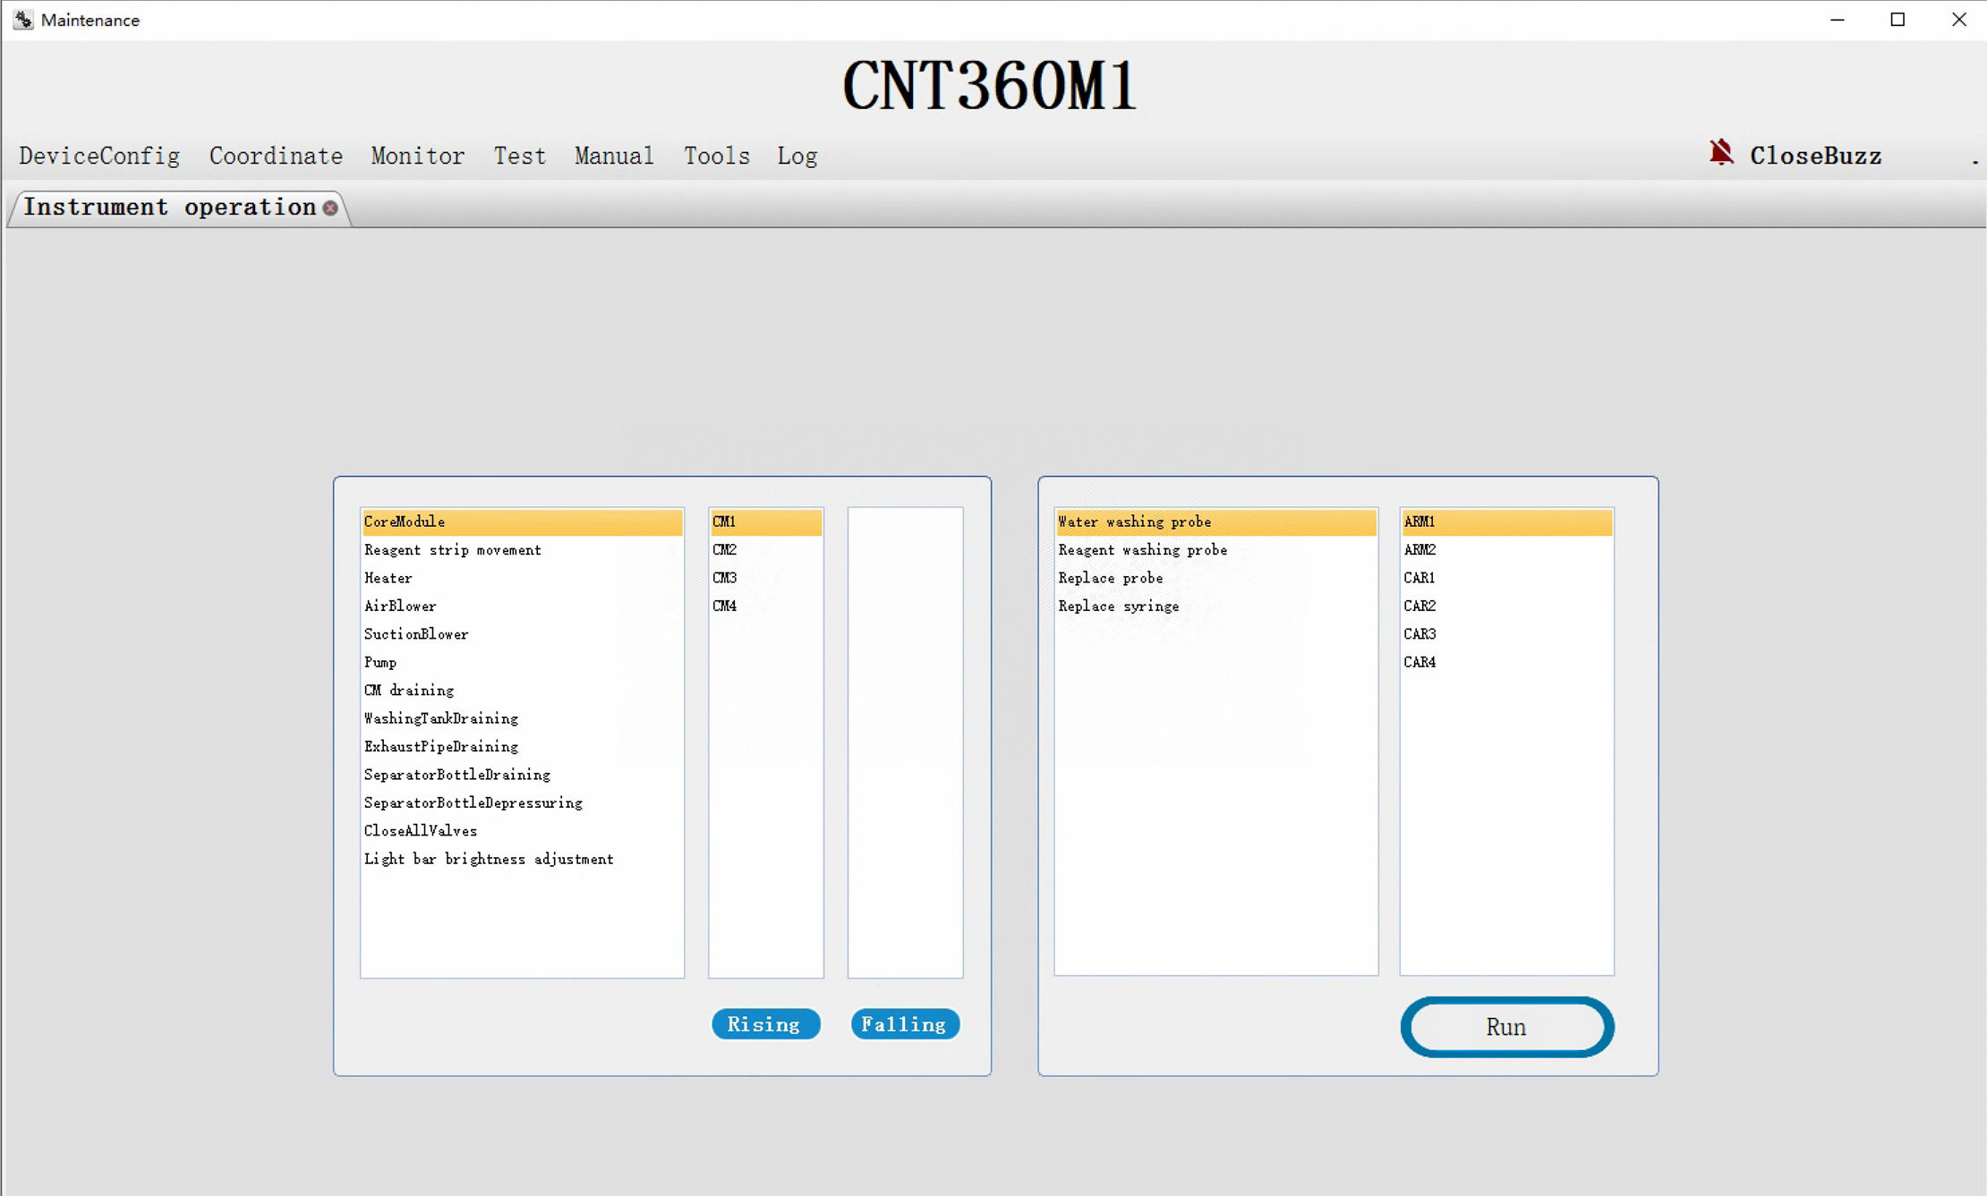
4. Position calibration
4.1 Enter the maintenance operation page
Click “System Management”— “Maintenance” to enter the maintenance operation page.

Slide 14
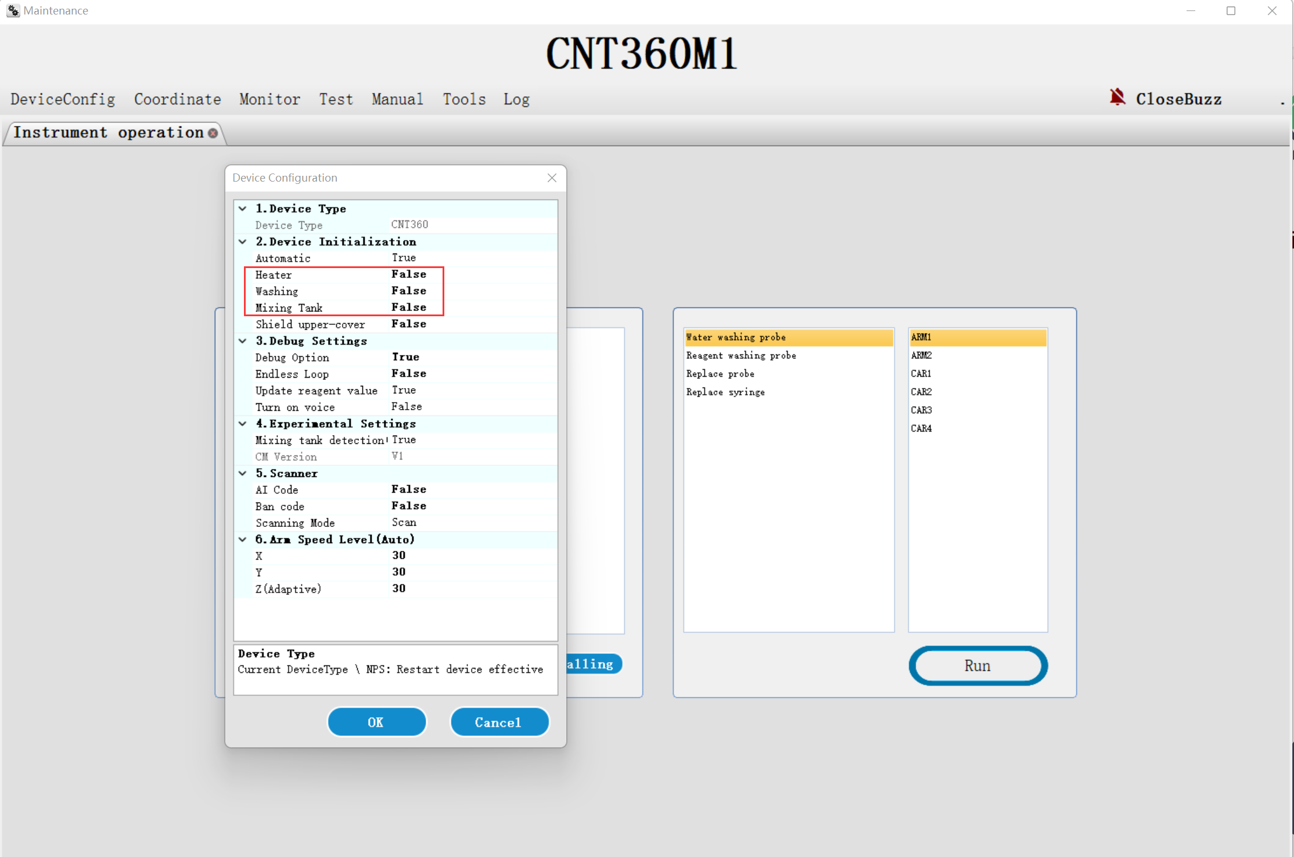
4. Position calibration
4.2 Set the device initialization parameter
4.2.1 Click “DeviceConfig”— “Config” to open “Device Configuration” dialog.
4.2.2 Check if the device initialization parameters of “Heater”, “Washing” and “Mixing Tank” are “False”. if “True”，please set them as “False” . And set “Debug Option” as “True”.
4.2.3 Click “OK” to save.
Notes:
可以建议客户把Device cover signal shield 设置为True（不检测仪器盖 not to detect the instrument cover status）， 校准完后再设置为 “False”（检测仪器盖 detect the instrument cover status, when open the cover, the status screen will display a “cover open” alarm）

Slide 15
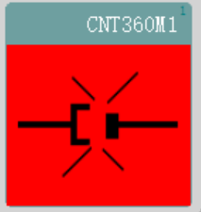
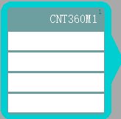
4. Position calibration
4.3 Power on the processing module.
Power on the processing module. Waiting until the software display connection successfully.
Below in this document only show the No.1 robotic arm position calibration, please do not forget to do the No.2 robotic arm position calibration.
Note: Any parameter change during the calibration,please remember to click “Save and Write” to active the settings.

Slide 16
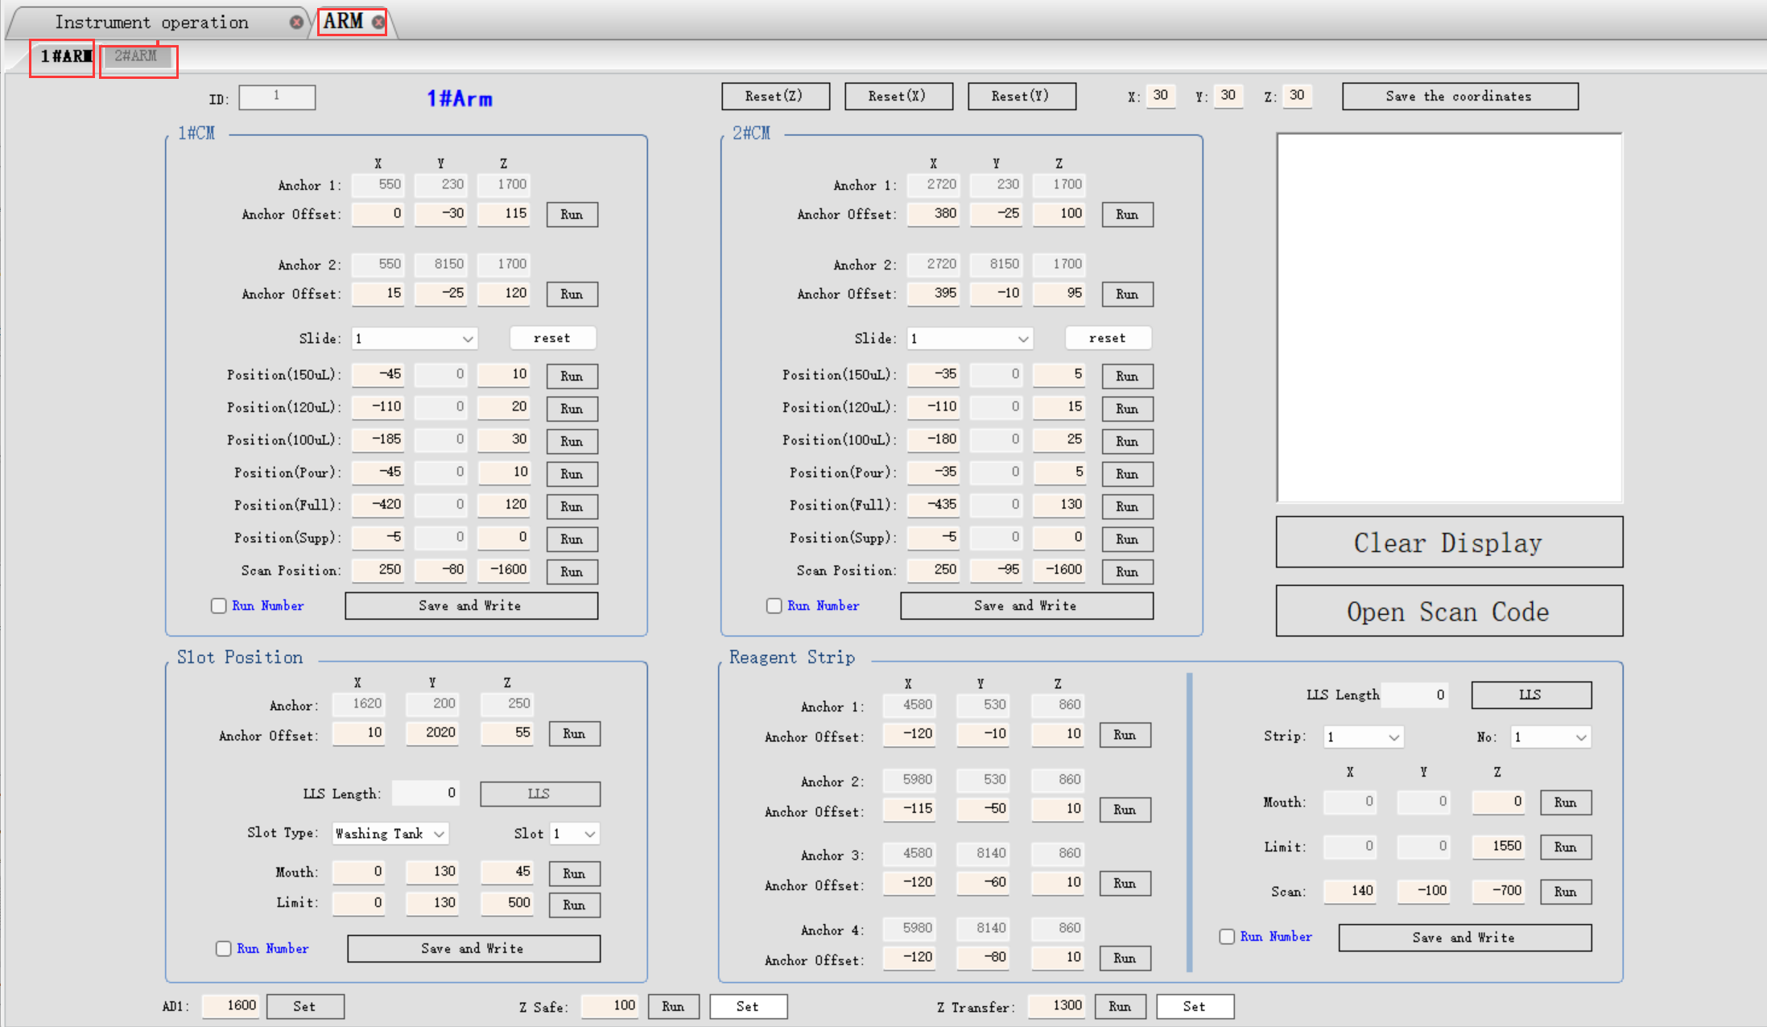
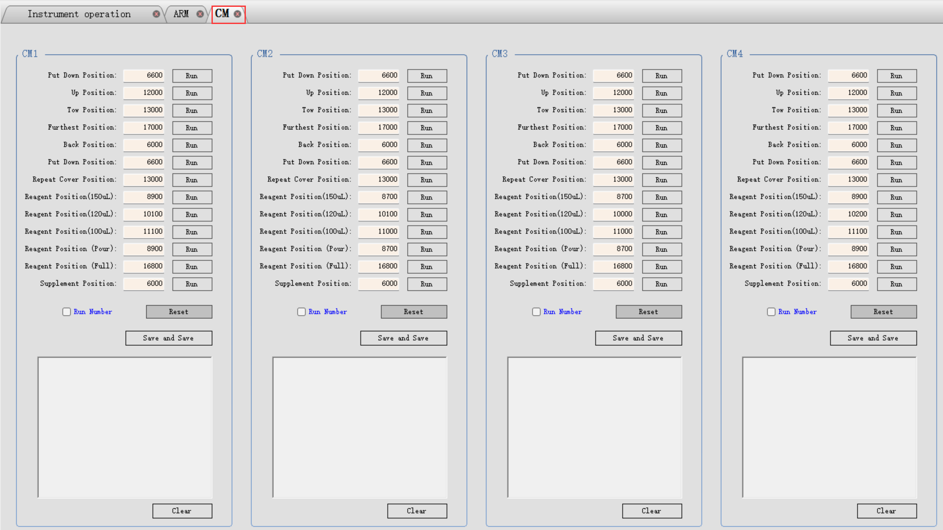
4. Position calibration
4.4 check the processing module status and save the coordinate information
4.4.1 check if all of the CMs is unlocking after power-on initialization.
4.4.2 suggest screenshot the 1#Arm & 2#Arm pages and CM page and save them into a maintenance file folder. Before delivery the device, our factory debug engineer already has done the position calibration, The field engineer just need to do the fine adjustment or just check the positions are right.

Slide 17
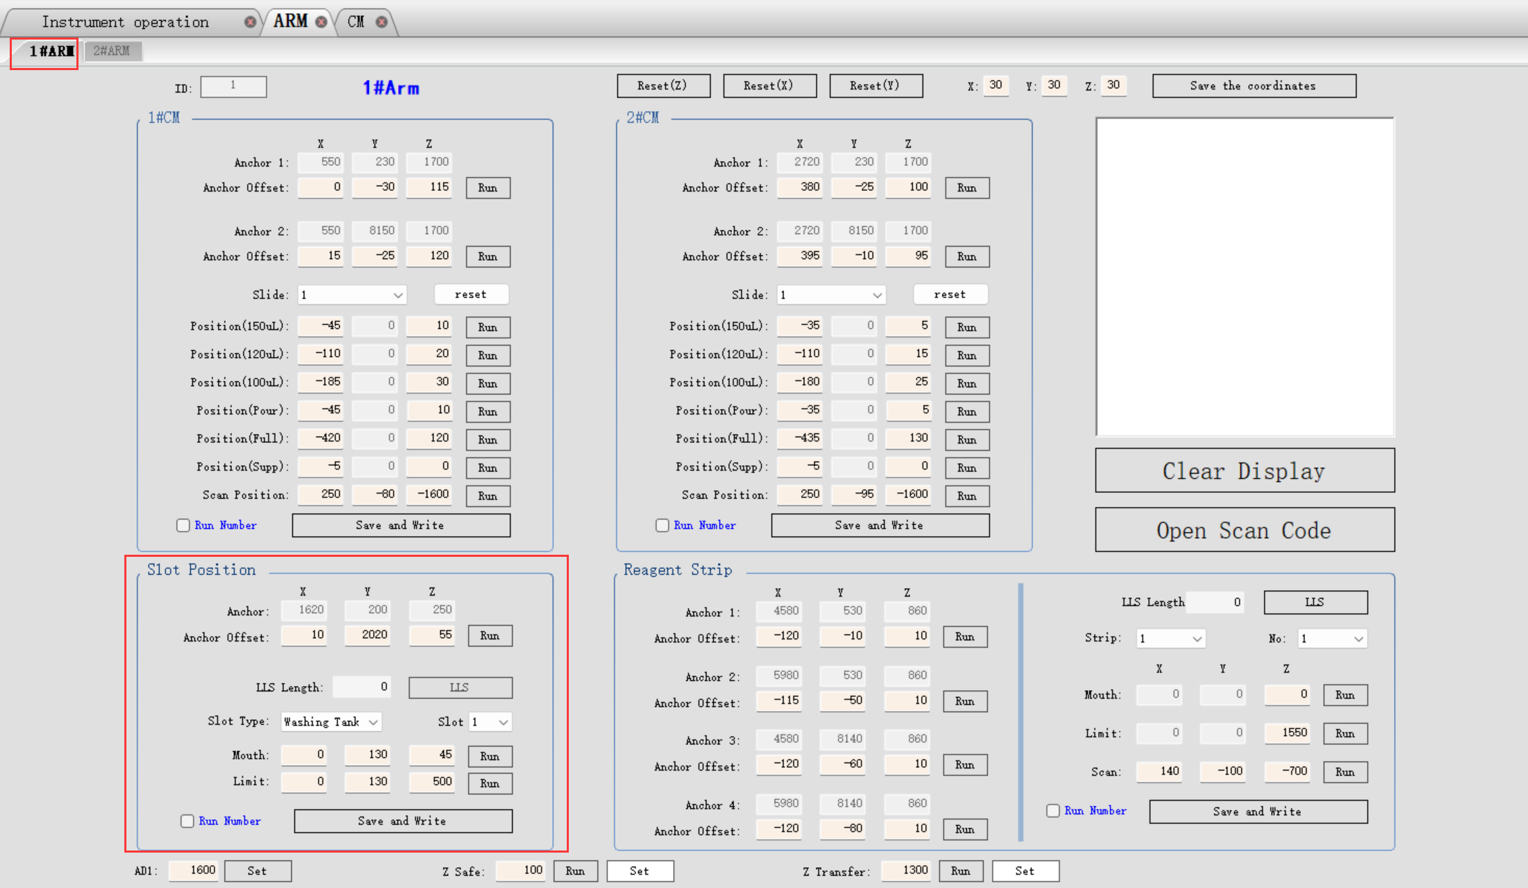
4. Position calibration
4.5 washing area and mixing station
4.5.1 click “Coordinate”—”Arm” to access the 1# robotic arm position calibration page.

Slide 18
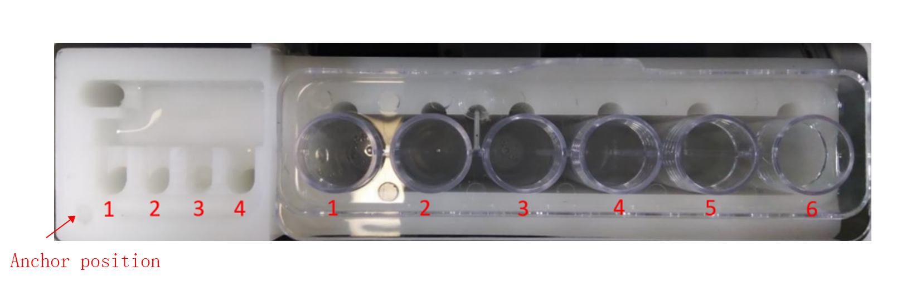
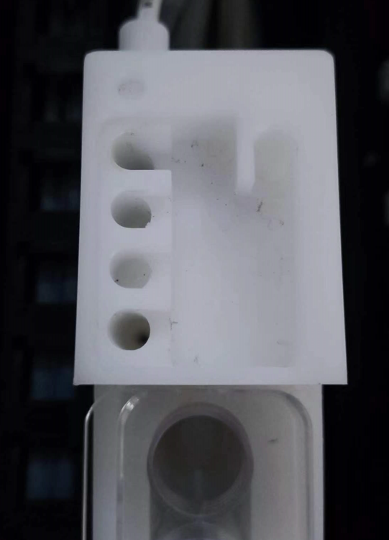
4. Position calibration
4.5 washing area and mixing station
There are 11 positions that need to be calibrated, “anchor position”, 4 washing tanks, 6 vials of the mixing station. The anchor position is a “safe position”,please move the probe to this safe position before executing the next step.
Please note, for the washing area and mixing station datum calibration, firstly Must finish the anchor position calibration.
left 1,2,3,4 are washing area; right 1,2,3,4,5,6 are mixing station

Slide 19
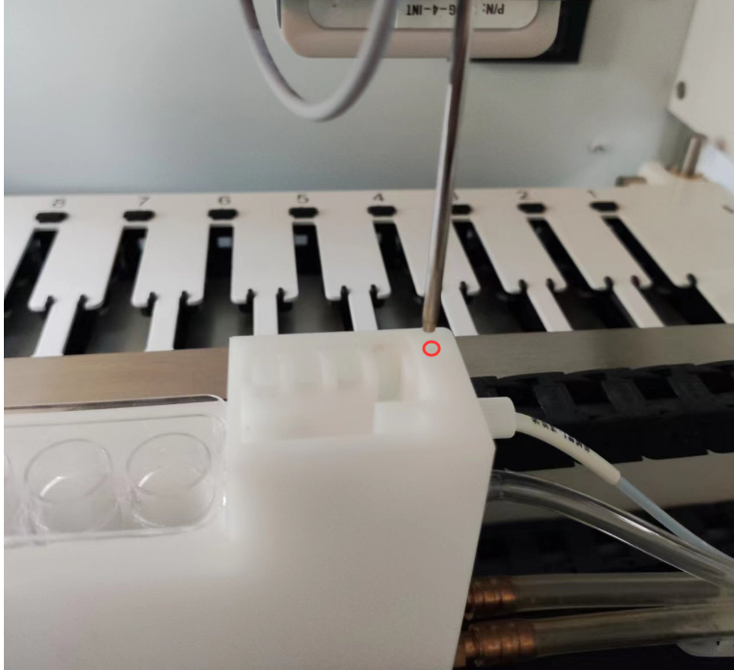
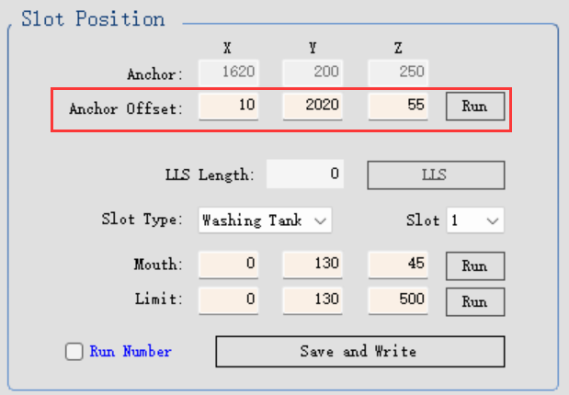
4. Position calibration
4.5 washing area and mixing station
4.5.2 calibrate the “Anchor”position of washing area (Slot Position).
First Reduce the Z value to “-200”, click “Run” to move the probe to the above of the anchor position, Then adjust X, Y, Z value to make sure the tip of probe is close to the anchor. The height is about 2 mm( the thickness of 2 slides).
Any parameter change,please remember
to click “Save and Write” to active the settings.
Notes:
Why set “-200”, prevent the probe collision，when adjust Z value，according to the actual height，set like these， -100， -50， -30 ，-10 to move the probe reach the anchor position. suggest you remember the factory value before adjust it.

Slide 20
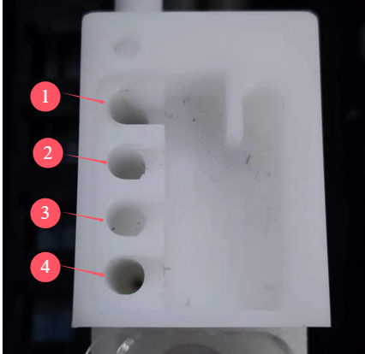
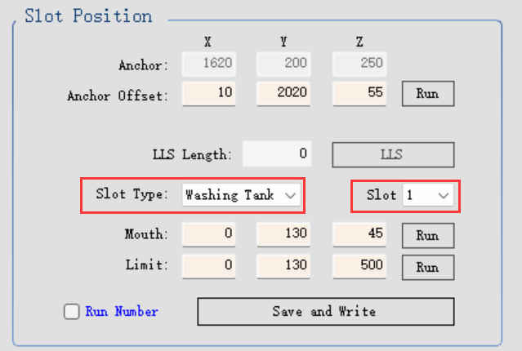
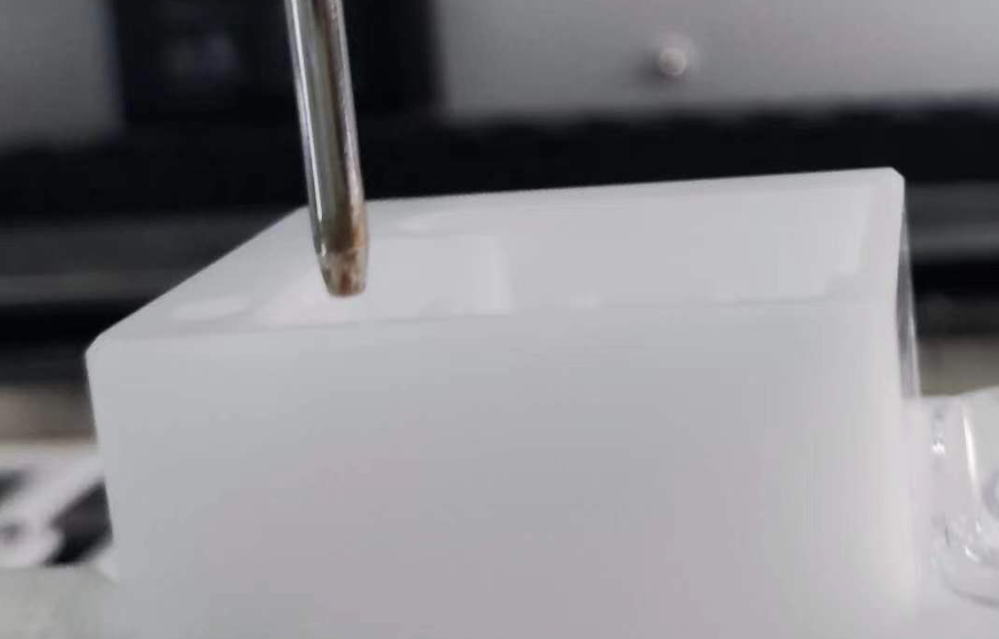
4. Position calibration
4.5 washing area and mixing station
4.5.3 calibrate the slot mouth position of washing area
From inside to outside, slot 1, slot 2, slot 3, slot 4.
Select the Slot Type as “Washing Tank” and relevant slot to finish the mouth position calibration for the four slots. Refer to the below picture, the tip of the probe is on the center of the slot hole, and the plastic tip should be at the same level with the level surface of the washing area.
Any parameter change,please remember to click “Save and Write” to active the settings.
Notes:
It is very important to ensure the probe tip is on the center of the slot hole. Before adjust the Z value, first check if the probe tip is on the center of the slot hole, you can fine adjust the X and Y values to check.

Slide 21
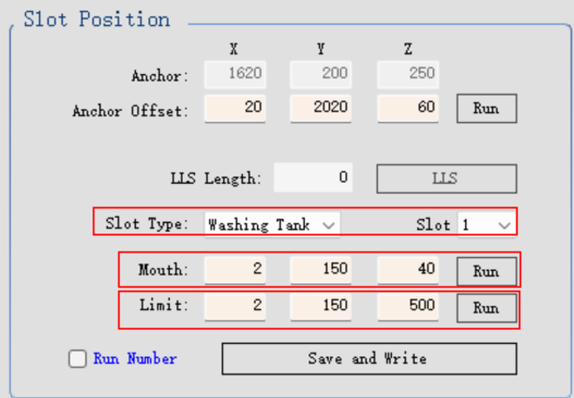
4. Position calibration
4.5 washing area and mixing station
4.5.4 calibrate the slot limit position of washing area
After confirm the mouth position of the slots, please adjust the Z values of the limit position as the following：
500 for slot 1,
150 for slot 2,
150 for slot 3,
1000 for slot 4.
Here the limits of the washing tank use the fixing value.
Please move the probe to the limit position to check the position is right,ensure the probe is just on the center of the slot hole, then move then probe to safe position.
Repeat the 4.5.3 and 4.5.4 steps to finish all washing area slot position calibration.
Notes:
500， 200， 150，1000 (230918 同邱工确认）,241114, 建议修改为500,150,150,1000.后续出厂也参考此设置

Slide 22
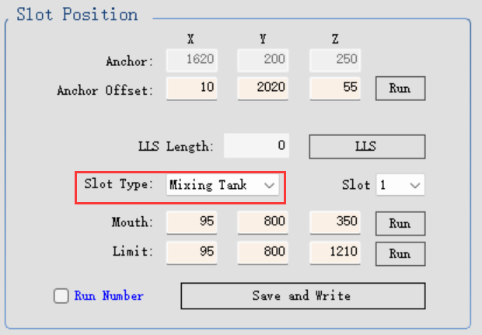
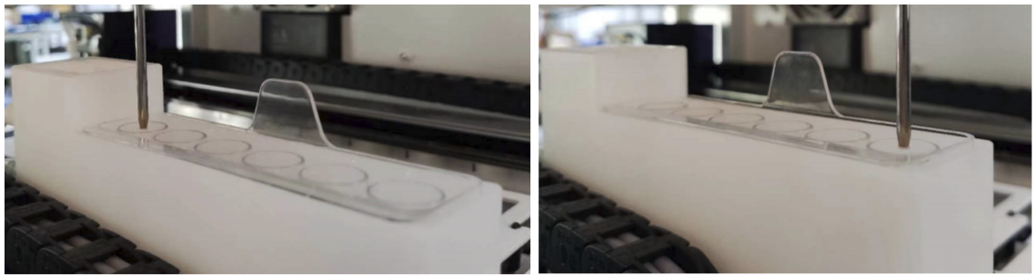
4. Position calibration
4.5 washing area and mixing station
4.5.5 calibrate the slot mouth position of mixing station
Select the Slot Type as “Mixing Tank” and relevant slot to finish the mouth position calibration for the 6 slots.
Refer to the below picture, the tip of the probe should be at same level with bottle mouth level surface of the mixing bottle.

Slide 23
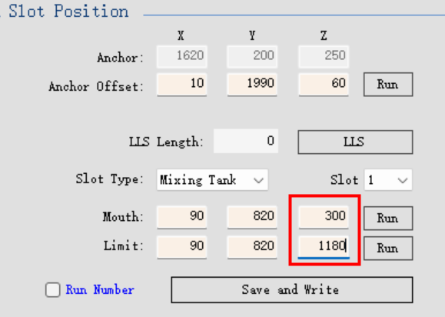
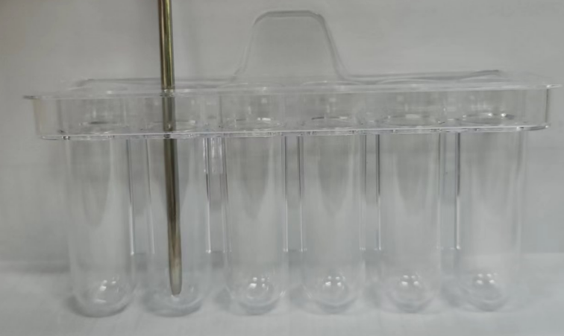
4. Position calibration
4.5 washing area and mixing station
4.5.6 calibrate the slot limit position of mixing station
For the limit Z value, please set the offset as 880 with the mouth position. see the picture ,if the mouth Z value is 300, set the limit Z value as 1180. then click “Run” to move the probe to the bottom. Check if the distance is about 1 mm from the bottom. Then please move the probe to the safe position.
The height between the tip and the bottom position should be less than 1 mm. But there should be a little space to avoid the probe touch the bottom of the bottle. You can try to lift up the mixing station. The height you can lift should just be about 1 mm.
Repeat 4.5.5 and 4.5.6 steps to finish all 6 slot mouth and limit position calibration.
Notes:
231207 测试 如果瓶口位是基于一张玻片，则瓶底位为：瓶口位+900, there is another way to get the limit position of the mixing station. place a slide on the mixing station, for the mouth position, just ensure the plastic tip of the probe reach the surface of the slide as much as possible. then for the limit, just need to plus 900 offset based on the numerical value of the mouth position.

Slide 24
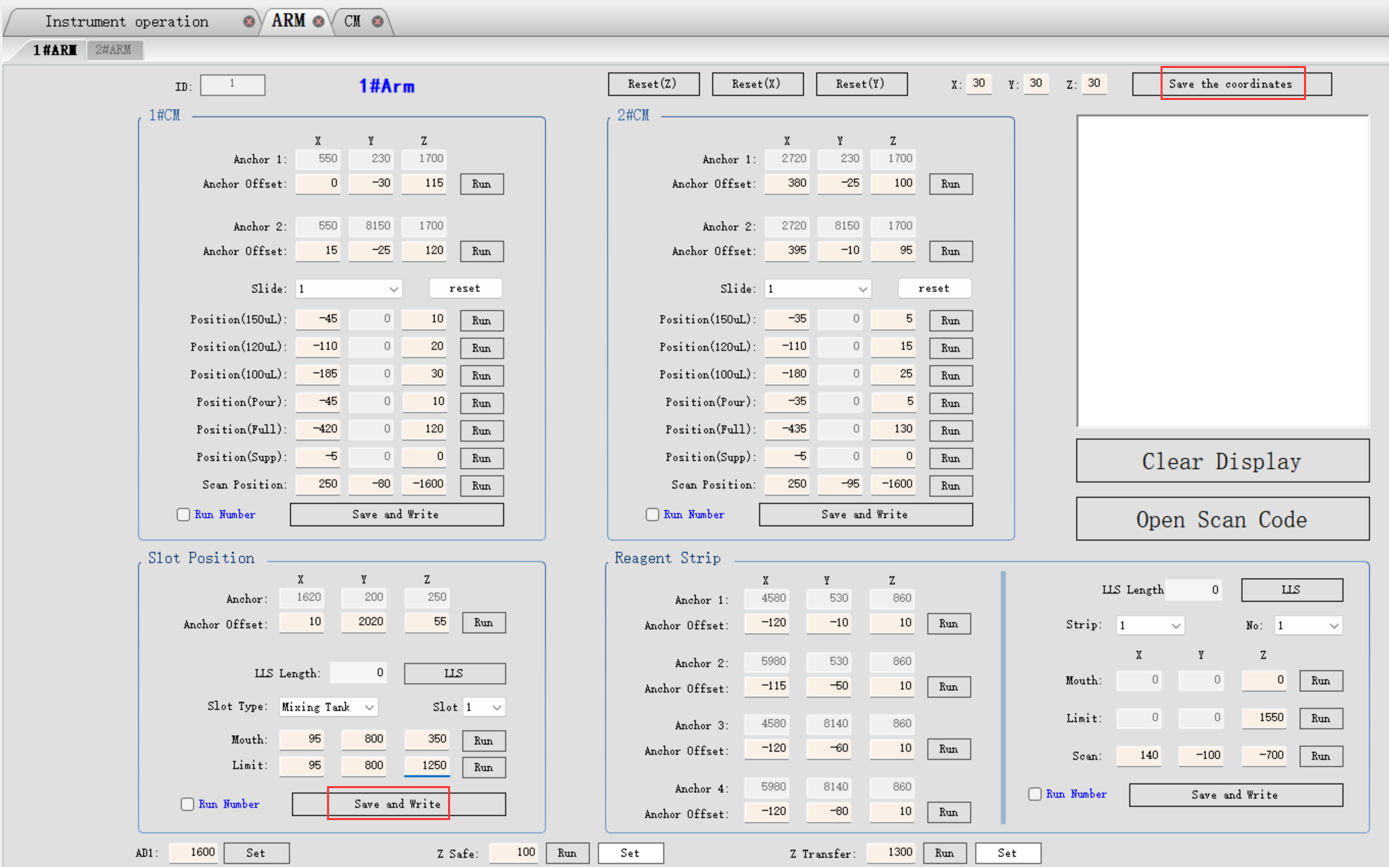
4. Position calibration
4.5 washing area and mixing station
4.5.7 Save the calibration parameters of the washing area and mixing station
Click “save and write” to save the slot position calibration parameter into the database and main board .
Then click “Save the coordinates” to save all arm position parameters into the database and main board.
Refer to the above 4.5.1 to 4.5.7 to perform the washing area and mixing station position calibration for No.2 Arm.

Slide 25
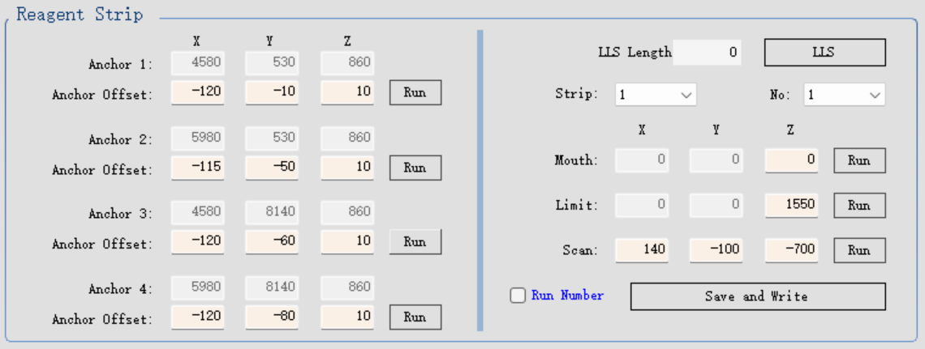
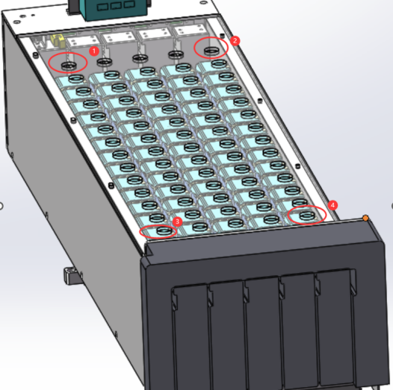
4. Position calibration
4.6 Reagent platform calibration
Anchor 1 ：No.1 reagent container of the RS1
Anchor 2 ：No.1 reagent container of the RS5
Anchor 3 ：No.14 reagent container of the RS1
Anchor 4 ：No.14 reagent container of the RS5
For easily check the position, you can remove the plastic cover. after the position calibration is done, install the cover back.

Slide 26
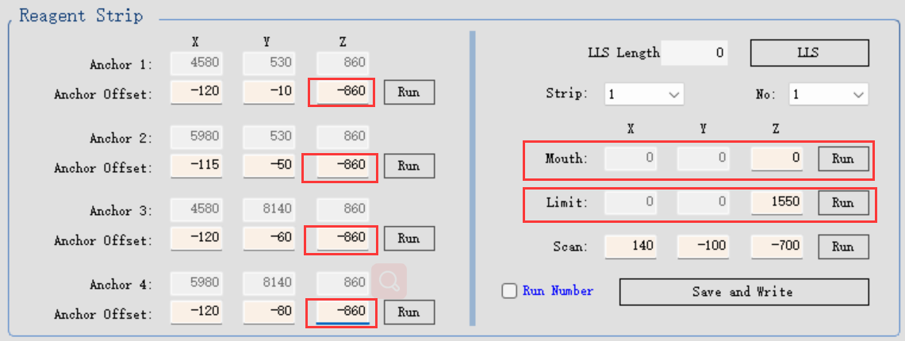
4. Position calibration
4.6 Reagent platform calibration
4.6.1 calibrate anchor 1,2,3,4 mouth position
Notice. please move the probe to safe position when to do next step operation or before inserting the reagent tray into the reagent platform.
step1. On the instrument operation page, control the RS1 and RS5 out of reagent platform. Place two open reagent bottles in position 1 and 14 on each empty reagent strip. insert them into the RS1 and RS5 position.
step2. Set Z value as -860, then click Run to move the probe to the above of the position 1.
step3. Adjust X, Y value to move the probe to the center position of the position 1.
step4. check if the value of Mouth is 0, the value of Limit is 1550.

Slide 27
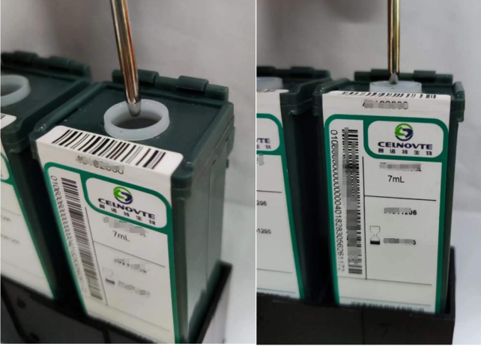
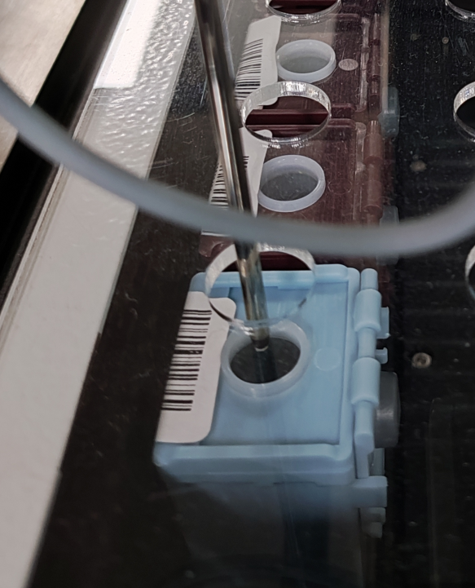
4. Position calibration
4.6 Reagent platform calibration
4.6.1 calibrate anchor 1,2,3,4 mouth position
step5. adjust Z value to move the probe to reach the mouth position.
Refer to the left picture, the plastic tip of the probe should be inserted 2 mm below the bottle mouth level surface.
step6. Refer to the above step 2 to step 5 to finish other anchor position calibration for No.1 Arm.
step7. click “Save and Write” to save the parameters into the database.
Refer to the above steps finish the anchor position calibration of the reagent platform for the No.2 Arm.
Notice. please move the probe to the safe position before performing the next step.
Notes:
use a marker pen mark it at 2 mm height position, ensure the marker is at the same level with the bottle mouth. For easily check, you can remove the transparent plastic cover
关于CNT300/CNT360液位检测校准说明：在确保开放试剂瓶安装到位的情况下，1ml去离子水，LLS值约为144，+/- 20,（124~164）可以算正常
CNT360: 如果检测到LLS值偏大，瓶口位Z轴值减少，往上调一些。

Slide 28
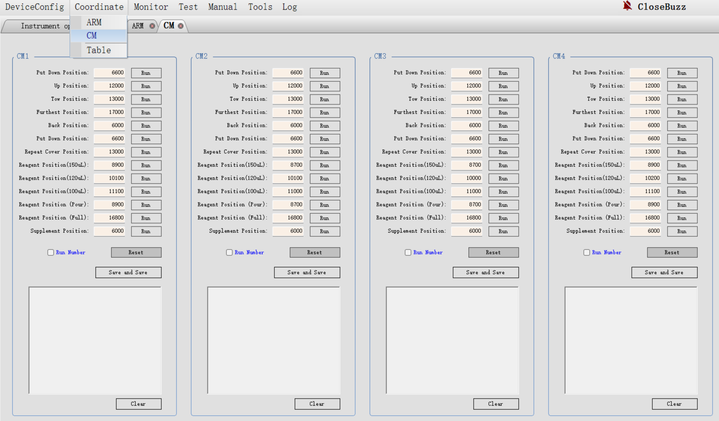
4. Position calibration
4.7 Slide staining unit, CM position calibration
CM position calibration needs to use two maintenance pages, Arm and CM pages. Refer to the below picture,click them to open.
In this document, only show how to calibrate the 1#CM position. for 2#CM, 3#CM, 4#CM, please refer to the below steps to finish the position calibration. then click “save the coordinates” to save the parameters.

Slide 29
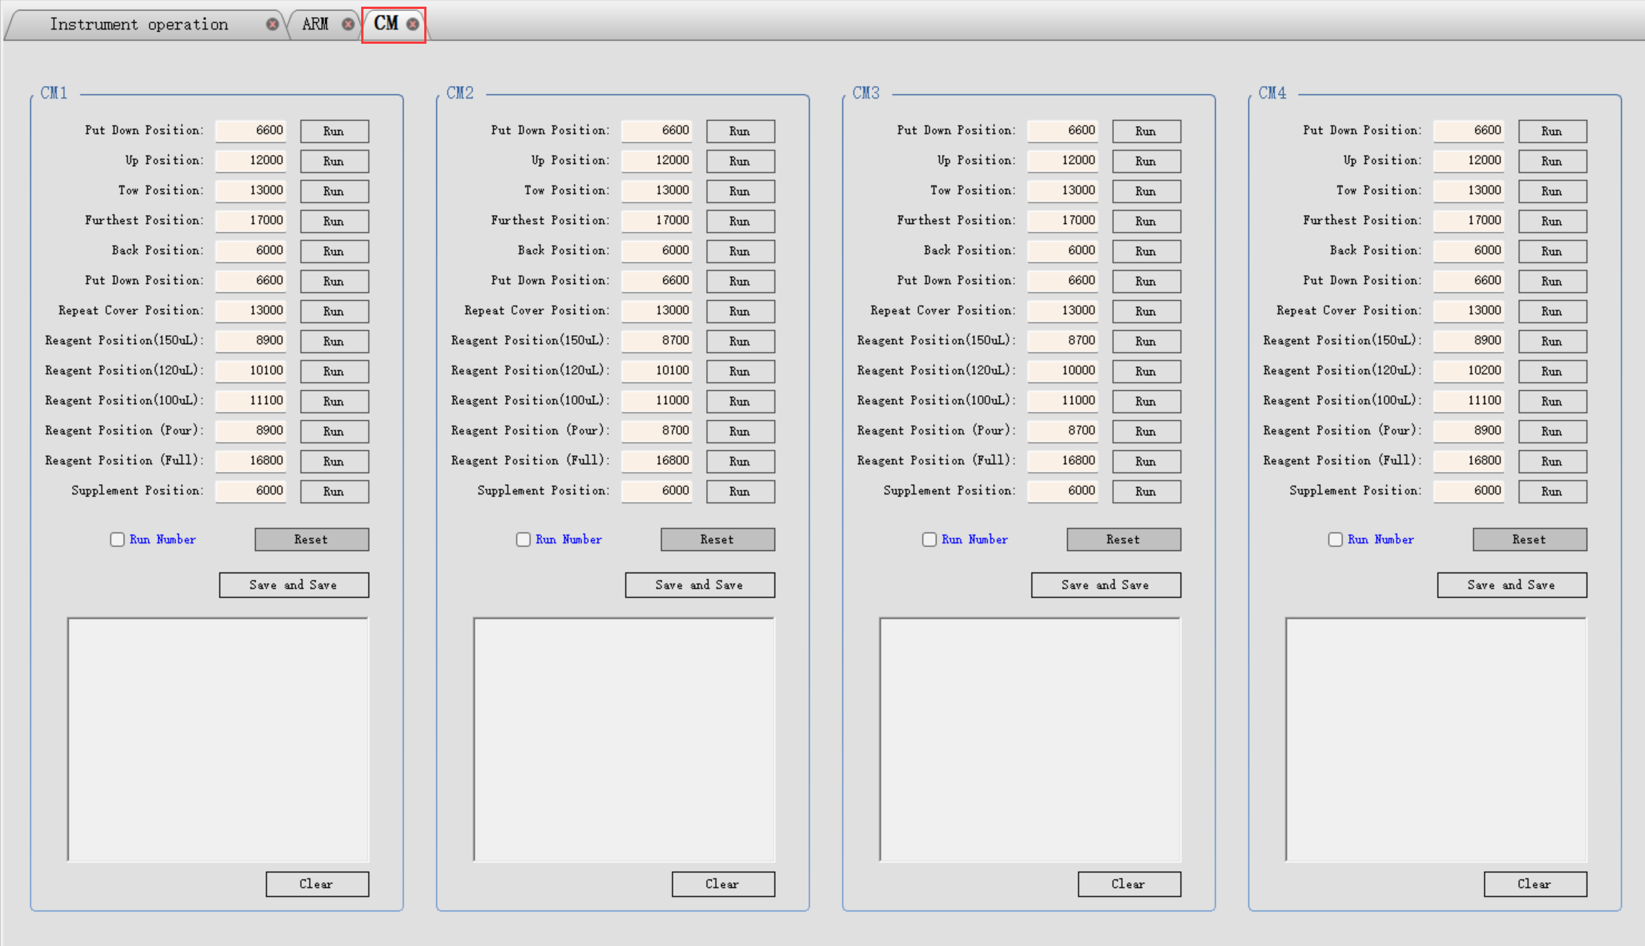
4. Position calibration
4.7 Slide staining unit, CM position calibration
CM position coordinate page, refer to the below picture.

Slide 30
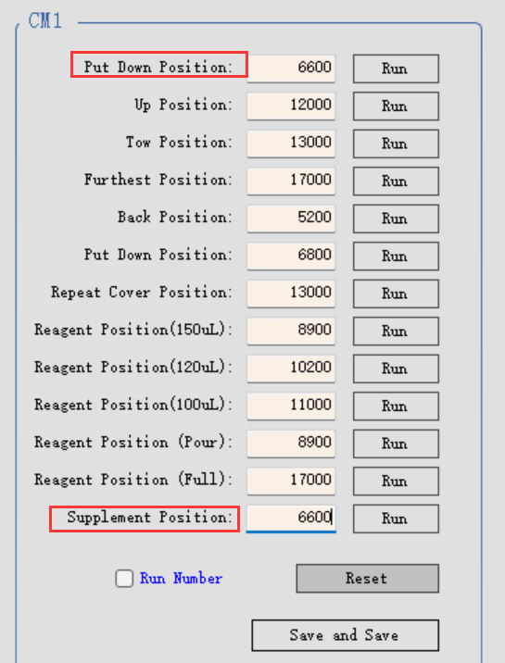
4. Position calibration
4.7 Slide staining unit, CM position calibration
4.7.1 anchor 1 and anchor 2 of CM1 position calibration
step 1. place slides and liquid covers on position 1 and position 15 of the slide tray. insert the tray into the 1#CM.
step 2. Select CM1 on the “instrument operation” interface to control it fall, wait until the slides of the CM1 are loaded.
step 3. click “Run” of Put Down Position to lock the 1#CM, wait until the running is done.
step 4. click “Run” of “Supplement Position” . wait until the running is done.

Slide 31
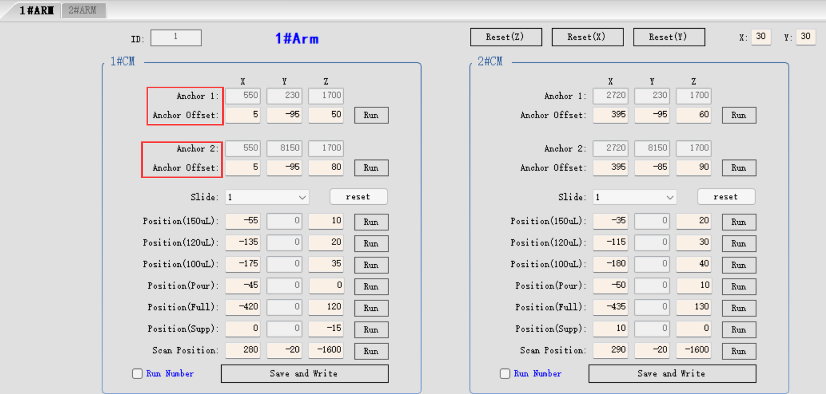
4. Position calibration
4.7 Slide staining unit, CM position calibration
4.7.1 anchor 1 and anchor 2 of CM1 position calibration
step 4. Return back “1#Arm” page to finish 1#CM anchor 1 and anchor 2 position calibration.
step 5. click “Save and Write” to save the calibration parameters.

Slide 32
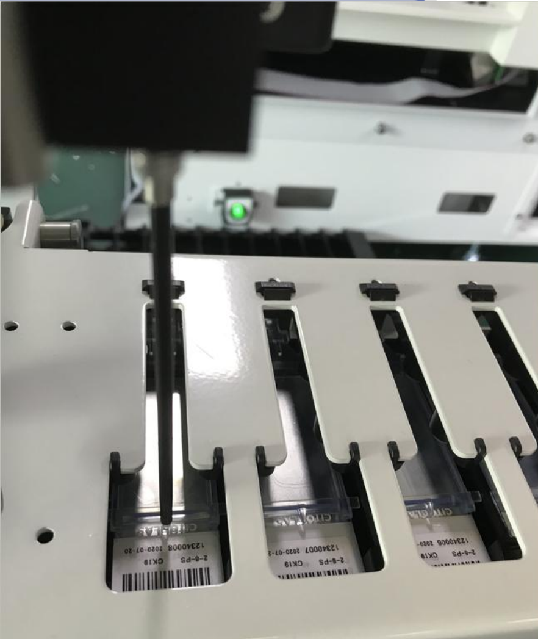
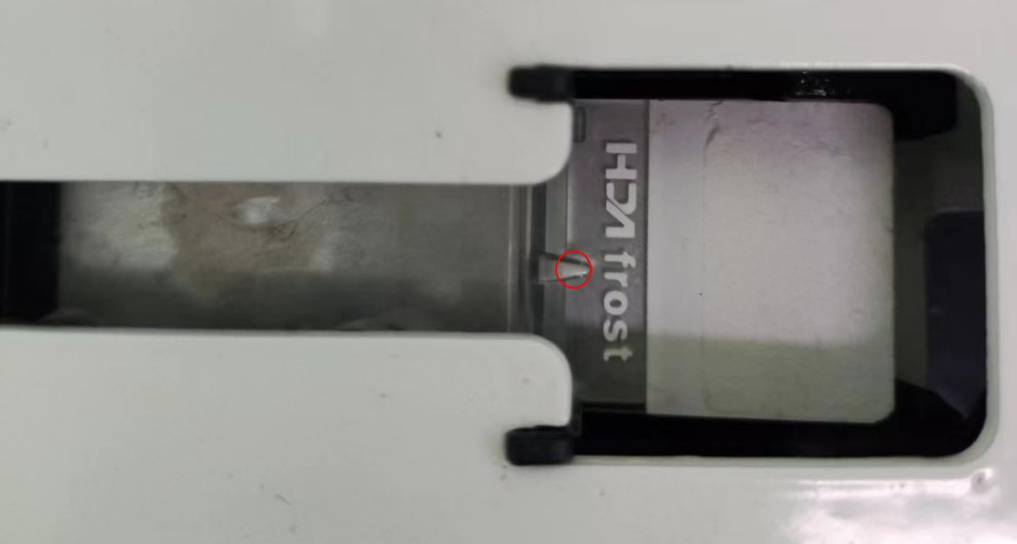
4. Position calibration
4.7 Slide staining unit, CM position calibration
4.7.1 anchor 1 and anchor 2 of CM1 position calibration
calibration position requirement:
X direction. the probe right edge just aligns with the tip of the liquid cover.
Y direction. the probe just is in the middle of the top plane slit.
Z direction. the probe height is about 1 to 2mm to the tip of the liquid cover.
Refer the above steps to finish the anchor 1 and anchor 2 position calibration of CM2,CM3 and CM4.
Do not forget to click “save and write” to save the calibration parameters.

Slide 33
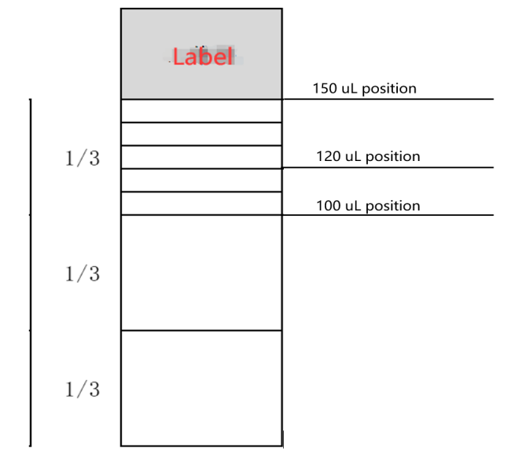
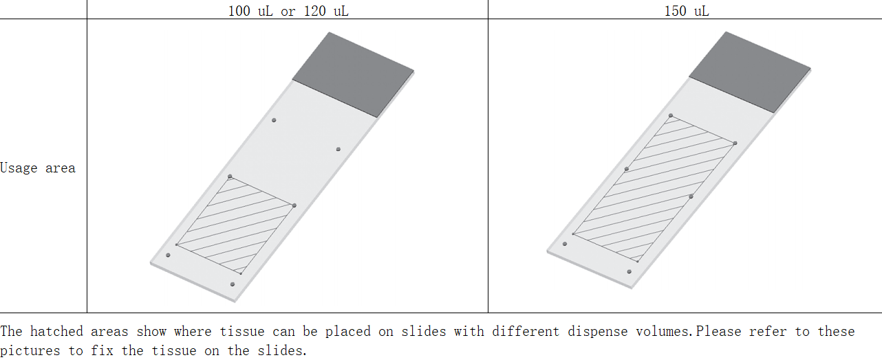
4. Position calibration
4.7 Slide staining unit, CM position calibration
4.7.2 dispense position calibration
See the below slide diagram , the relevant dispense positions for the 150uL, 120uL, and 100uL.

Slide 34
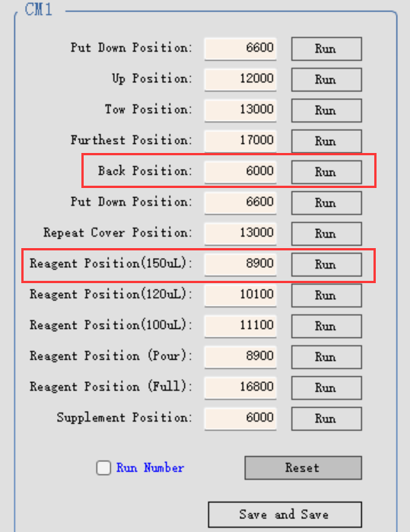
4. Position calibration
4.7 Slide staining unit, CM position calibration
4.7.3 calibrate the 150uL dispense position.
step 1. click “Reset(Z)” under “Arm” page to move the probe to Z home position to prevent the collision.
step 2. return “CM”page, click“Run” of the Back Position, wait until the running is done.
step 3. click” Run”of the “Reagent Position(150uL)”, wait until running is done.

Slide 35
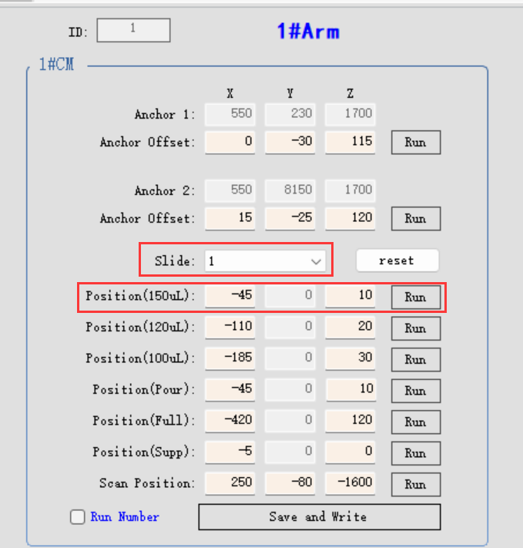
4. Position calibration
4.7 Slide staining unit, CM position calibration
4.7.3 calibrate the 150uL dispense position.
step 4. return “1#Arm” page. click “Run” of the “Position（150uL)”.
step 5. adjust X, Z value to move the probe until it meets the calibration position requirement.
refer to 4.7 calibration position requirement
step 6. select “15” under “Slide” down-list, repeat step 4 and step 5 to finish position 15 dispense position calibration. suggest usig the #15 slide position, easy to check the position.
step 7. click “Save and Write “ to save the calibration parameters.
Refer the above steps to finish the 150uL dispense position calibration of CM2 and CM3, CM4.
Notes:
Step 6: but you also need to check the despense position of #1 slide position meet the “4.7 calibration position requirement”, maybe need to take a compromise value between #1 and #15 slide position

Slide 36
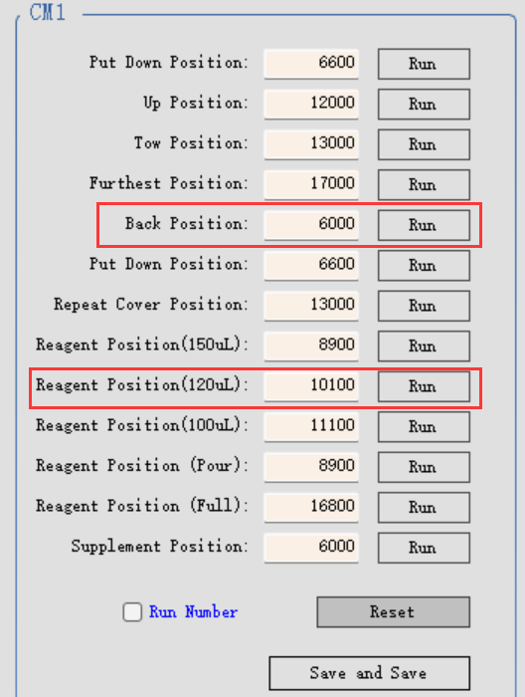
4. Position calibration
4.7 Slide staining unit, CM position calibration
4.7.4 calibrate the 120uL dispense position.
step 1. click “Reset(Z)” under “Arm” page to move the probe to Z home position to prevent the collision.
step 2. return “CM”page, click“Run” of the Back Position, wait until the running is done.
step 3. click” Run”of the “Reagent Position(120uL)”, wait until running is done.

Slide 37
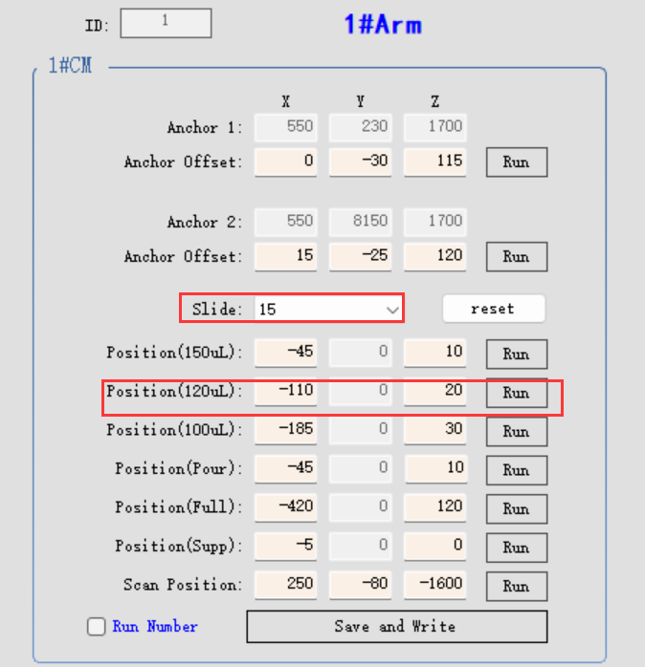
4. Position calibration
4.7 Slide staining unit, CM position calibration
4.7.4 calibrate the 120uL dispense position.
step 4. return “Arm” page. click “Run” of the “Position（120uL)” for 1# slide.
step 5. adjust X, Z value to move the probe until it meets the calibration position requirement.
refer to 4.7 calibration position requirement
step 6. select “15” under “Slide” down-list, repeat step 4 and step 5 to finish position 15 dispense position calibration.suggest usig the #15 slide position, easy to check the position.
step 7. click “Save and Write “ to save the calibration parameters.
Refer the above steps to finish the 120uL dispense position calibration of CM2 and CM3, CM4.

Slide 38
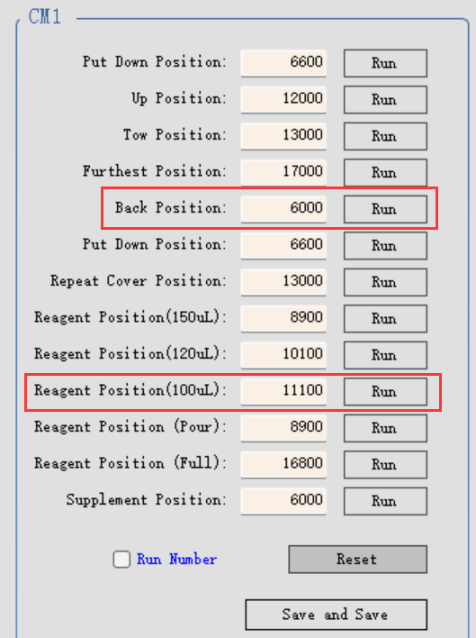
4. Position calibration
4.7 Slide staining unit, CM position calibration
4.7.5 calibrate the 100uL dispense position.
step 1. click “Reset(Z)” under “Arm” page to move the probe to Z home position to prevent the collision.
step 2. return “Coremodule”page, click“Run” of the Back Position, wait until the running is done.
step 3. click” Run”of the “Reagent Position(100uL)”, wait until running is done.

Slide 39
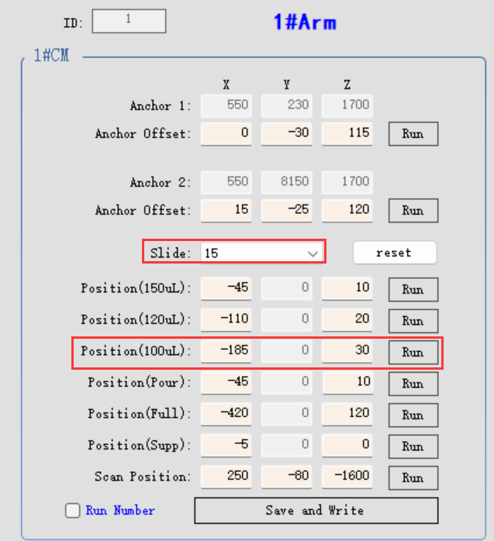
4. Position calibration
4.7 Slide staining unit, CM position calibration
4.7.5 calibrate the 100uL dispense position.
step 4. return “Arm” page. click “Run” of the “Position（100uL)” for 1# slide.
step 5. adjust X, Z value to move the probe until it meets the calibration position requirement.
refer to 4.7 calibration position requirement
step 6. select “15” under “Slide” down-list, repeat step 4 and step 5 to finish position 15 dispense position calibration. suggest usig the #15 slide position, easy to check the position.
step 7. click “Save and Write “ to save the calibration parameters.
Refer the above steps to finish the 100uL dispense position calibration of CM2 and CM3, CM4.

Slide 40
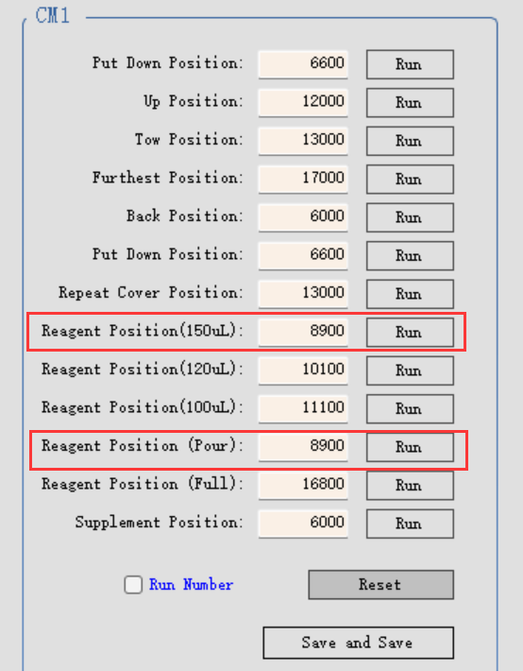
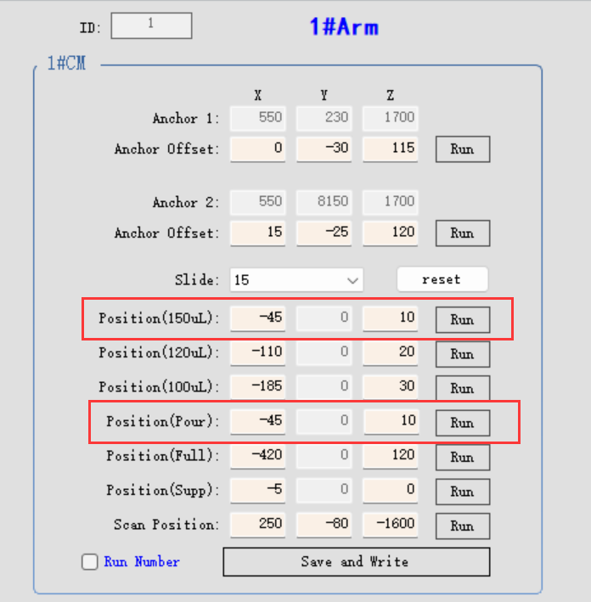
4. Position calibration
4.7 Slide staining unit, CM position calibration
4.7.6 the pour position, please keep the parameters same as the 150uL dispense position.

Slide 41
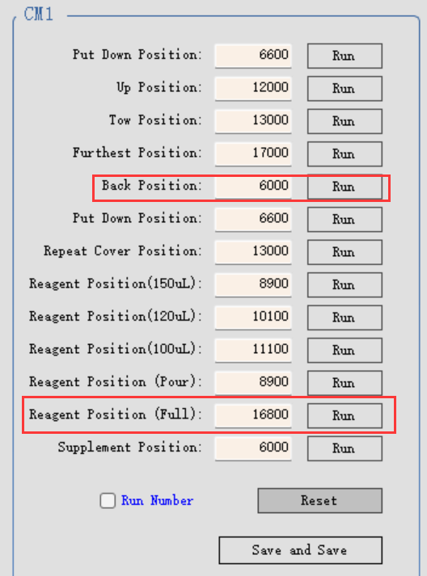
4. Position calibration
4.7 Slide staining unit, CM position calibration
4.7.7 Full-open position checking
step 1. click “Reset(Z)” under “Arm” page to move the probe to Z home position to prevent the collision.
step 2. return “CM”page, click“Run” of the Back Position, wait until the running is done.
step 3. click” Run”of the “Reagent Position(Full)”, wait until running is done.
step 4. refer to step 2 and step 3, perform same operation for CM2 and CM3,CM4.
step 5. check to make sure the pull-push rods will not happen collision.
step 6. if there is a collision or abnormal sound , adjust “Reagent position(Full)” parameters,such as change it from 16800 to 16700, and then “Save” it.
For the Arm page, no need to adjust the values of the Full position.
Notes:
客户培训，全开位可以不包括，工厂出货已经校准好，不会有异常。 for arm1， the default value -420, 120 ; for arm2, the default value 440, 110

Slide 42
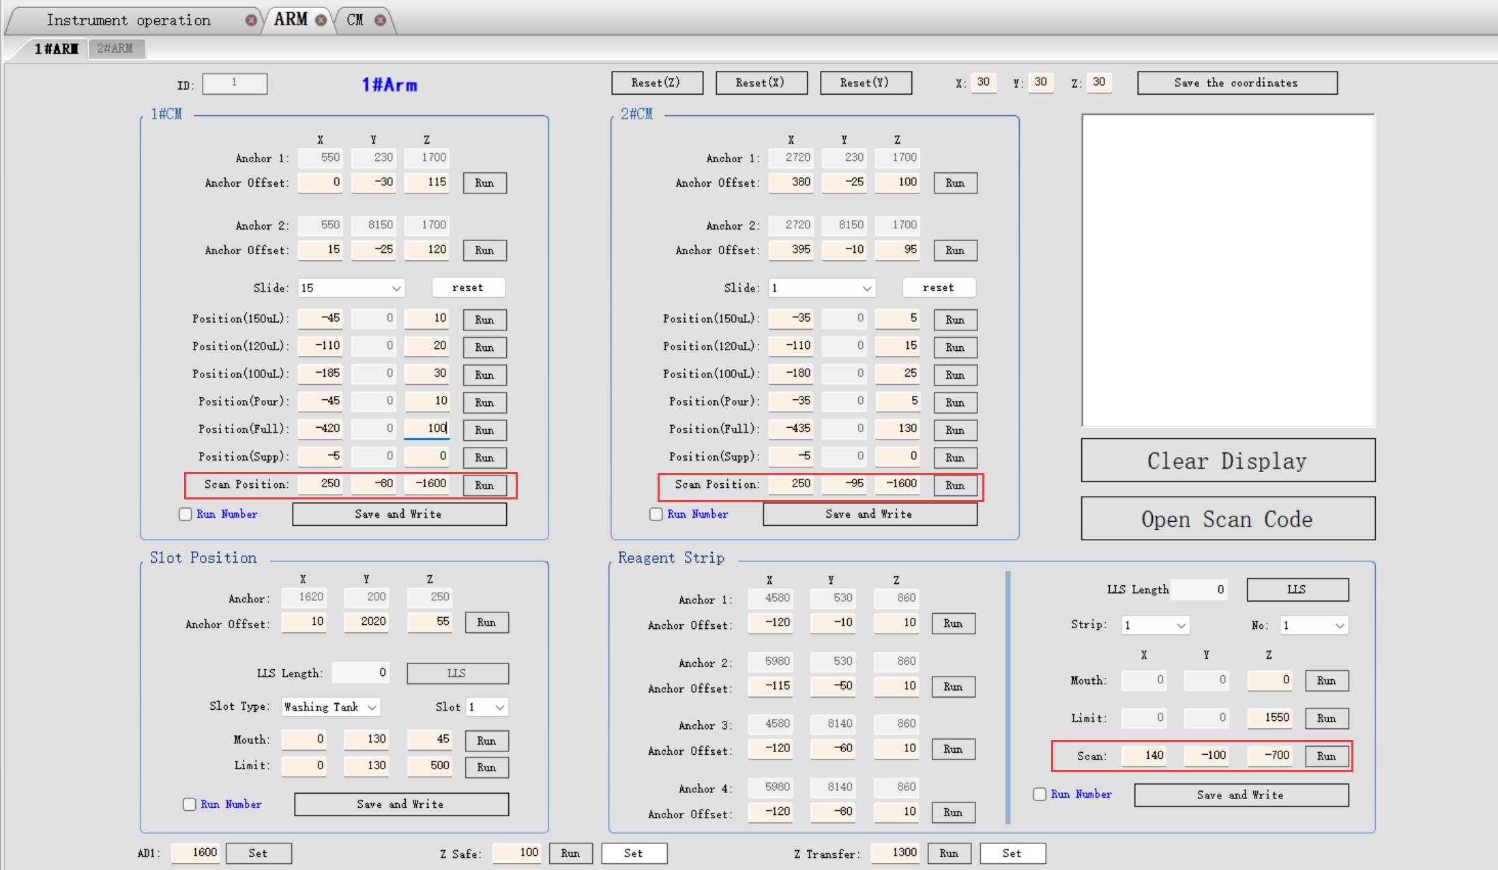
4. Position calibration
4.8 Scan position calibration
4.8.1 Click “Run” of the CM1 “Put down position” under CM page,
4.8.2 return back to 1#ARM page, click “Run” of the “Scan position”, then click “Open Scan Code” to check if the scanner can get the code.
4.8.3 If can not, please adjust the X, Y,Z value of the scan position.

Slide 43
PART 4
Regularly clean and maintenance

Slide 44
Regularly clean and maintenance
Task
Daily – when the daily work starts
Check that the low concentration waste liquid container is not more than half full *
Check that the large reagent container should be more than half full and filled with the correct reagent*
Daily - at the end of daily work
Clean the liquid cover
Weekly
Clean the slide staining units *
Check the liquid cover clamps
Restart the processing module
Clean the aspirating probe of the robotic arm | r
Check washing area and mixing station, clean or replace if necessary
Clean the instrument surface, instrument door and instrument cover
Clean scanning module
Monthly
Clean the large reagent container rack
Replace the mixing station
Clean the large reagent container
Clean the low concentration waste liquid container
Clean slide trays
Clean slide label printer
Check the syringes
Wash the aspirating probes by the reagent cleaning kit
When necessary or least a year
Replace the aspirating probe of the robotic arm
Replace the syringe
Please inform the laboratory staff perform the regularly clean and maintenance task in order to maximize the performance of the instrument and extend the service life of the instrument.

Slide 45
THANKS!
汇报人： ####
部 门：###

