Slide 1

IHC Staining Guide
Principle and Method
Jackson Liu
Dec. 2025

Slide 2
01
Introduction of IHC
CONTENTS
02
Principle and Method

Slide 3
Introduction of IHC

Slide 4

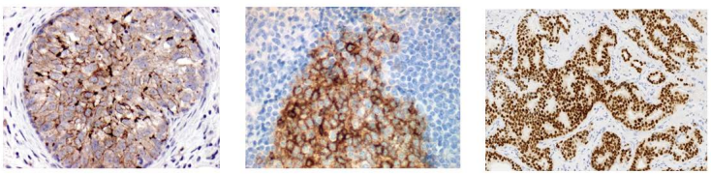
What is IHC ?
Definition：Immunohistochemistry ( IHC) is a branch of histochemistry, It refers to a new technology that uses specific antibodies and chromogenic reagent to conduct qualitative, positional and quantitative determinations of corresponding antigens in tissue cells through antigen-antibody reactions and histochemical color reactions.
HER2
CD10
ER

Slide 5
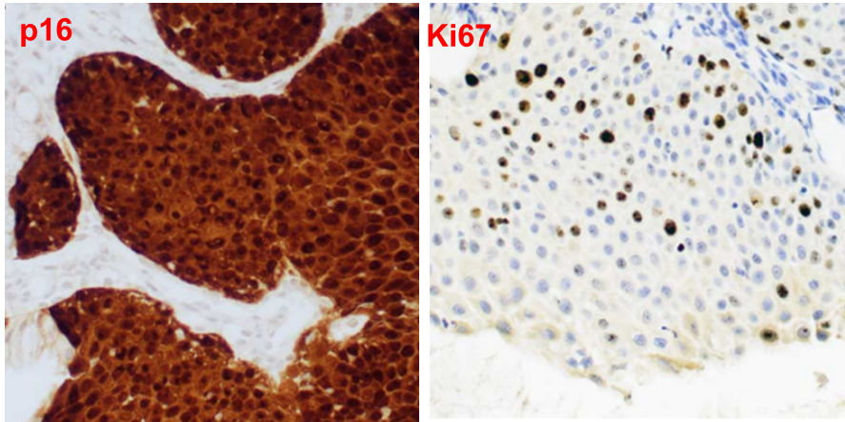
What is IHC ?
Clinical significance of IHC detection
  Identifying the nature of the lesion, detecting tiny lesions;
  Exploring the origin or differentiation phenotype of the tumor, determining the tumor stage, guiding treatment and prognosis;
  Assisting in disease diagnosis and classification, identifying the cause of infection, etc.
The IHC detection of cervical tissue showed that it was a lesion of stage CIN3, and surgical removal was necessary.

Slide 6
Principle and Method

Slide 7
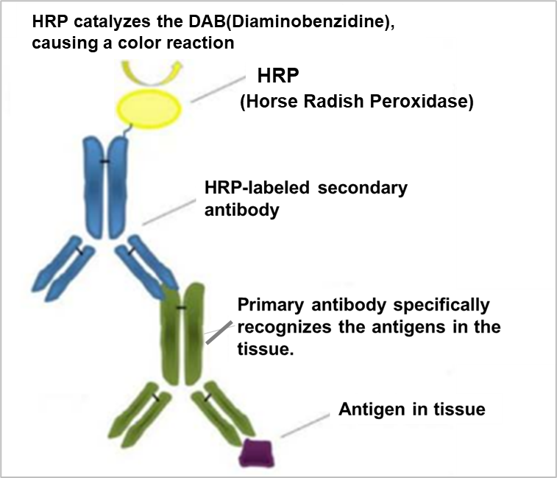
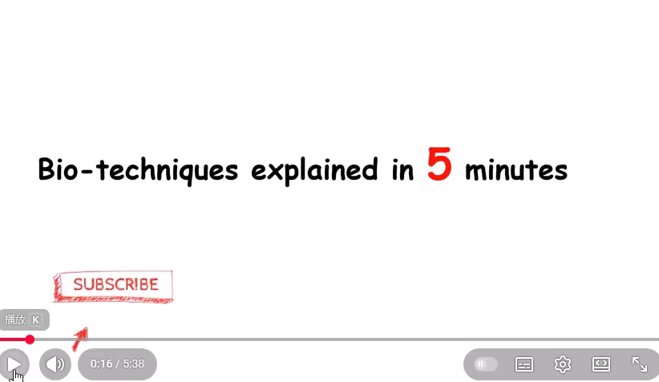
Principle of IHC
The specific primary antibody combines with the antigens in the tissue cells, and then the secondary antibody combines with the primary antibody. the substrate chromogenic agent is catalyzed by the enzyme labeled on the secondary antibody to produce a color reaction, thereby achieving a macroscopic visible result .

Slide 8
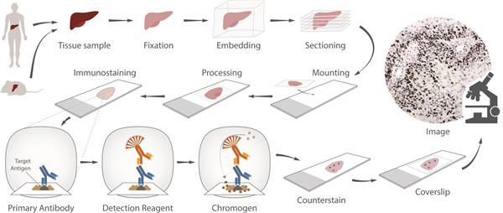
IHC technique process
IHC technique process diagram

Slide 9
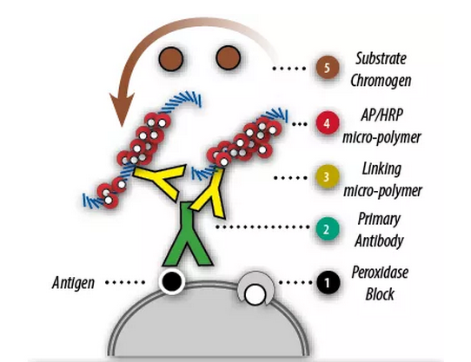
IHC staining process diagram
Dewaxing & Hydration
Antigen Retrieval
Peroxidase Block
Primary Antibody
Post Linker
Dehydration & Sealing
Counterstain
DAB Chromogen
HRP micro-polymer
Manual or machine operational two-step method

Slide 10

IHC staining manual operation steps
Dewaxing & Hydration
wax
tissue slice
CELNOVTE
Tumor tissue slide
组织标本
Dewax：Remove the paraffin from the tissue to ensure that the reagents can enter the tissue and participate in the reaction.
Hydration：Restore the tissue to its natural state of normal cells.

Slide 11
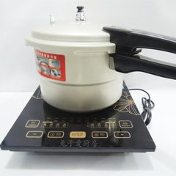

IHC staining manual operation steps
Dewaxing & Hydration
Antigen Retrieval
Use the appropriate retrieval solution for antigen retrieval . use a pressure cooker for 3 minutes to expose the epitope.
CELNOVTE
Tumor tissue slide
组织标本

Slide 12
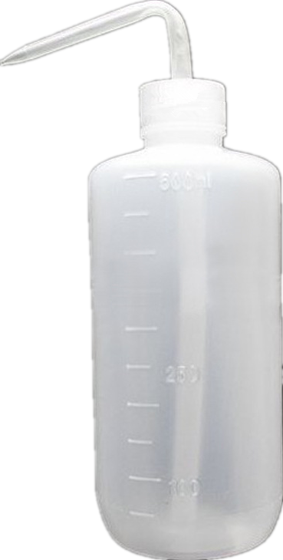
IHC staining manual operation steps
Dewaxing & Hydration
Antigen Retrieval
washing
DI water
CELNOVTE
Tumor tissue slide
组织标本
After the antigen retrieval , Wash three times with DI water, for 3 minutes each time.

Slide 13
IHC staining manual operation steps
Dewaxing & Hydration
Antigen Retrieval
TBS cleaning solution
washing
CELNOVTE
Tumor tissue slide
组织标本
Use immunohistochemical pap-pen to enclose the tissue, then rinse and soak the tissue with TBS cleaning solution once, for 3 minutes each time.

Slide 14
IHC staining manual operation steps
Dewaxing & Hydration
Peroxidase Block Reagents
Antigen Retrieval
washing
Peroxidase Block
CELNOVTE
Tumor tissue slide
组织标本
Add Peroxidase block reagents, incubating at room temperature for 5 minutes to block the endogenous peroxidase present in the tissue.

Slide 15
IHC staining manual operation steps
Dewaxing & Hydration
Antigen Retrieval
TBS cleaning solution
washing
Peroxidase Block
washing
CELNOVTE
Tumor tissue slide
组织标本
Rinse and soak the tissue with TBS cleaning solution 3 times, for 3 minutes each time.

Slide 16
IHC staining manual operation steps
Dewaxing & Hydration
CEA
antibody
Antigen Retrieval
washing
Peroxidase Block
washing
Add Primary Antibody
CELNOVTE
Tumor tissue slide
组织标本
Add antibody reagent；CEA antibody (primary antibody), incubating at room temperature for 60 minutes.

Slide 17
IHC staining manual operation steps
Dewaxing & Hydration
Antigen Retrieval
washing
Peroxidase Block
TBS cleaning solution
washing
Add Primary Antibody
washing
CELNOVTE
Tumor tissue slide
组织标本
Rinse and soak the tissue with TBS cleaning solution 3 times, for 3 minutes each time.

Slide 18
IHC staining manual operation steps
Dewaxing & Hydration
Goat anti-Mouse/Rabbit
HRP polymer
Antigen Retrieval
washing
Peroxidase Block
washing
Add Primary Antibody
washing
Add Secondary Antibody
CELNOVTE
Tumor tissue slide
组织标本
Add primary antibody-HRP polymer，incubating at room temperature for 30 minutes.

Slide 19
IHC staining manual operation steps
Dewaxing & Hydration
Antigen Retrieval
washing
Peroxidase Block
TBS cleaning solution
washing
Add Primary Antibody
washing
Add Secondary Antibody
washing
CELNOVTE
Tumor tissue slide
组织标本
Rinse and soak the tissue with TBS cleaning solution 3 times, for 3 minutes each time.

Slide 20
IHC staining manual operation steps
Dewaxing & Hydration
Antigen Retrieval
washing
DAB substrate
Peroxidase Block
washing
Add Primary Antibody
washing
Add Secondary Antibody
washing
Add DAB substrate，chromogenic reaction
CELNOVTE
Tumor tissue slide
Add DAB substrate, carry out chromogenic reaction for 5 to 8 minutes.
组织标本

Slide 21

IHC staining manual operation steps
Dewaxing & Hydration
Antigen Retrieval
washing
Peroxidase Block
DI water
washing
Add Primary Antibody
washing
Add Secondary Antibody
washing
CELNOVTE
Tumor tissue slide
Add DAB substrate，chromogenic reaction
组织标本
washing
Rinse and soak the tissue with DI water 3 times, for 3 minutes each time, remove the excess substrate.

Slide 22
IHC staining manual operation steps
Dewaxing & Hydration
Antigen Retrieval
Hematoxylin
washing
Hematoxylin
Peroxidase Block
washing
Add Primary Antibody
washing
Add Secondary Antibody
washing
Add DAB substrate，chromogenic reaction
washing
CELNOVTE
Tumor tissue slide
Add Hematoxylin, Counterstain
组织标本
Add hematoxylin, incubate for 1 minute to stain the cell nuclei, making it easier to observe the tissue morphology.

Slide 23

IHC staining manual operation steps
Dewaxing & Hydration
Antigen Retrieval
washing
Tap water
Peroxidase Block
washing
Add Primary Antibody
washing
Add Secondary Antibody
washing
Add DAB substrate，chromogenic reaction
CELNOVTE
Tumor tissue slide
washing
组织标本
Add Hematoxylin, Counterstain
washing
Rinse thoroughly with tap water to remove the excess hematoxylin and make it turn blue, the cell nuclei will appear "blue".

Slide 24
IHC staining manual operation steps
Dewaxing & Hydration
Mounting medium
Antigen Retrieval
washing
Peroxidase Block
washing
Add Primary Antibody
washing
Add Secondary Antibody
washing
Add DAB substrate，chromogenic reaction
washing
CELNOVTE
Tumor tissue slide
Add Hematoxylin, Counterstain
组织标本
washing
Dehydration & Sealing
Sealing with mounting medium and coverslip.

Slide 25
THANKS!
CELNOVTE
Dec.2025

