Slide 1

CNT300&CNT330
Basic Operation

Slide 2

1. Check before operation and startup
Steps
2. Check the reagent and protocol
3. Setting up slides
4. Loading reagents
5. Loading slides
6. Start the experiment
7. Finish the experiment
8. How to refill the primary antibody
9. Operation cautions
10. Regularly maintenance operation
11. Troubleshooting guide

Slide 3
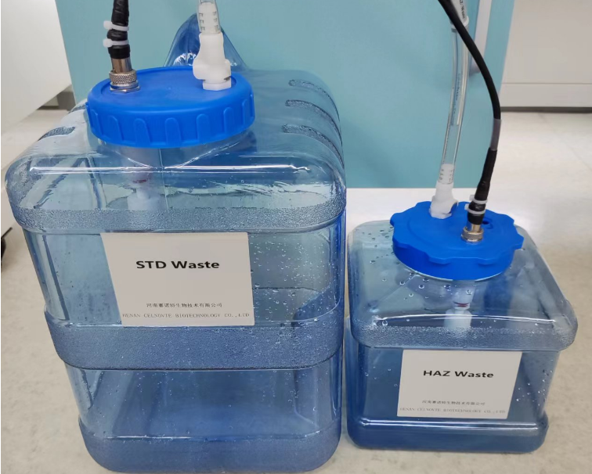
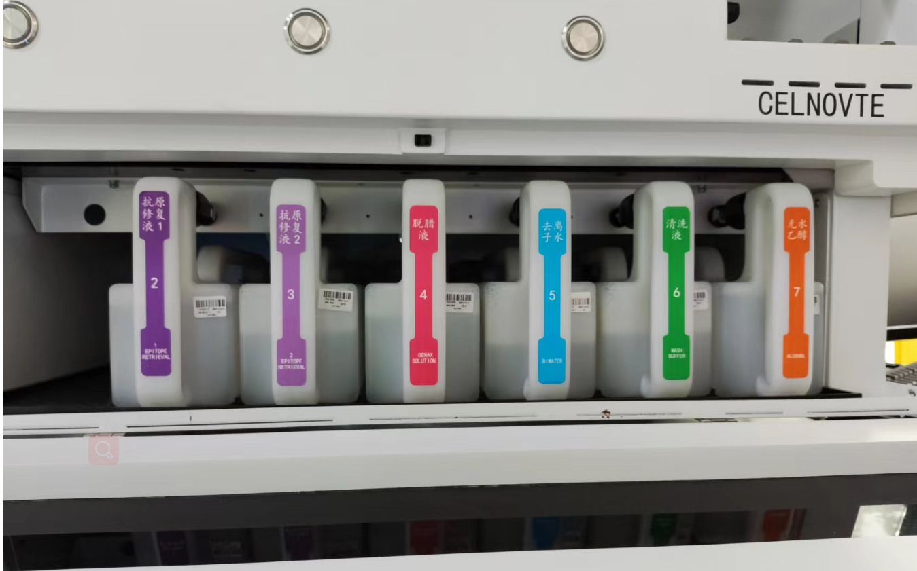
1. Check before operation and startup
1.1 Check the waste containers (standard & hazardous) are no more than half full.
1.2 Check the large reagent containers are at least half full, with correct reagent.
Please note: For the first usage, or stop one week or more, before starting a run, please fill the system with the large reagent solutions. Access it with “Service”account, click in turn “system management”--“maintenance”--“Test”--“Framework”, select “ALL”under “Washing Initialization”,then click “Start” to fill the system. After filling, please continue the below steps.

Slide 4
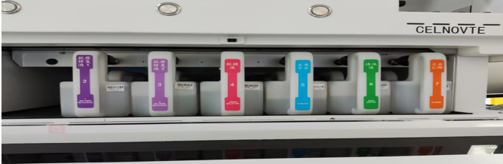
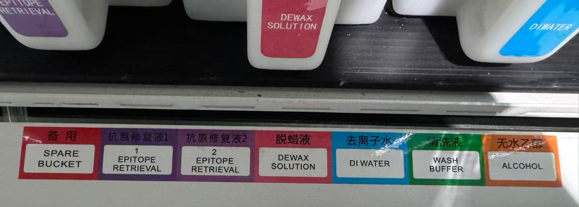
1. Check before operation and startup
ER1: Acidic Antigen Retrieval Solution, pH 6.0
ER2: Alkaline Antigen Retrieval Solution, pH 9.0

Slide 5
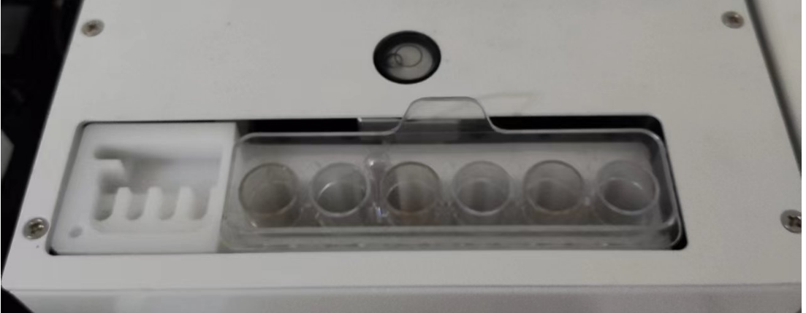
1. Check before operation and startup
1.3 Check the washing area and mixing station, clean or replace if necessary. Check and empty when there is liquid in the six plastic tubes of the mixing station when last experiment ends abnormally. Ensure the mixing station is empty before loading a new experiment.

Slide 6

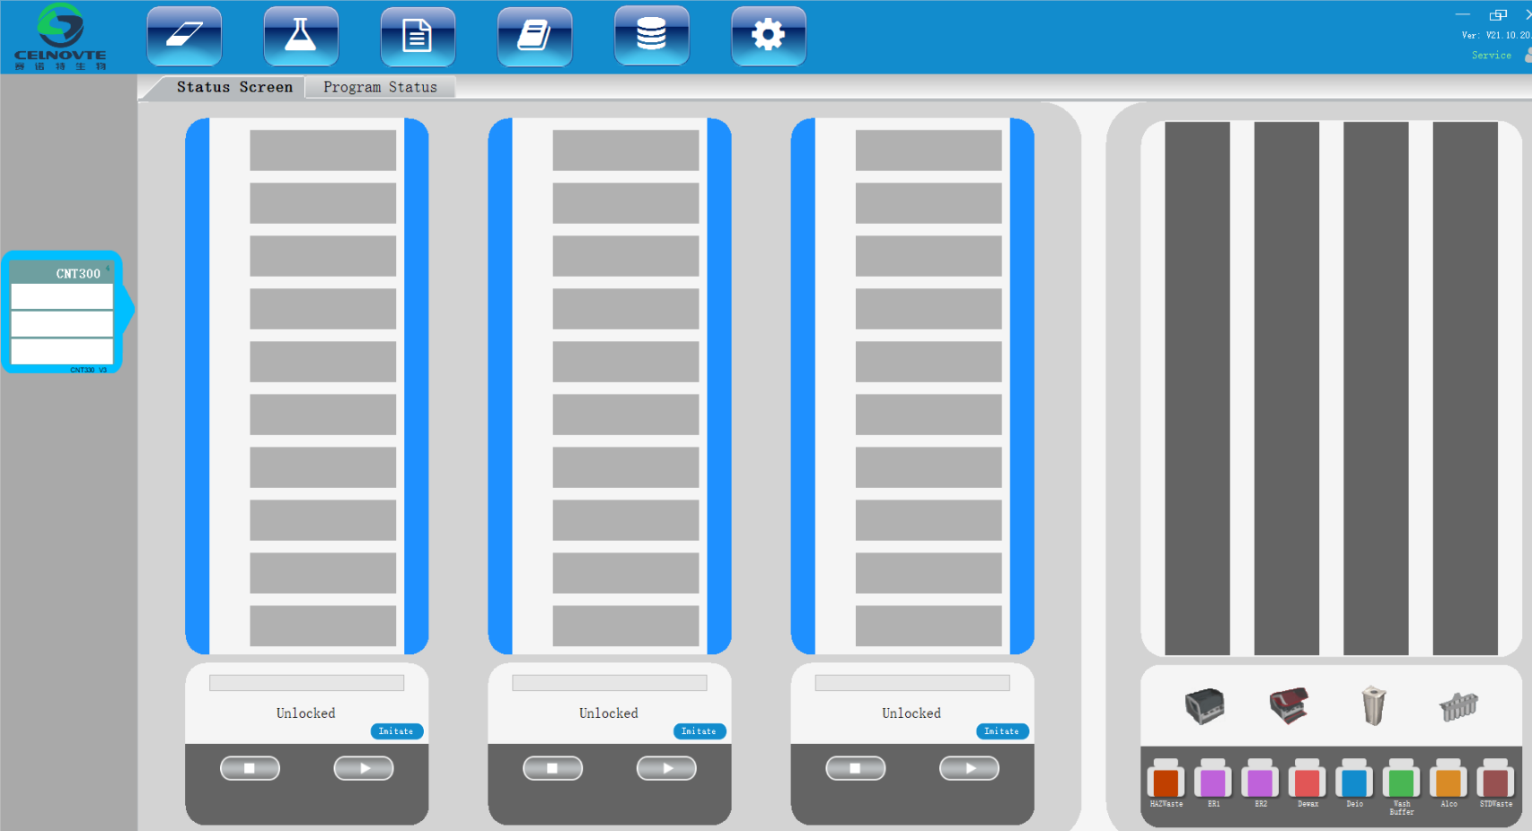
1. Check before operation and startup
1.4 Check the slide lable printer, ensure the lable is enough, then power on it.
1.5 Power on the host computer ( For the first run,strongly recommand you check if the computer time is right before opening the client software. If not, please adjust the time zone, then restart the computer) , open the client software after accessing the desktop.
1.6 Power on the processing module, waiting about 3 minutes unitl the processing module initialization is done. (Please make sure the device cover is close before powering it on.)
1.7 Check the “Status” screen on the client software to ensure there are no processing module notifications. Rectify before attempting to run any slides.

Slide 7
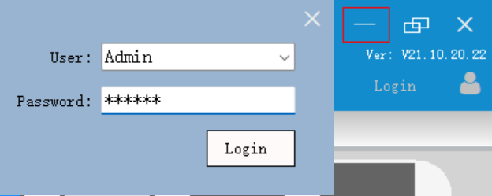


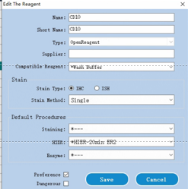
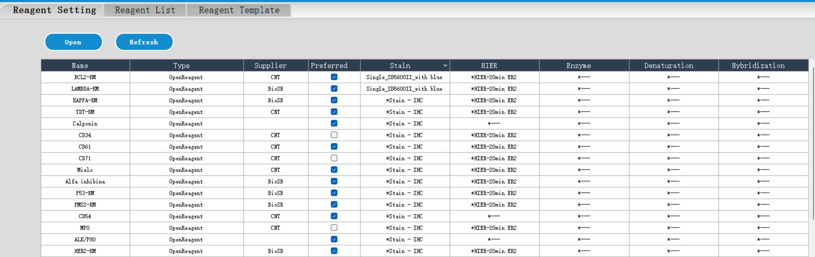
2. Check Reagents and Protocols
Pre-load into the client software with protocols and reagents validated.
1. Login the software,default password”123”
2. Enter Reagent Management page
3. Click “Add” button
4. Edit the reagent information, input the name of the primary antibody. Both the name and short name must be filled in.
Default staining protocol (**** Hospital).
Retrieval method (select "Default HIER Protocol" as recommended by the antibody, retrieval time 20 minutes. For example, the EDTA alkaline retrieval procedure is: *Antigen Retrieval ER2 20min).
Notes:
This part is all about making sure our reagents are valid and our protocols are suitable. Let’s break it down step by step.
First, log in to the client software. The default password is “123”—you can change it later for security. Once logged in, go to the “Reagent Management” page and click the “Add” button to edit reagent information. For each reagent, especially the primary antibody, you must fill in both the full name and the short name (e.g., full name “CD10”, short name “CD10”).
Next, set the default staining protocol. We use the protocol from “**** Hospital” as the base. For the antigen retrieval method, we recommend selecting “Default HIER Protocol” as suggested by the antibody, with a retrieval time of 20 minutes. A common example is the EDTA alkaline retrieval procedure: “Antigen Retrieval ER2 20min”. You can find this in the reagent settings.

Slide 8
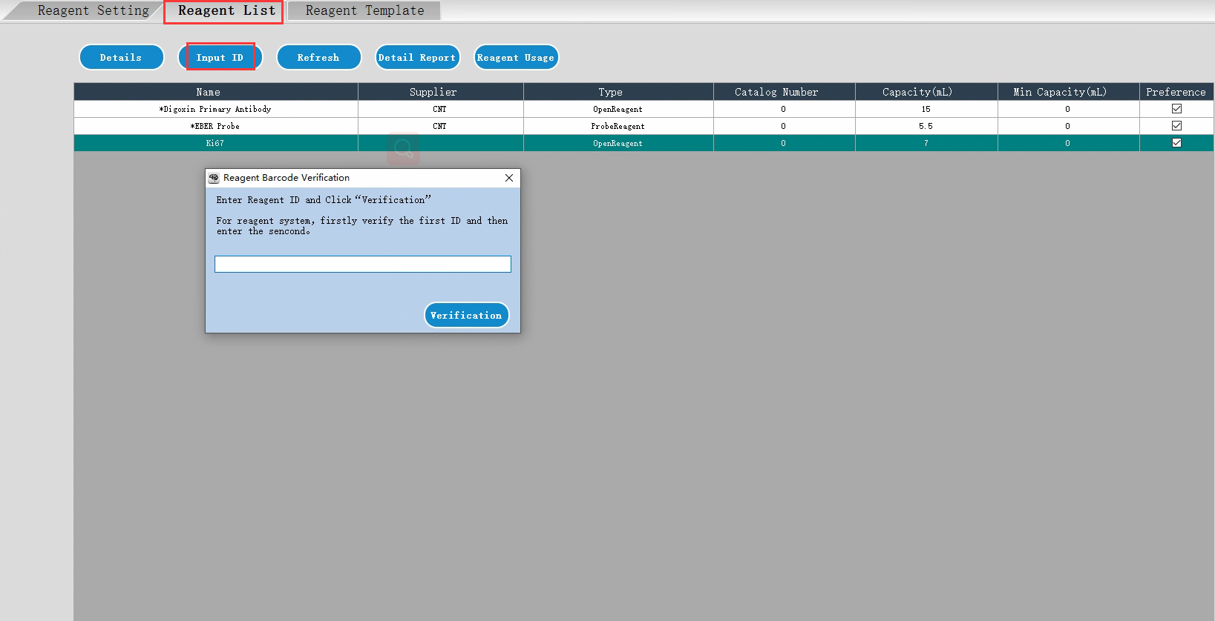
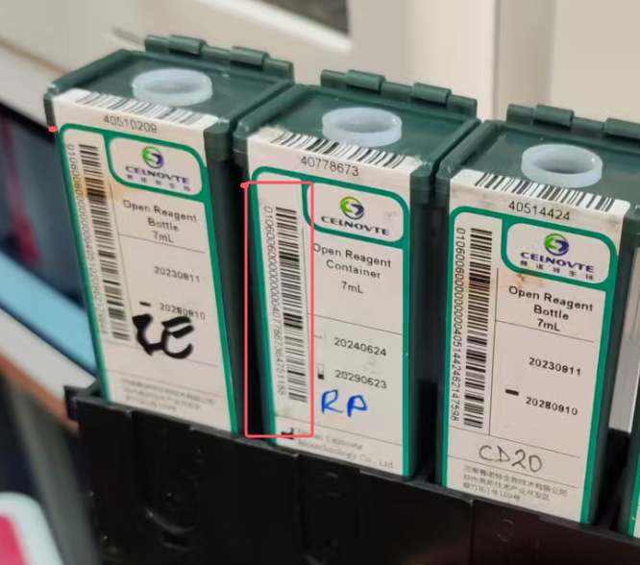
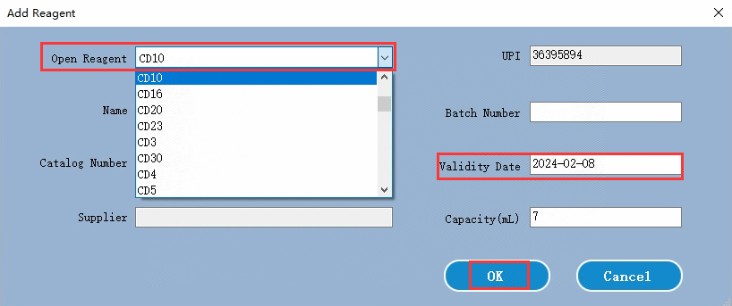
2. Check Reagents and Protocols
Primary antibody bind with open container:
Enter “Reagent List” page,click Input ID,Manually input the long barcode or use the scanner directly scan the registration code on the open container.
Select the antibody from the drop-list,input the validity information, then click “OK” to save the settings.
After binding, please mark the primary antibody name on the open container by the mark pen.
Notes:
Then, bind the primary antibody to the open container. Go to the “Reagent List” page, click “Input ID”, and either manually enter the long barcode on the open container or scan it with a scanner. Then select the corresponding antibody from the drop-down list, input its validity period, and click “OK” to save. After binding, use a marker pen to write the primary antibody’s name on the open container—this prevents mix-ups later.

Slide 9
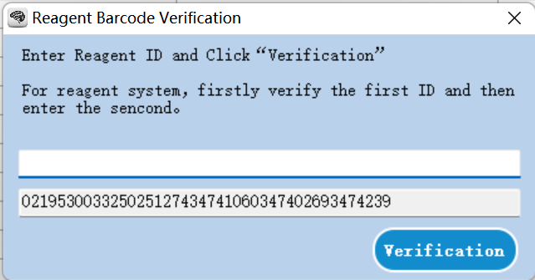
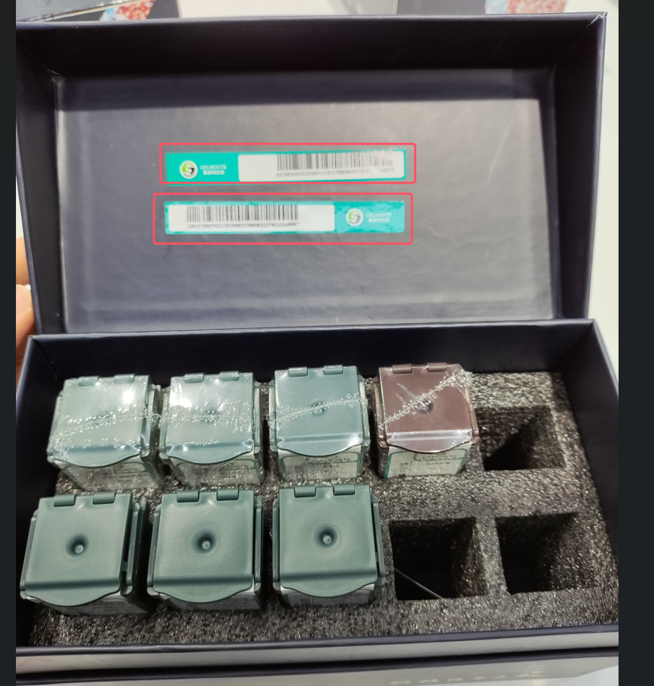
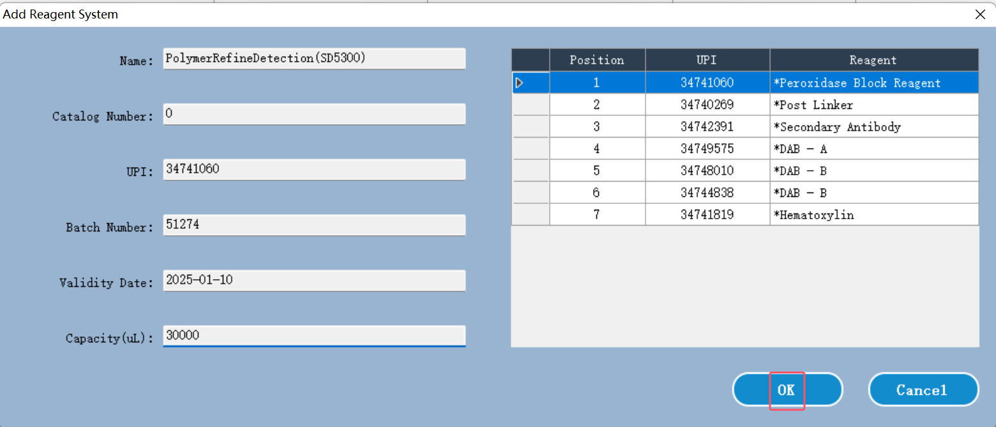
2. Check Reagents and Protocols
Add detection system reagent kit into the system.
Notes:
We also need to add the detection system reagent kit to the system. Go to “Add Reagent System”, select the kit (e.g., SD5300). Then verify the reagent barcode—first verify the first ID, then the second one—to ensure the kit is recognized correctly.
测试SD5300条码， 扫码操作视频。
021953003325025127434741060347402693474239
1213474957534748010347448383474181943958

Slide 10

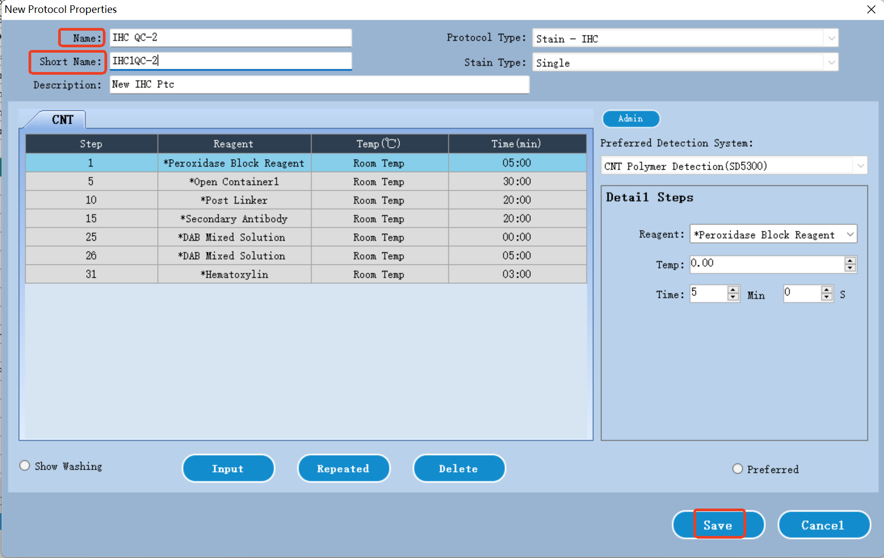
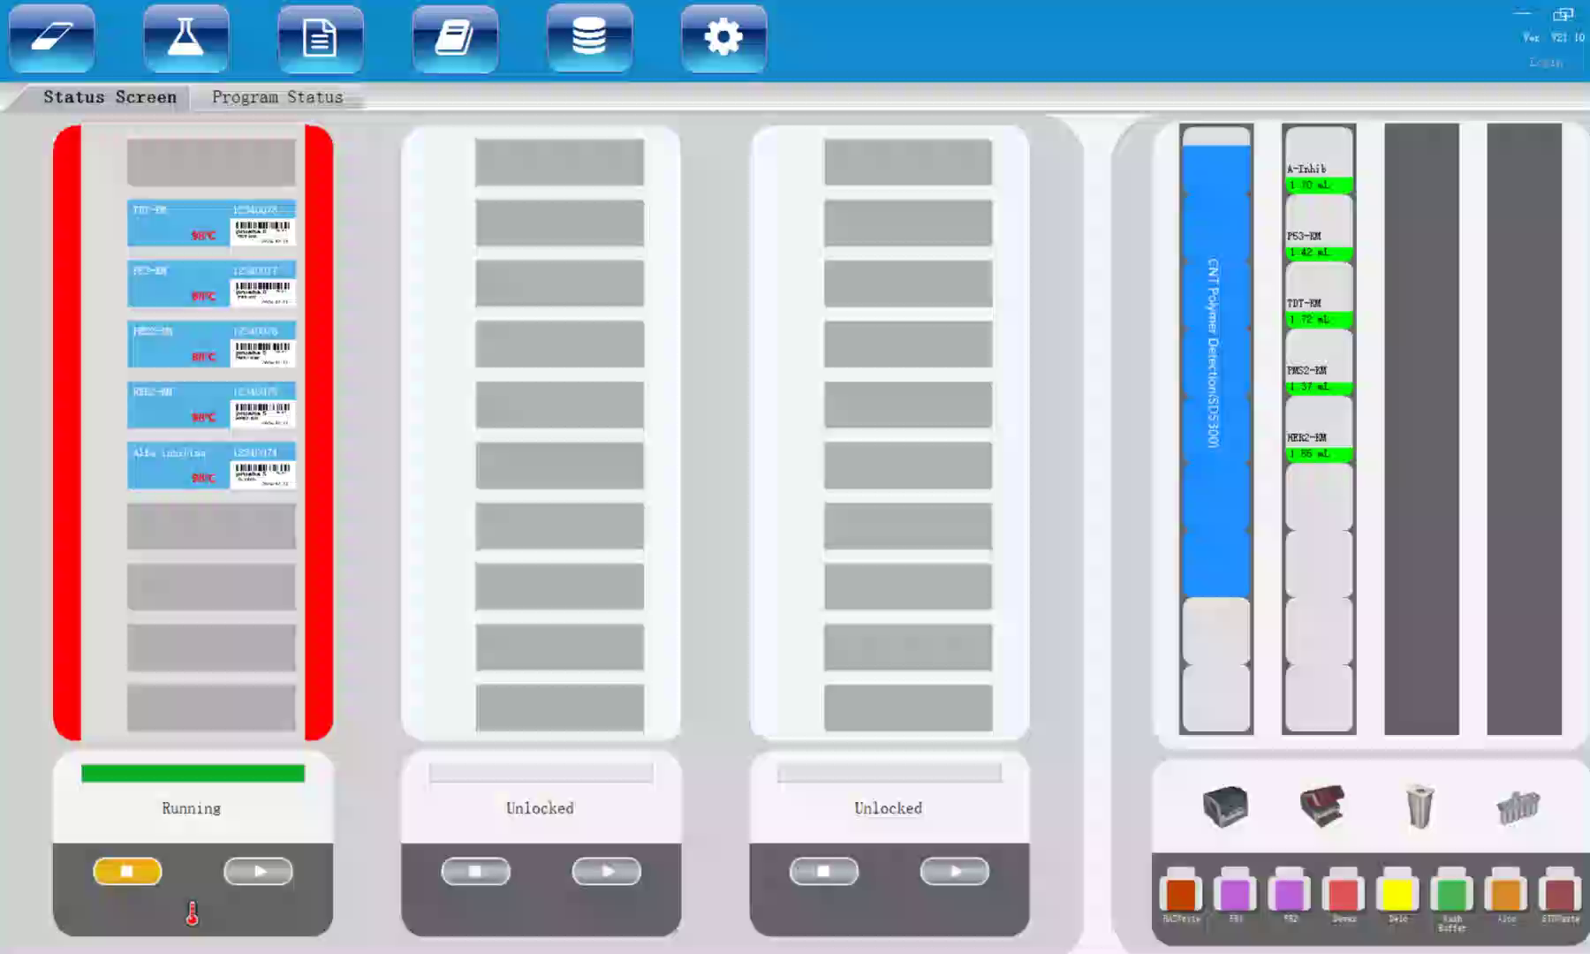
2.Check Reagents and Protocols
Goto “Protocol management ” page. Check if the built-in protocol whose name start with a asterisk(*) is suitable for your experiment. If not, you can click “Add” to set a new protocol or click “Copy” to adjust the built-in protocol to generate a new protocol.
Adjust the Name and short name and relative paramters (such as incubation time), then click “Save” to generate a new one.
Notes:
Finally, check the built-in protocols in the “Protocol Management” page. Protocols starting with an asterisk (*) are pre-set. If they don’t fit your experiment, click “Add” to create a new one or “Copy” to modify the built-in one. For example, if you need to adjust the incubation time, edit the “Temp” and “Time” parameters, then save the new protocol with a clear name (e.g., “IHC QC-2”).
Any questions so far? Great. Now, let’s talk about setting up slides.

Slide 11
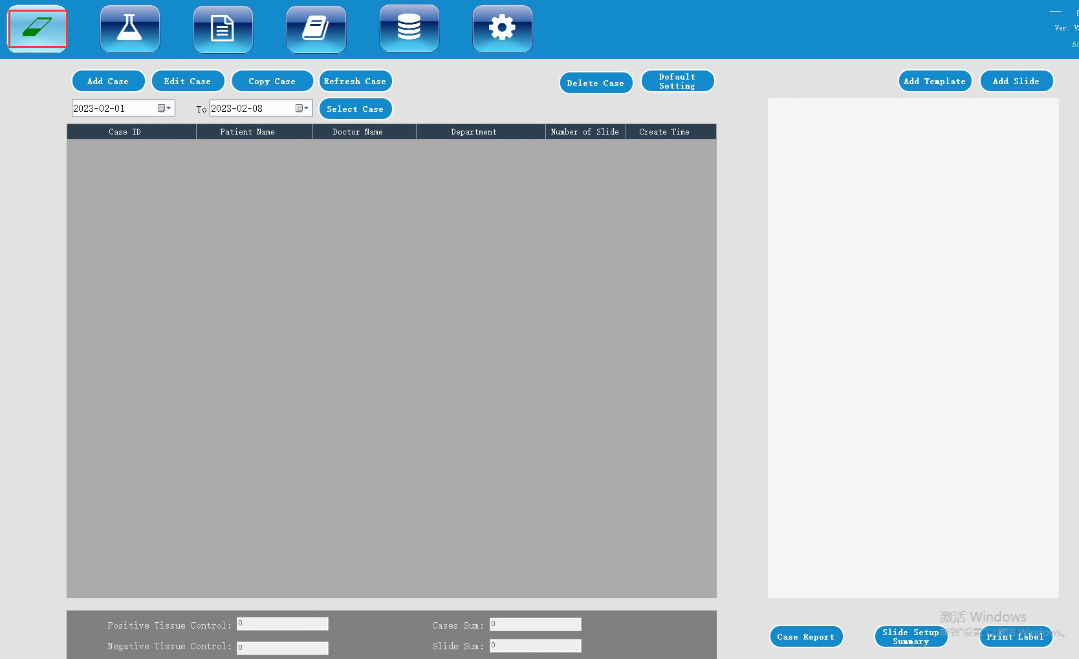
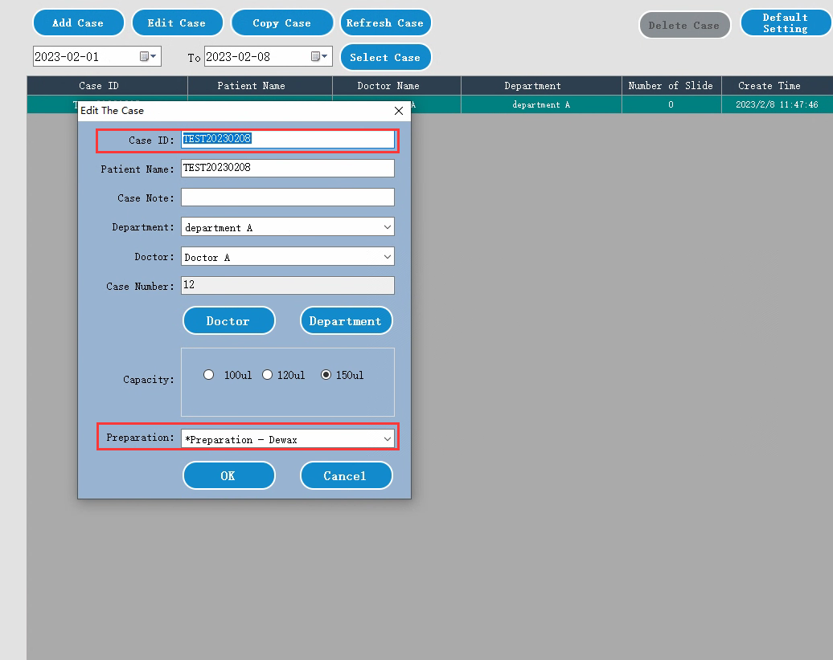
3. Setting up slides
3.1 Goto “Slide Management ” page. Click “Add Case” to create a new case. Then input the “Case ID” and set the “ Preparation” and other details, Click “OK” .
Notes:
Proper slide setup ensures that each sample is tracked correctly. There are 3 main steps here.

Slide 12
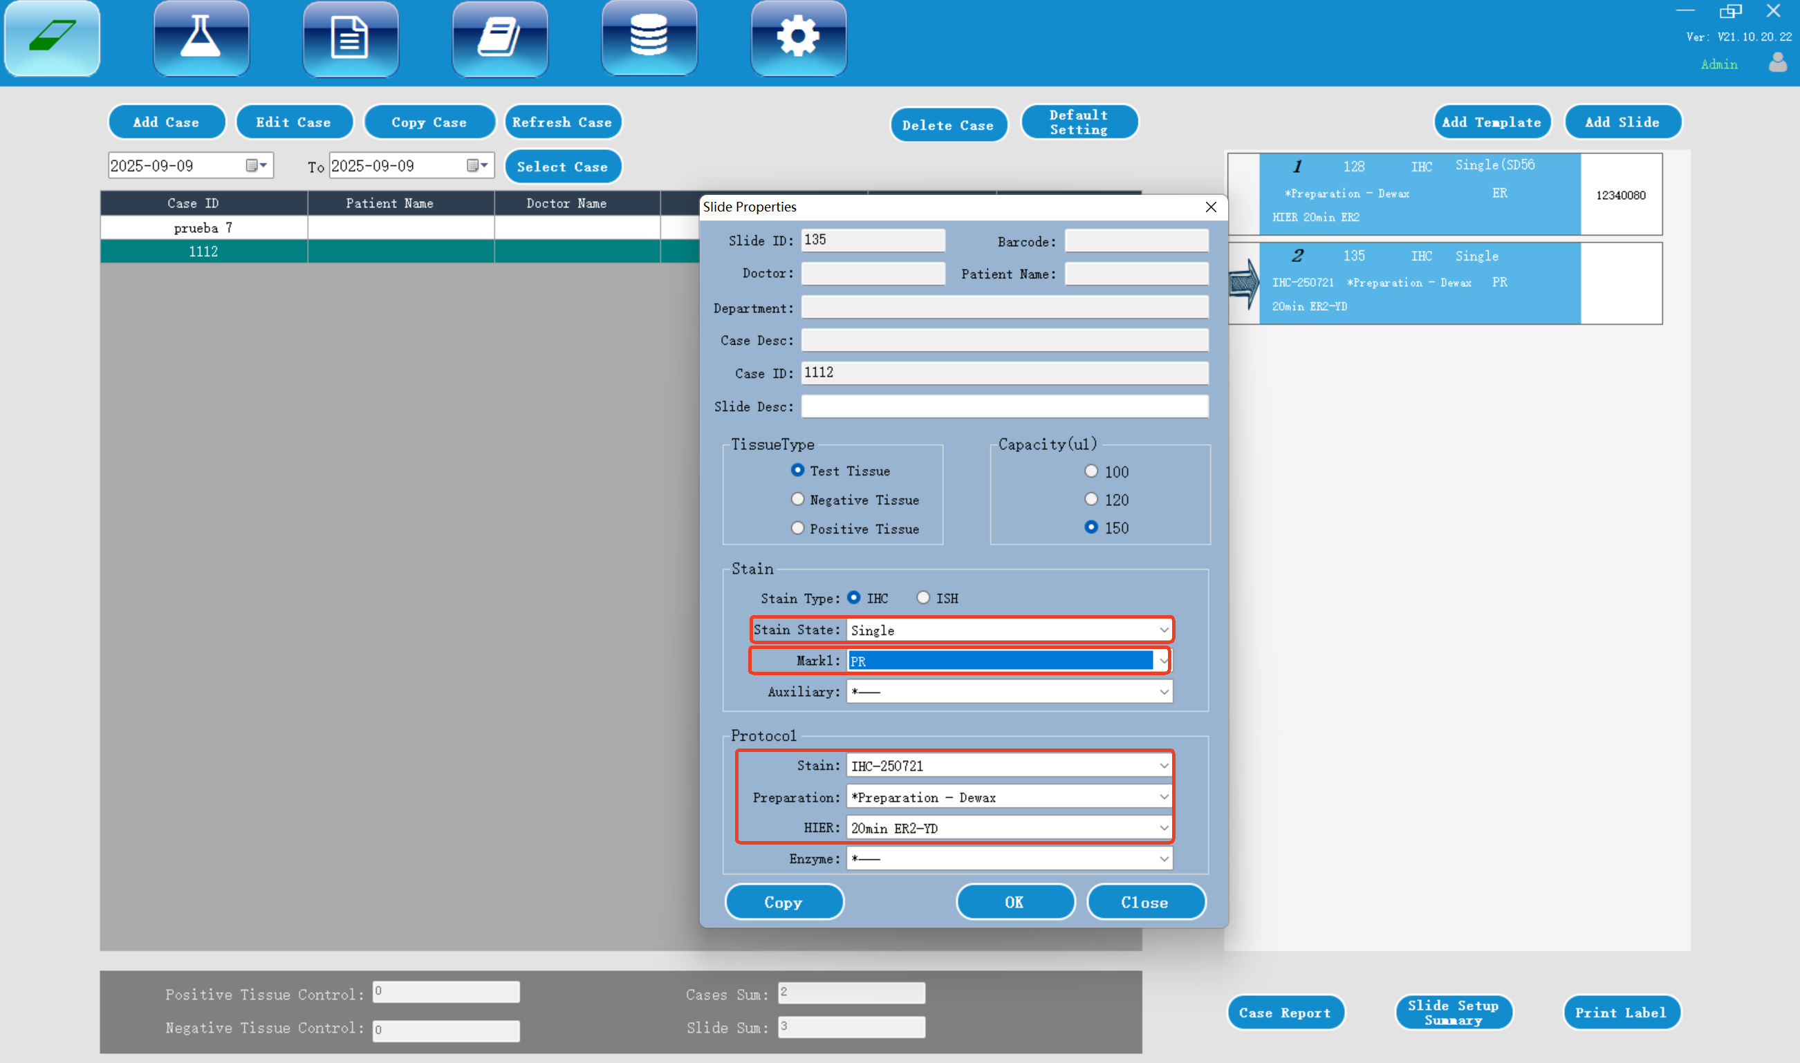
3. Setting up slides
3.2 Select one case added, then click “Add Slide” on the upper right. Select primary antibody from the “Mark1”option and set other parameters according to the protocol you are going to use. Click “Add Slide” to create a slide. Repeat to add more.
Notes:
Second, add slides to the case. Select the case you just created, then click “Add Slide” in the upper right corner. From the “Mark1” option, choose the primary antibody (e.g., PR, Ki67) and set other parameters according to your protocol: select “Stain Type” (IHC or ISH), “Stain State” (Single), and confirm the “Preparation” and “HIER” settings. Click “Add Slide” to create one slide—repeat this to add more slides for the same case.

Slide 13
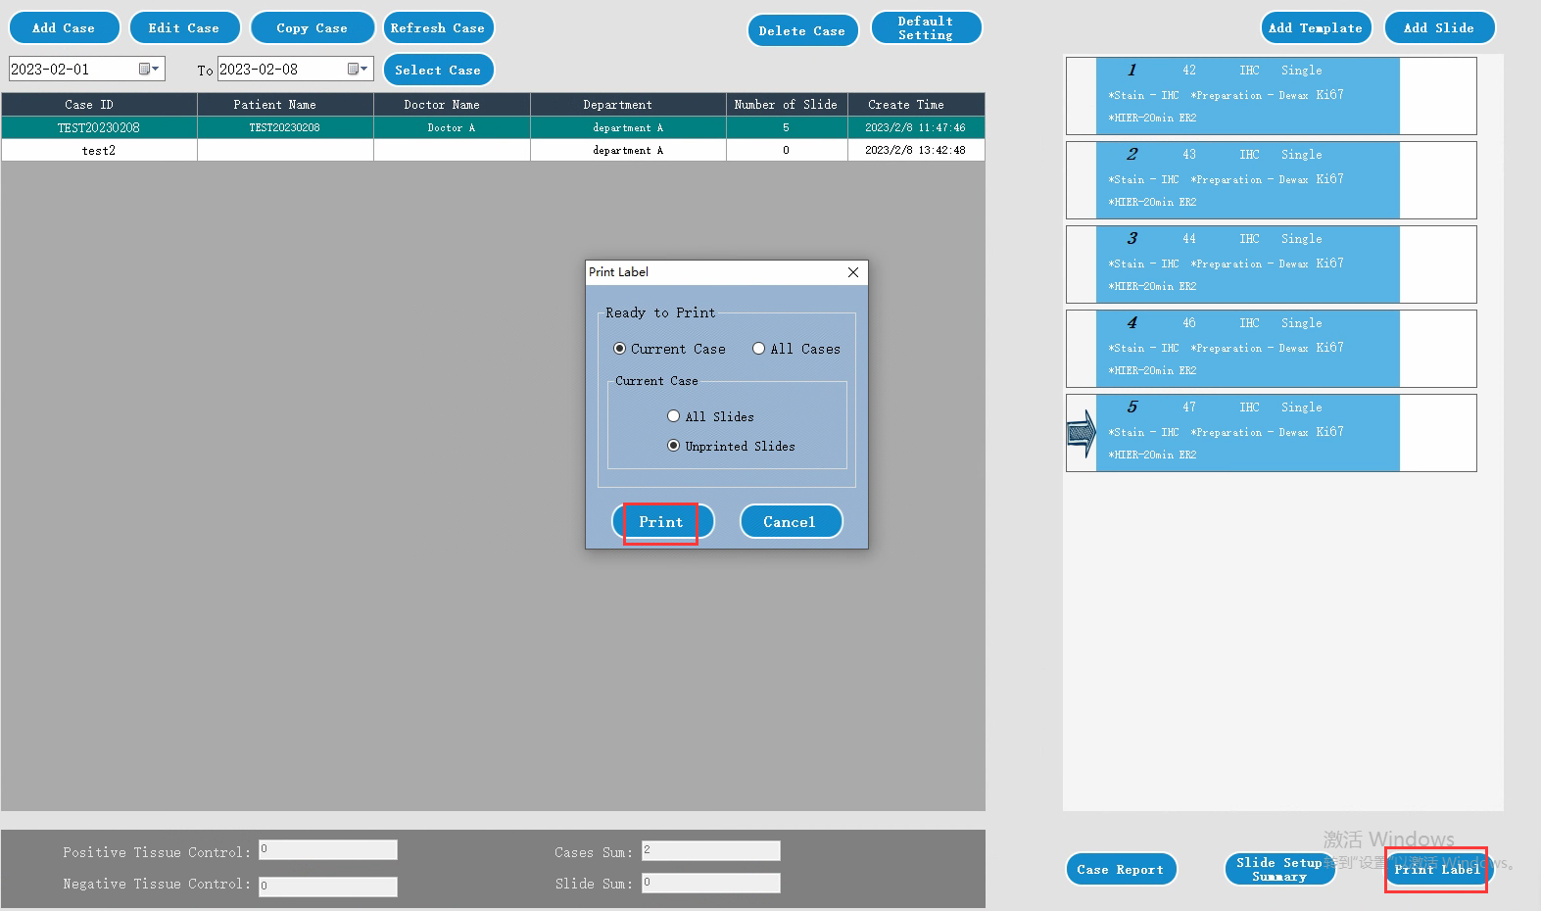
3. Setting up slides
3.3 Click “Print Label” to open a dialog, then click “Print”, the labels are printed. Then apply the labels with the slides.
Notes:
Third, print and apply labels. Click “Print Label” to open the dialog box. Choose whether to print labels for the “Current Case” or “All Cases”, and “All Slides” or “Unprinted Slides”. Then click “Print” and stick the labels on the corresponding slides. This helps track each slide throughout the experiment.

Slide 14
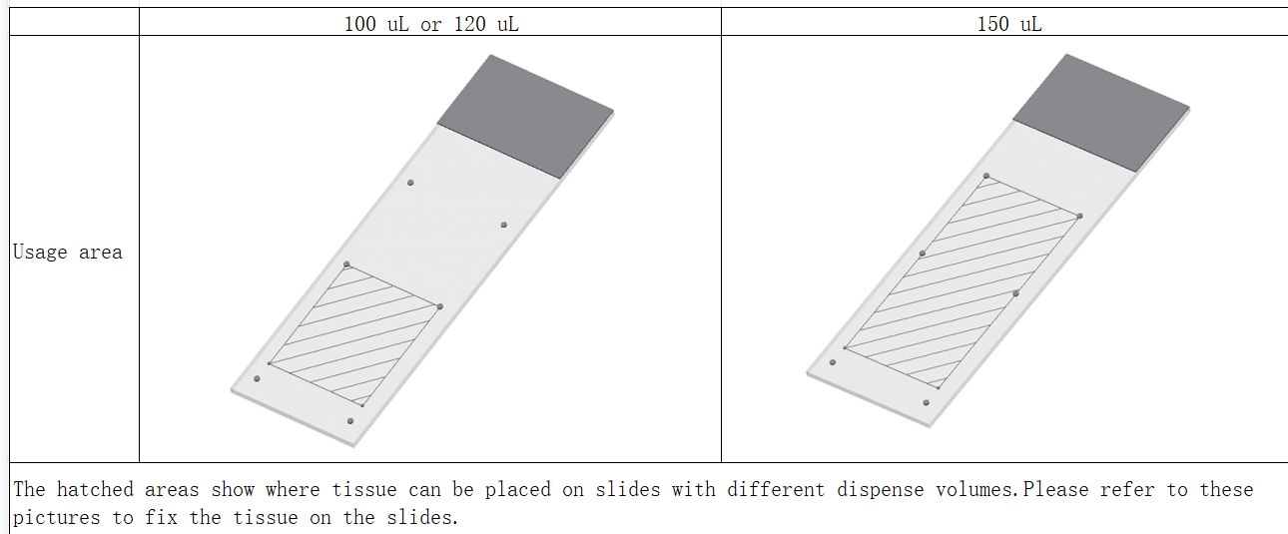
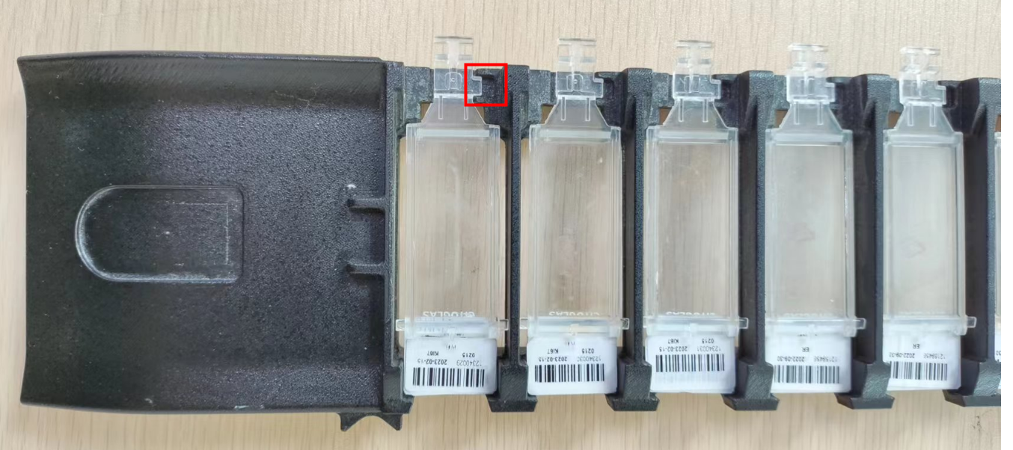
4. Loading slides
4.1 Place the slides onto the slide tray, cover them with liquid covers.
Refer to the below picture, the key on the neck of liquid cover should match the slot of the slide position. When fixing the tissue on the slide, please refer to the below picture to fix the tissue on the middle as possibly.
Note: Do not install the liquid cover reversely; otherwise, abnormal test results will occur.
Notes:
A quick tip: When placing tissue on the slide, refer to the usage area guidelines. For 100μL or 120μL dispense volumes, the tissue should be in the smaller hatched area; for 150μL, use the larger area. This ensures the reagent covers the tissue evenly. Got it? Let’s move to loading the slides.
First, place slides on the slide tray. Put each slide in the tray, then cover them with liquid covers. Important: The key on the neck of the liquid cover must match the slot of the slide position—this locks the cover in place. Also, center the tissue on the slide as much as possible, following the usage area we just talked about.

Slide 15
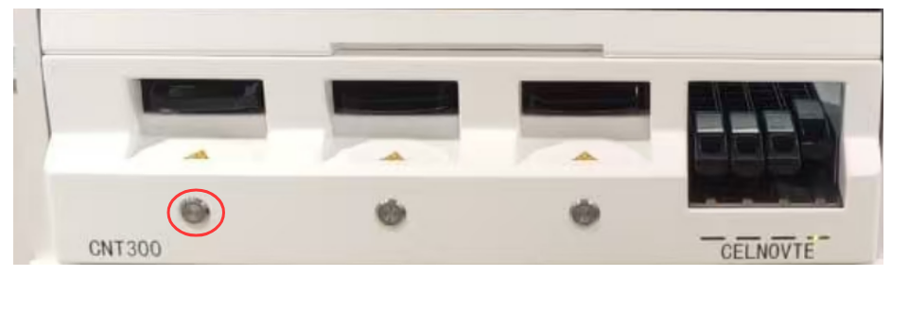
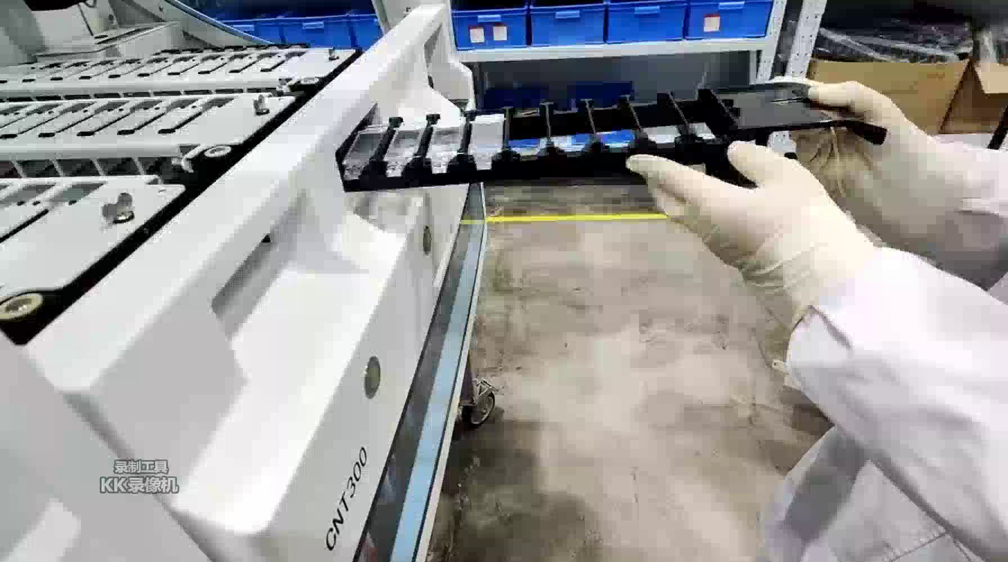
4. Loading slides
4.2 Insert the slide tray into an empty slide staining unit. Press the “load” button on the front panel. The system will move the robotic arm to scan and recognize identify the slide IDs.
Notes:
Second, insert the slide tray into the staining unit. Find an empty slide staining unit, slide the tray in, then press the “Load” button on the instrument’s front panel. The system will move the robotic arm to scan and recognize the slide IDs. Wait until the instrument confirms the slides are detected—you’ll see the slide IDs on the status screen.
If the instrument doesn’t recognize a slide, check if the label is clear, the tray is inserted correctly, or the liquid cover is properly aligned. Fix the issue and press “Load” again. here is a video, for your reference. Alright, next is loading reagents.

Slide 16
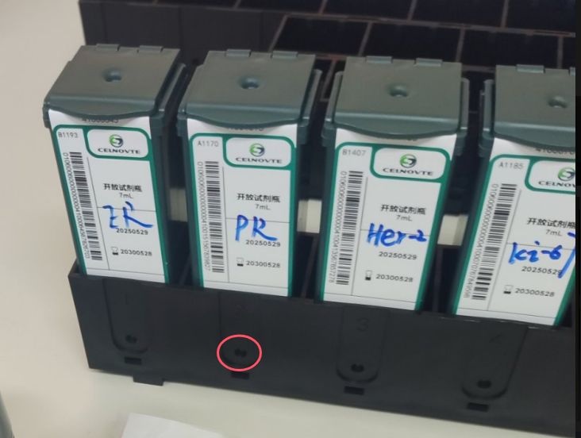
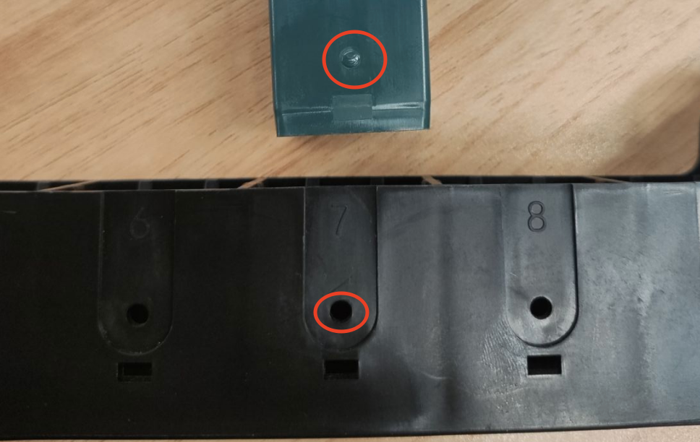
5. Loading reagents
5.1 Place the marker containers into the reagent tray with correct direction. Press down until the containers click into place. Open the cover of the marker containers which the experiment will use, then insert it into the reagent platform. The system will move the robotic arm to scan and recognize them. Note, the covers must be fixed on the back clamp.
Notes:
Just like slides, reagents need to be loaded properly for the instrument to access them.
First, load marker containers (primary antibodies). Place the marker containers into the reagent tray with the correct direction—check the labels to make sure you don’t mix them up. Press down on each container until you hear a “click”—this means it’s secured. Open the covers of the containers you’ll use in the experiment, then insert the reagent tray into the reagent platform. The robotic arm will scan and recognize the reagents. Note: The covers must be fixed on the back clamp of the tray—don’t leave them loose.

Slide 17
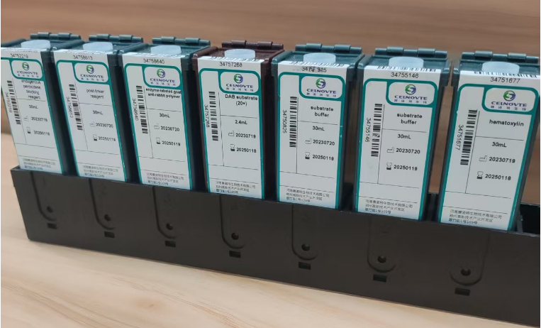
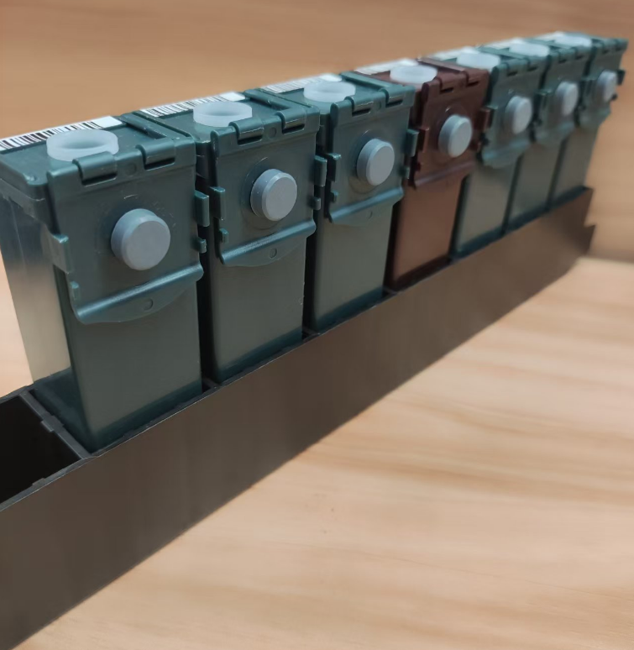
5. Loading reagents
5.2 Place the secondary antibody detection system reagent containers onto the reagent tray, Press down until the containers click into place.. Then open the covers, insert the reagent tray into the reagent platform. The system will move the robotic arm to scan and recognize them. Note, the covers must be fixed on the back clamp of the containers.
Notes:
Second, load secondary antibody detection system reagents. Place the detection system containers (e.g., Peroxidase Block Reagent, DAB-A, DAB-B, Hematoxylin) onto the reagent tray. Again, press down until they click into place. Open the covers, insert the tray into the reagent platform, and let the robotic arm scan them. Double-check that each reagent is in the correct position—refer to the tray’s label guide if needed.
After loading, the status screen will show the detected reagents. If any reagent is not recognized, check the barcode, container position, or cover clamp. Now that slides and reagents are loaded, we’re ready to start the experiment.

Slide 18

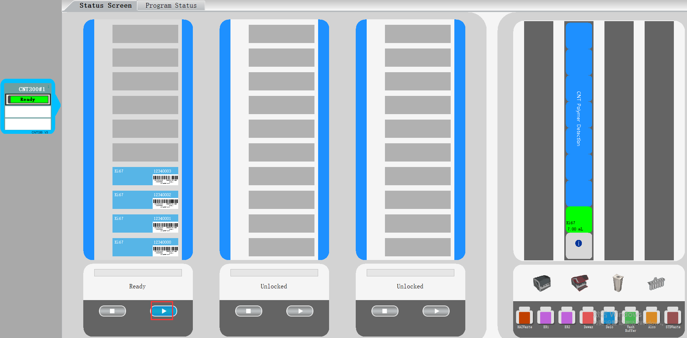
6. Start the experiment
Goto the Status Screen, when the slide staining unit displays “Ready” status, click to begin running the experiment.

Slide 19

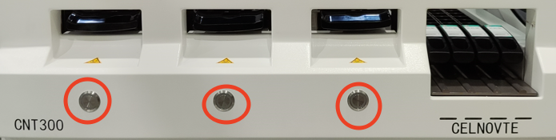
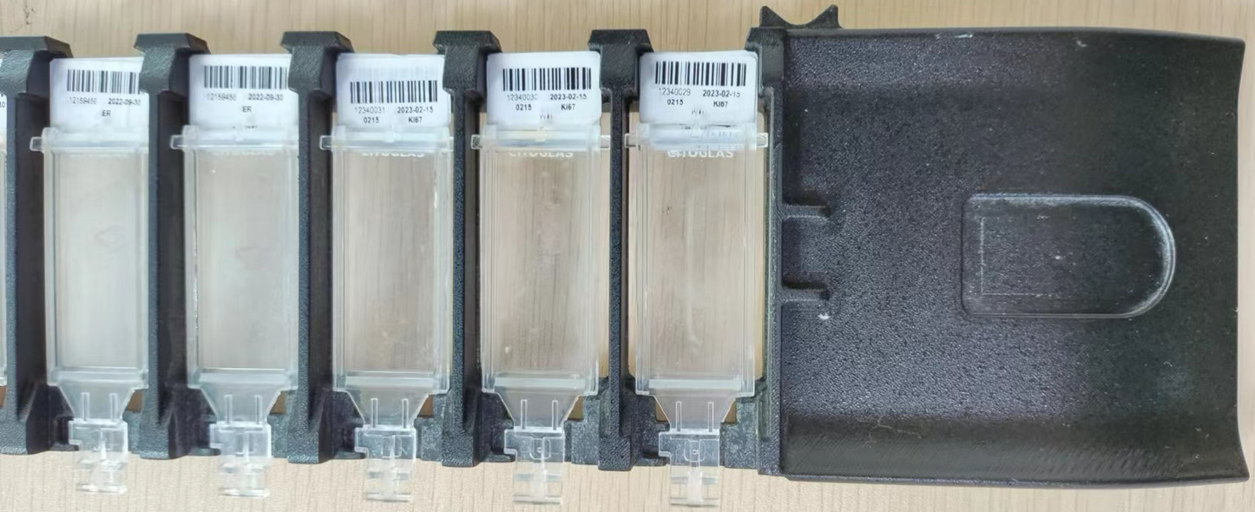
7. Finishing
1，when the status changes to “Finish”
2，Remove the reagents and store the reagents as recommended on the label. Press the button to unload the slides.
How to clean the covertiles
1. Immerse the covertiles in tap water. Rinse under running water at least 6 times.
2. Soak the covertiles in a fresh solution of 5% sodium hypochlorite for at least 30 minutes.
3. Rinse under running water approximately 10 times.
4. Immerse the slides in absolute ethanol for 10 minutes, then remove and hang them on a slide rack to air dry for future use.
Note: If there is a little DAB residue,please soak for more than 4 hours in the bleach solution. Carefully inspect covertiles for chips,cracks or warping.Discard if damaged in any way.
3，Place the slide tray on a flat, stable surface. Remove the Covertiles by holding down the label of the slide, then carefully putting pressure downwards on the neck of the Covertile to lift the end of the Covertile off the slide. Remove the slides and proceed with the next step in processing them according to your laboratory processes.
Notes:
Most experiments take 1-2 hours, depending on the protocol. Once it’s done, we’ll move to finishing up.
Finishing the experiment properly includes cleaning and storing materials for future use.
First, wait for the “Finish” status. When the experiment ends, the status screen will change to “Finish”. Don’t unload anything before this—interrupting early will ruin the slides.
Second, unload and store reagents. Remove the reagent tray from the platform, close the covers of the reagent containers, and store them according to the labels (e.g., some may need refrigeration, others room temperature). Dispose of any expired or contaminated reagents.
Thrid, unload the slides. Place the slide tray on a flat, stable surface. Hold down the slide’s label with one hand, then press down gently on the neck of the liquid cover to lift it off. Remove the slides and proceed with your lab’s next steps (e.g., mounting, imaging).
Fourth, clean the liquid covers. This is crucial—dirty covers can affect future experiments. Follow these steps:
Okay—almost done. Next, we’ll cover how to refill the primary antibody, a common task during experiments.

Slide 20
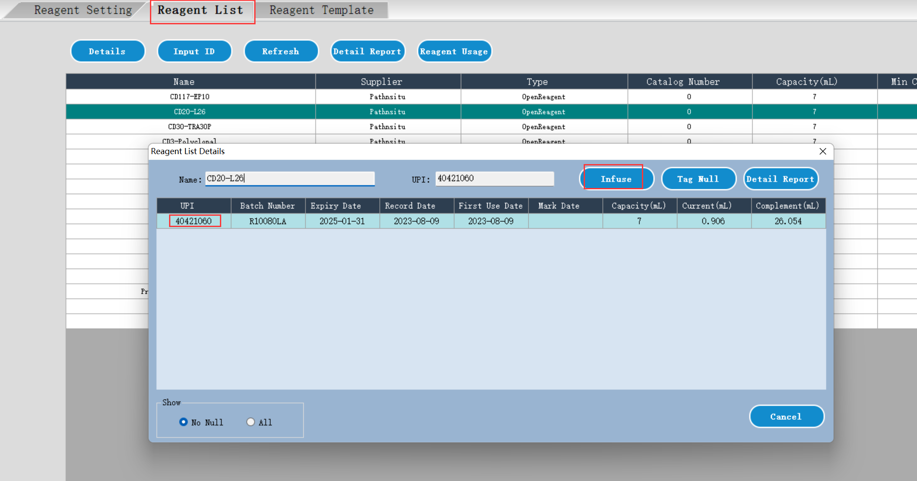
8. How to refill the primary antibody
The open container supports to cumulative add up to 30mL of a special antibody. Once the display volume is less than 1 mL, strongly suggest you refill the antibody.
Follow the below steps to refill:
1. Under “reagent list” page, double click the antibody which you need to add.
2. Select the open container, click “Infuse”.
3. Before starting a run or during the incubation when running, remove the reagent tray.
4. Add the antibody into the open container.
5. Load the reagent tray into the reagent platform, the system will move the probe to detect the volume and update the display volume.
Note that when infusing an open container, the system assumes that the container is
filled to the maximum available for that container. The reported volume will be updated after
a dip test is carried out. This may not occur until the container is used.
Notes:
1. 用新配制的 5% 漂白剂浸泡 10 分钟。
2. 用流水浸洗 10 分钟。
3. 将 Covertile 浸入 100% 乙醇中，共浸洗 10 min。
4. 干燥：
用无绒布擦干，或者
风干，或者
在 60°C 烘箱中干燥 10 分钟
5.仔细检查 Covertile 上是否有碎屑、裂纹或变形。若有任
何受损则将其丢弃。

Slide 21
9. Operation cautions
1. Correctly place the slides and liquid covers on the slide tray.
2. Ensure the system successfully recognizes all reagents after you insert the reagent tray. If failed to recognize the reagents, please check and clean the reagent container lables and reinsert the tray.
3. When the reagent volume of the open container is less then 1 mL, please refill it with correct reagent.
4. Check and confirm the mixing station is clean before starting the experiment.
5. Different staining procedures cannot be performed simultaneously in the same staining unit. please separate them into different staining units.
6. After setting the delayed start, do not do other settings or pull out the reagent tray. otherwise please reset the delayed start operation.
7. Do not open the instrument cover and do not close the client software during the experiment. Do not use the control computer to run other applications.

Slide 22
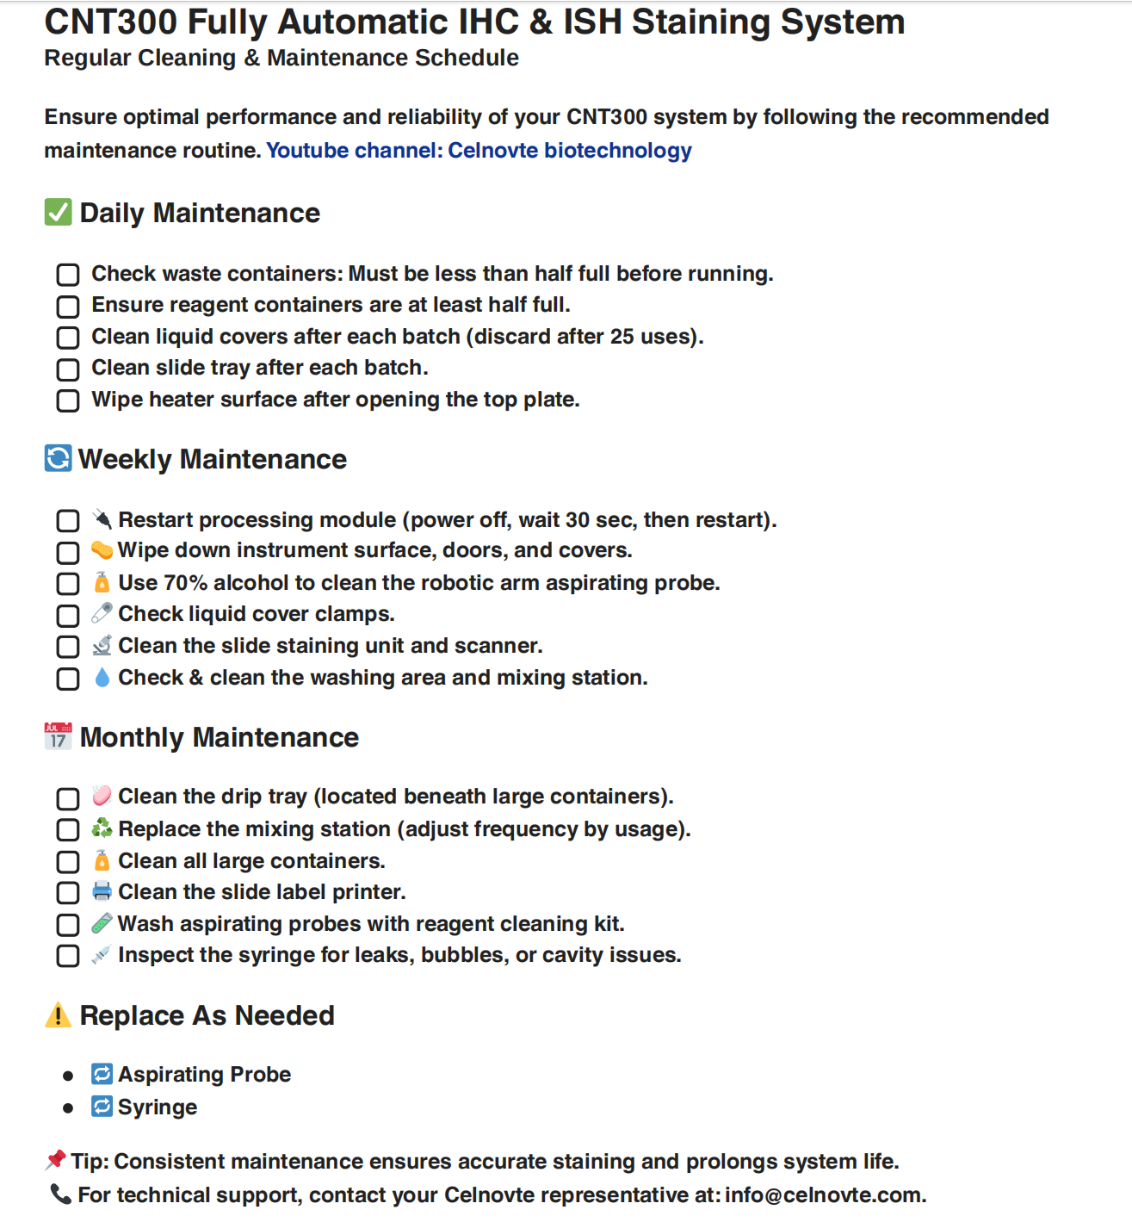
10. Regularly maintenance operation
The users should perform the regularly clean and maintenance according to this table.
Notes:
241015 adjustment

Slide 23
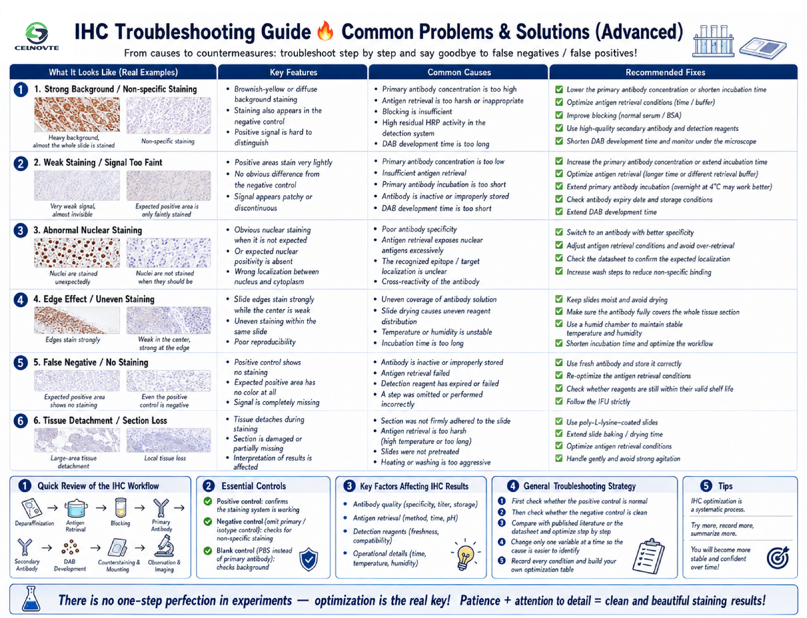
11. Troubleshooting guide
Notes:
241015 adjustment

Slide 24
THANKS!
汇报人： ####
部 门：###

