Slide 1

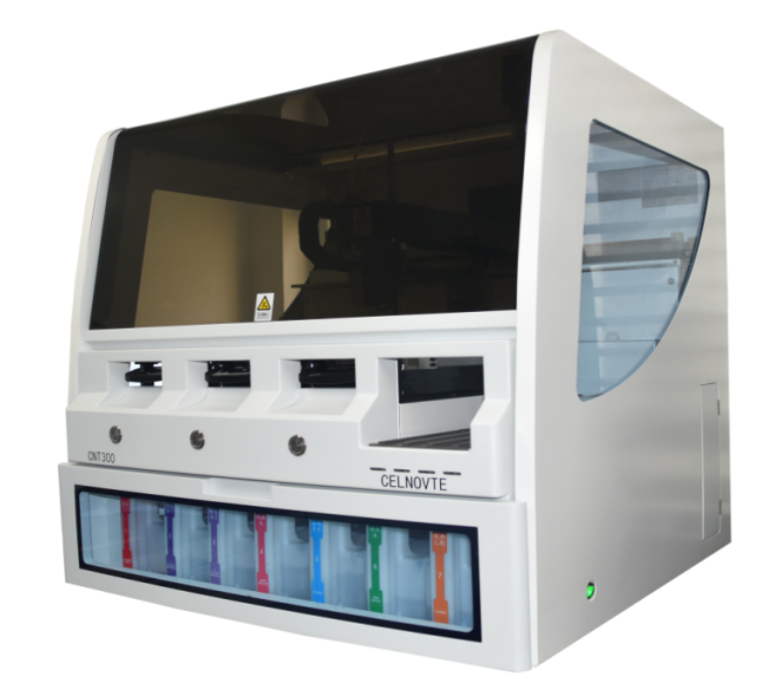
CNT300 Position calibration

Slide 2

why？
Position calibration ensures all components of the instrument move to designated positions during operation. Key calibrated positions include the washing area & mixing station, reagent platform and CM.

Slide 3
01
Hardware structure
CONTENTS
02
Materials for calibration
03
Position calibration
04
Regularly clean and
maintenance

Slide 4
PART 1
Hardware structure

Slide 5
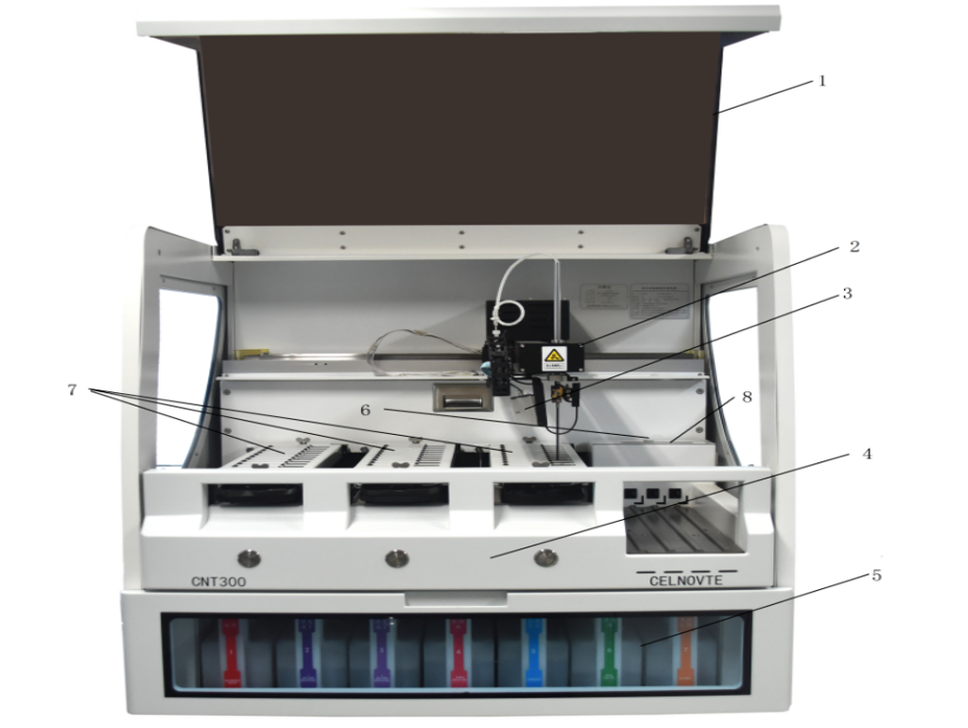
Hardware structure
No. | Name
1 | instrument cover
2 | robotic arm
3 | scanning module
4 | front panel
5 | large container rack
6 | air-bubble level
7 | slide staining unit( CM1, CM2, CM3 from left to right)
8 | washing area and mixing station
somewhere, we use “CM” or “ Core module” to represent “slide staining unit” for short.

Slide 6
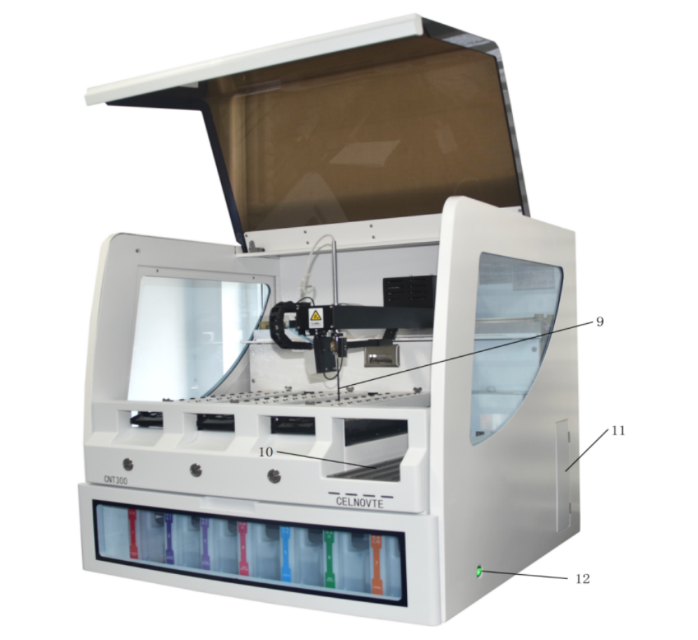
Hardware structure
No. | Name
9 | Aspirating probe
10 | reagent platform From left to right, RS1,RS2,RS3,RS4
11 | Syringe door
12 | power switch
somewhere, use “RS” to represent “reagent strip” or “reagent tray” for short.

Slide 7
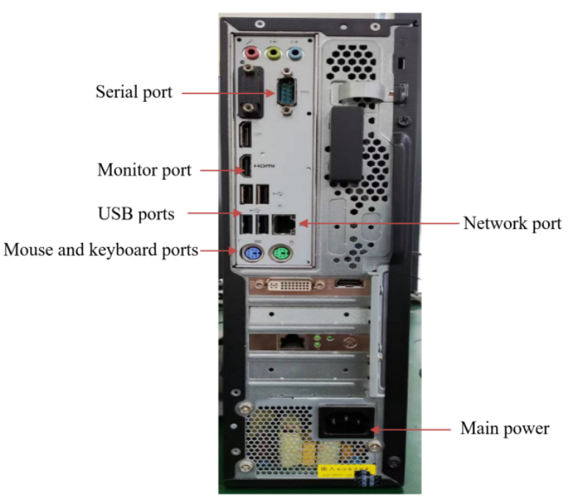
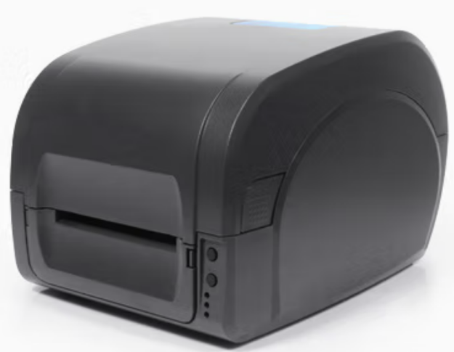
Hardware structure
1
2
3
No. | Name
1 | host computer
2 | label printer

Slide 8
PART 2
Materials for calibration

Slide 9
Materials for calibration
No. | Name | Quantity
1 | slide | 10
2 | liquid cover | 10
3 | open container | 4
4 | reagent tray | 2
Please confirm the belows before performing the position calibration :
There is no experiment running.
There are no slides to be processed on the slide tray.
Remove the reagents from the reagent platform.

Slide 10
PART 3
Position calibration

Slide 11

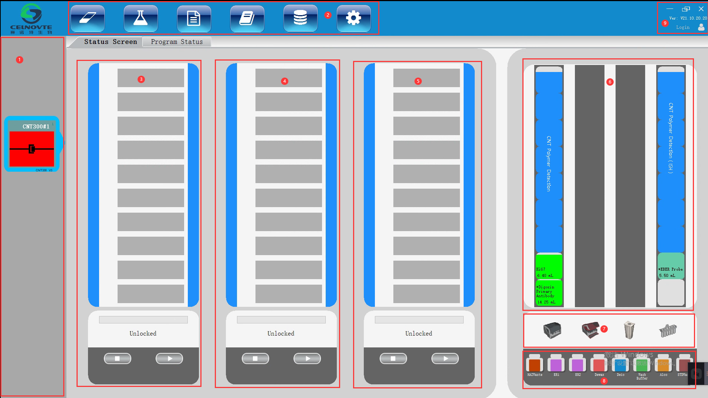
1. Know the client software
Click the below icon on the desktop of the host computer to open the client software.
1 | instrument list
2 | menu bar
3 | CM1
4 | CM2
5 | CM3
6 | reagent platform
7 | hardware status (whole machine, instrument cover, reagent, mixing station)
8 | large reagent container status
9 | user login and software version display
Notes:
1，display the connection status between host computer and processing module，also display the relevant instrument alarm information，right-click to deal with the alarm when alarm sign displays here. One client software supports max 5 CNT300 instruments.

Slide 12







2. Client software_page menu bar
 | Slide management | Add case, edit case ,delete case, copy case Add slide, print slide label.
 | Reagent management | Add/edit/delete reagent, view reagent, register reagent, reagent report.
 | Operating protocol | Add/Copy/edit/delete protocol, view protocol, protocol report.
 | History of slide | View slide history.
 | Running information | View real-time running information, display key step running log.
 | System management | Set system parameters and perform maintenance operation.

Slide 13
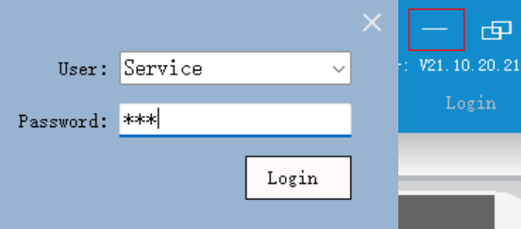
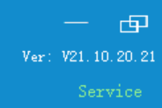
3. Client software_user login
Click “Login” on the right top corner to open the user login window.
Select the “Service” from the user list, input the password, the default password is “123”，then click “Login” button.
Notes:
1，display the connection status between host computer and processing module，also display the relevant instrument alarm information，right-click to deal with the alarm when alarm sign displays here. One client software supports max 5 CNT300 instruments.
2, 241016 modify the version information pictures

Slide 14
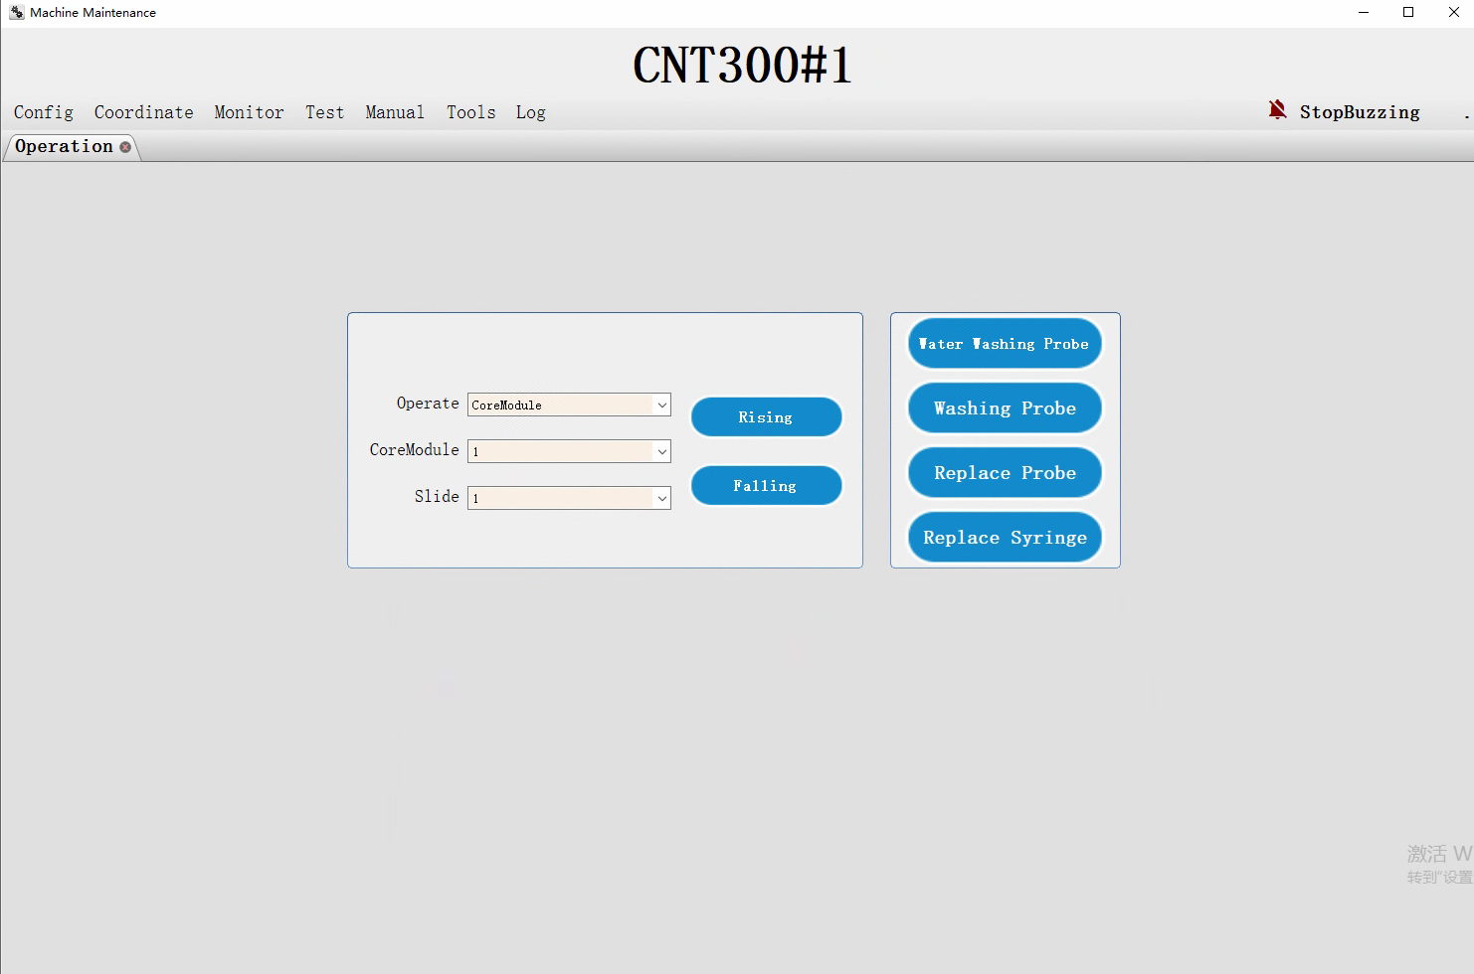
4. Position calibration
4.1 Enter the maintenance operation page
Click “System Management”— “Maintenance” — “Operation” to enter the maintenance operation page.

Slide 15
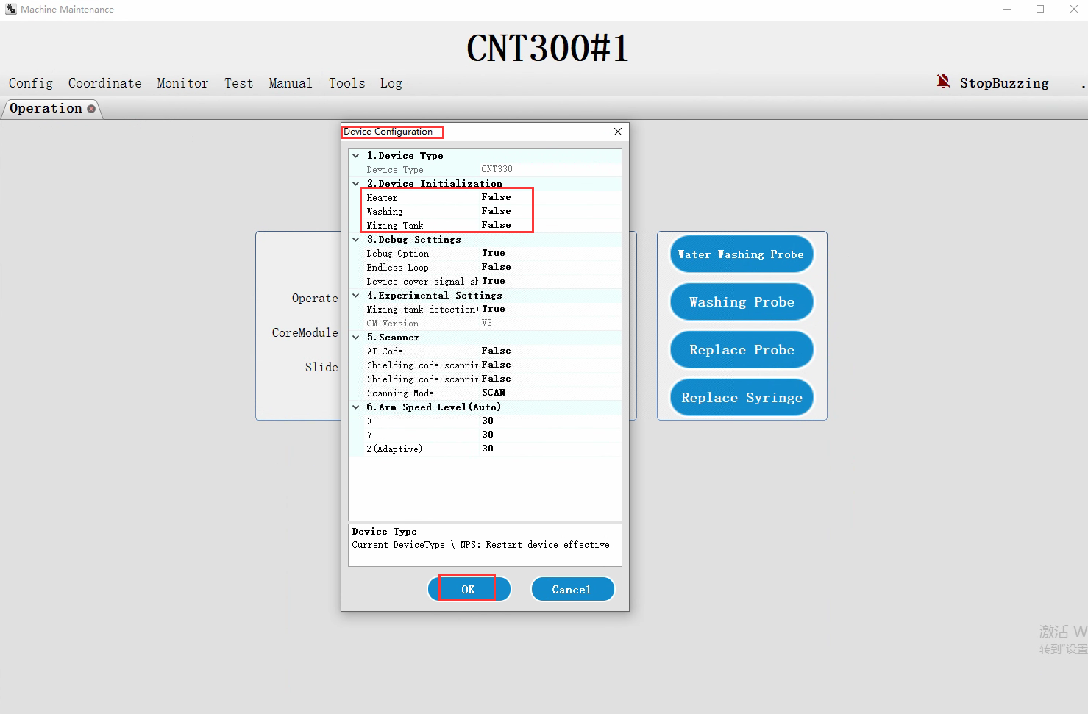
4. Position calibration
4.2 Set the device initialization parameter
4.2.1 Click “Config”— “Parameter” to open “Device Configuration” dialog.
4.2.2 Check if the device initialization parameters of “Heater”, “Washing” and “Mixing Tank” are “False”. if “True”，please set them as “False”.
4.2.3 Click “OK” to save.
Notes:
可以建议客户把Device cover signal shield 设置为True（不检测仪器盖 not to detect the instrument cover status）， 校准完后再设置为 “False”（检测仪器盖 detect the instrument cover status, when open the cover, the status screen will display a “cover open” alarm）

Slide 16
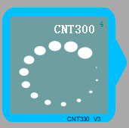
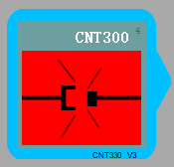
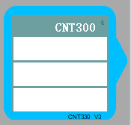
4. Position calibration
4.3 Power on the processing module.
Power on the processing module. Waiting until the software display connection successfully.

Slide 17
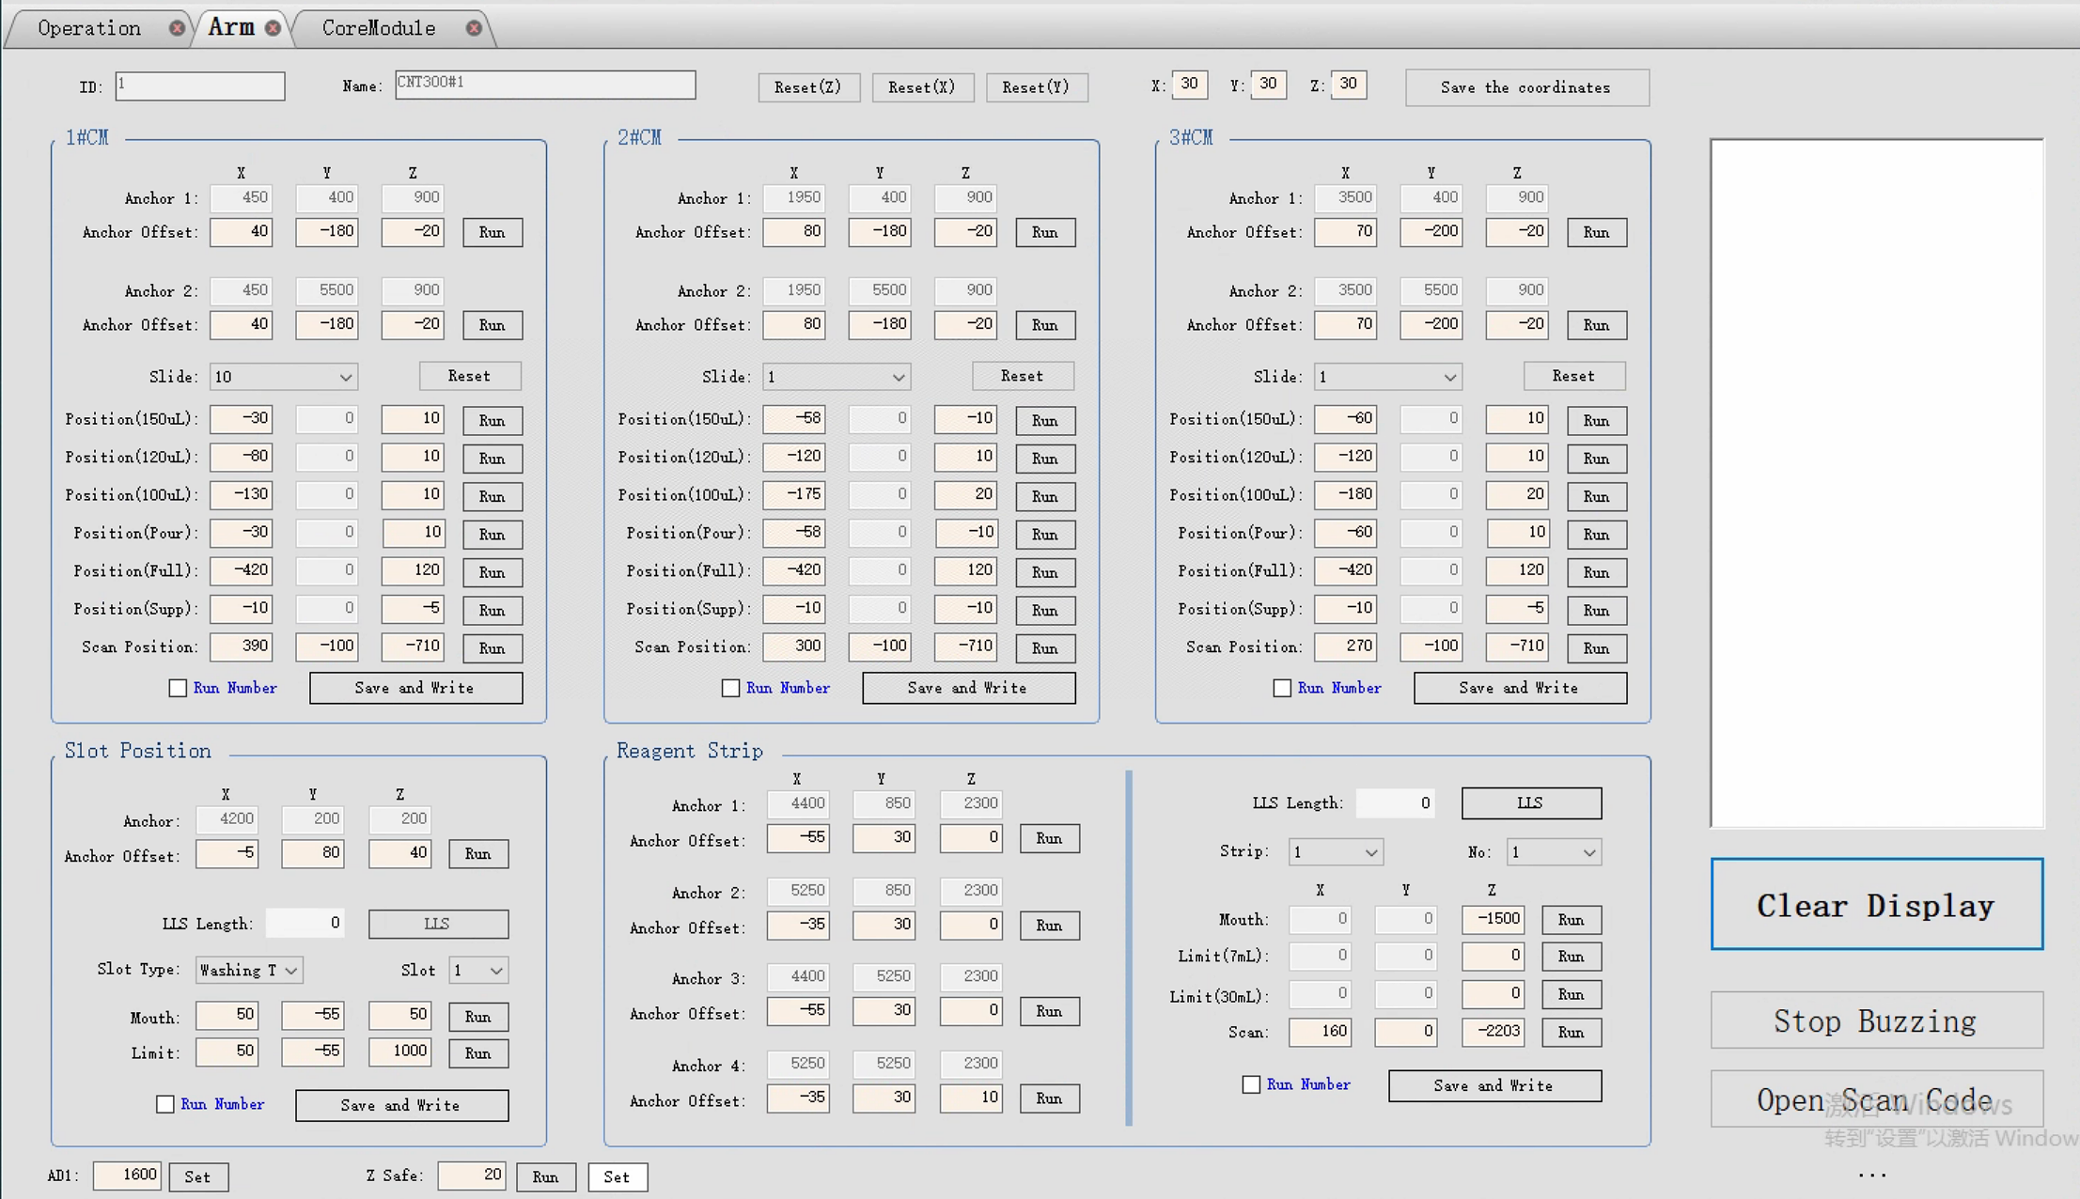
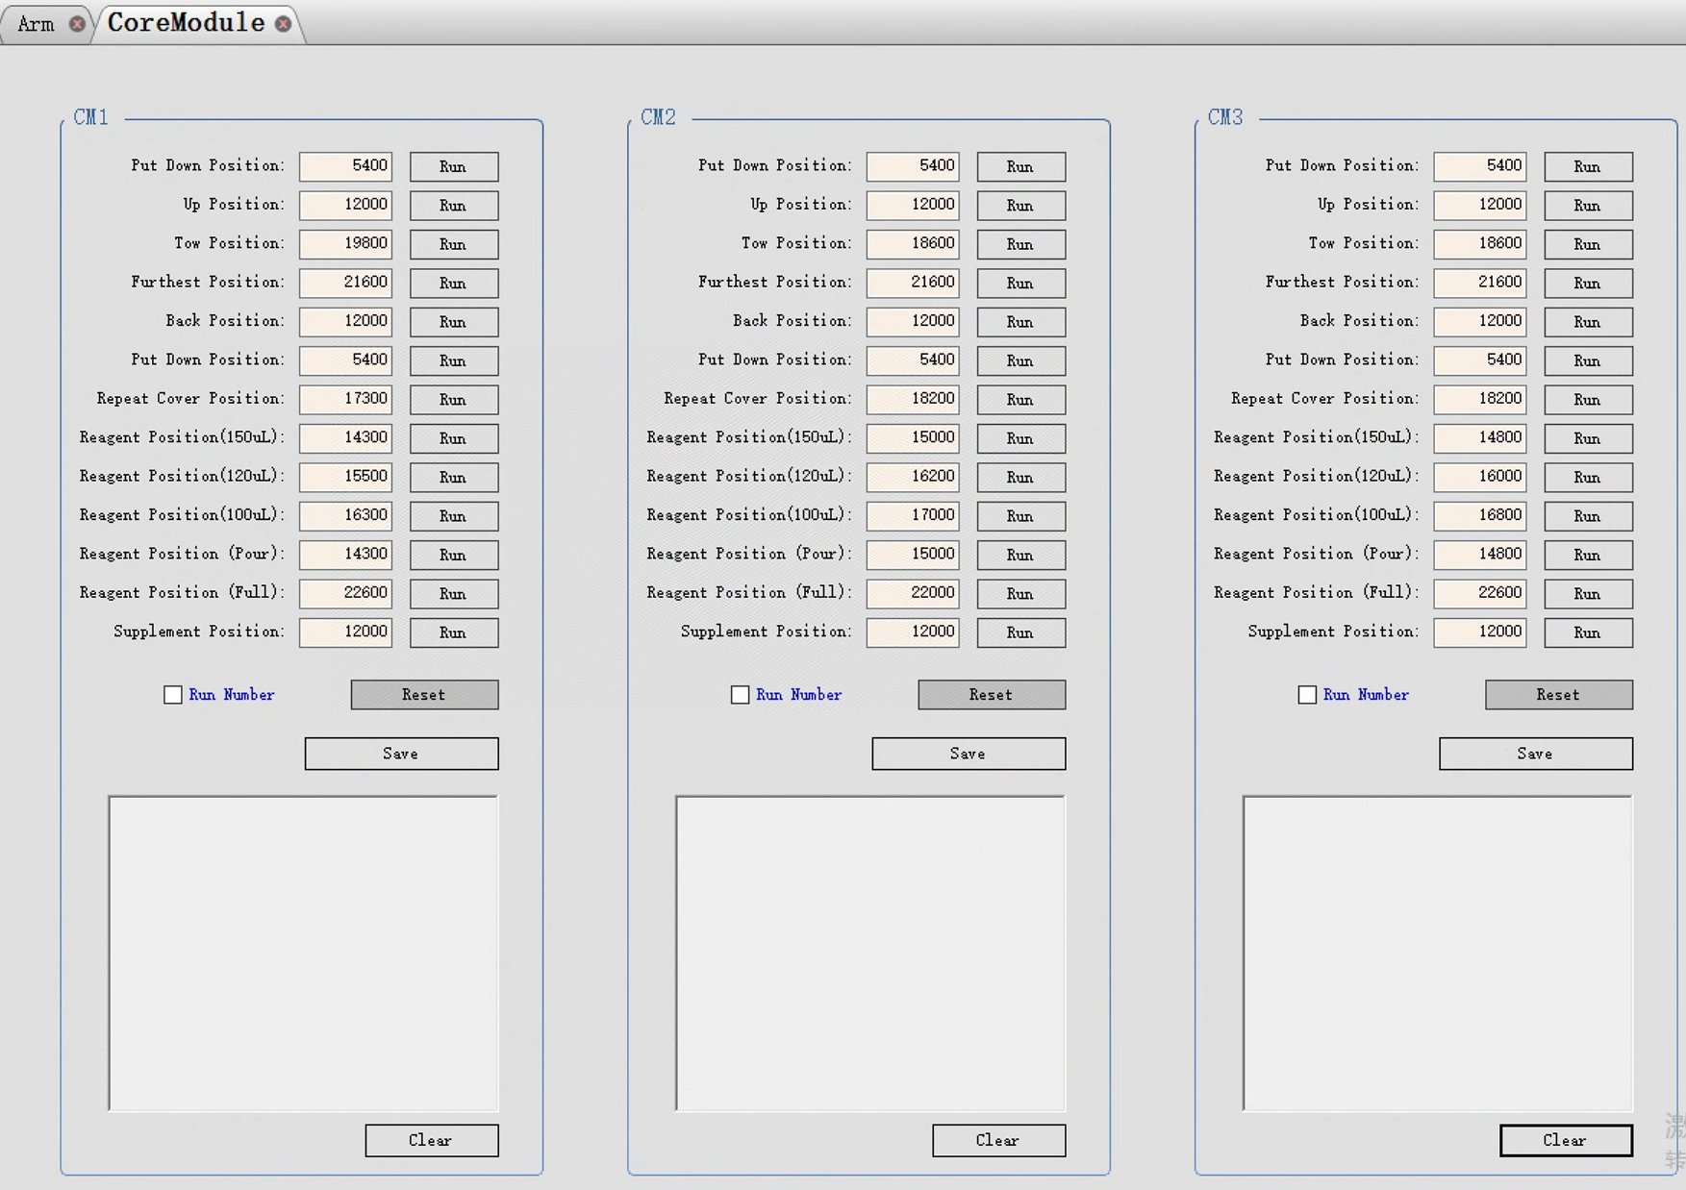
4. Position calibration
4.4 Check the processing module status
4.4.1 Check if all of the CMs is unlocking after power-on initialization.
4.4.2 Access the Arm page and the Coremodule page, “Maintenance”-”Coordinate”-”Arm”/”Coremodule”.

Slide 18
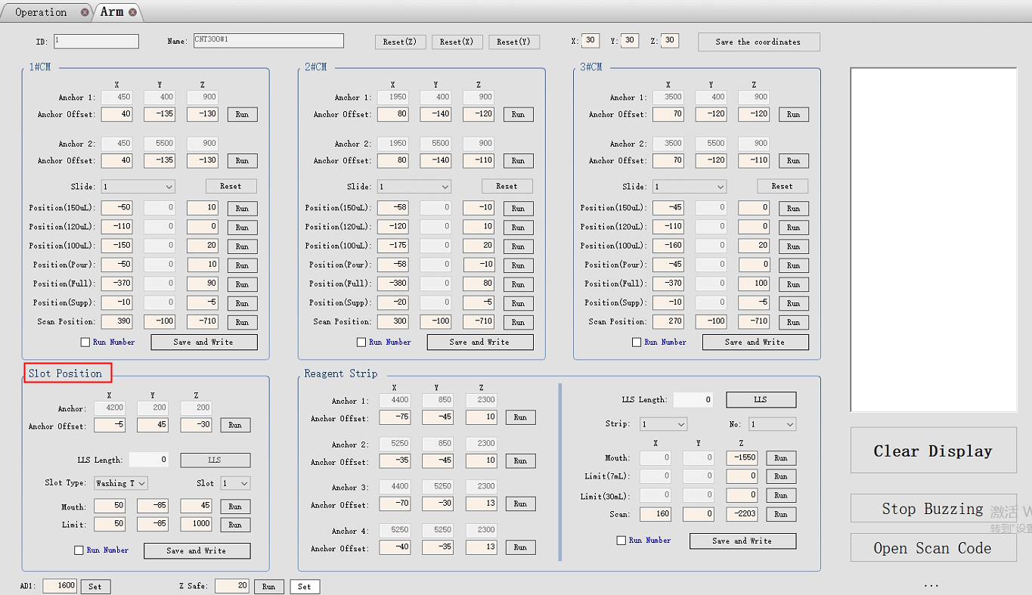
4. Position calibration
4.5 Washing area and mixing station
4.5.1 Click “Coordinate”—”Arm” to access the robotic arm position calibration page.
Notes:
清洗区和混液槽, “slot position” means the “slots of washing area and mixing station”position.

Slide 19
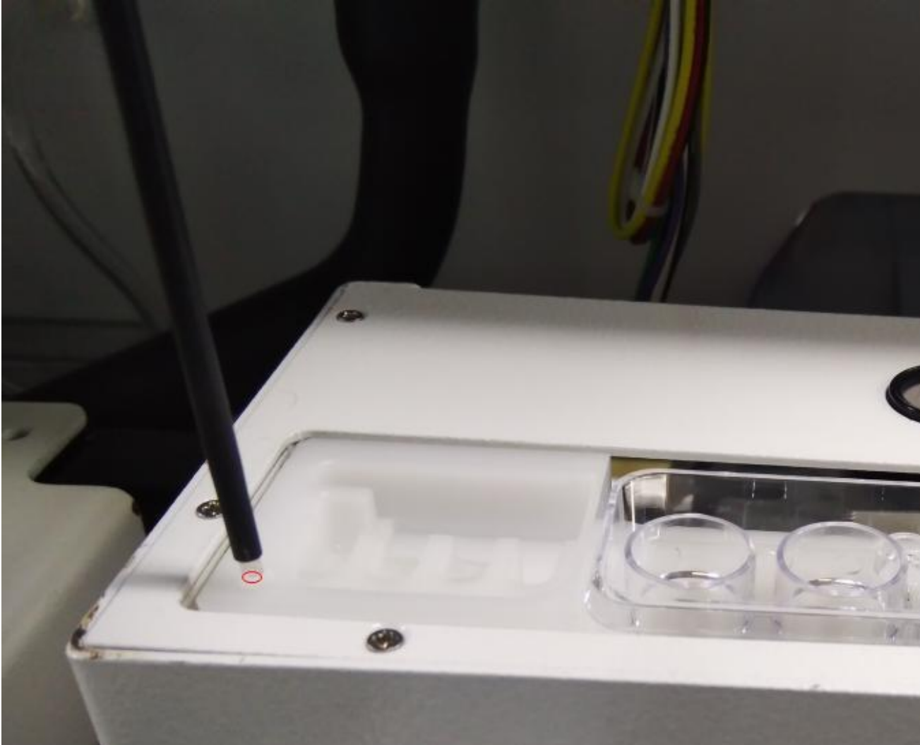
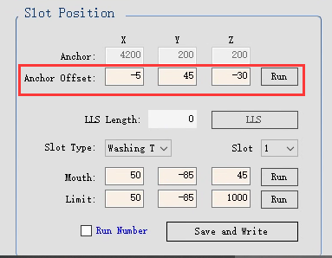
4. Position calibration
4.5 Washing area and mixing station
4.5.2 Calibrate the “Anchor”position of washing area. Call it as “Reference position”.
First reduce the Z value to “-200”, click “Run” to move the probe to the above of the anchor position, Then adjust X, Y, Z value to make sure the probe is close to the anchor. The distance is about 1 mm (place one slide on the washing area,then adjust the Z asix value to reach the slide surface as much as possible).
Please note：for postions of the washing area and mixing station, firstly MUST do the “Anchor” position calibration because its Z-axis value will affect the other position.
Notes:
Why set “-200”, prevent the probe collision，when adjust Z value，according to the actual height，set like these， -100， -50， -30 ，-10 to move the probe reach the anchor position.
rough adjust， then fine adjust
首先必须设置这个定位点Z轴坐标，因为清洗区，混液槽的Z轴方向坐标是相对定位点坐标。1张玻片的厚度刚好差不多1mm， the thickness of one slides is about 1mm。

Slide 20
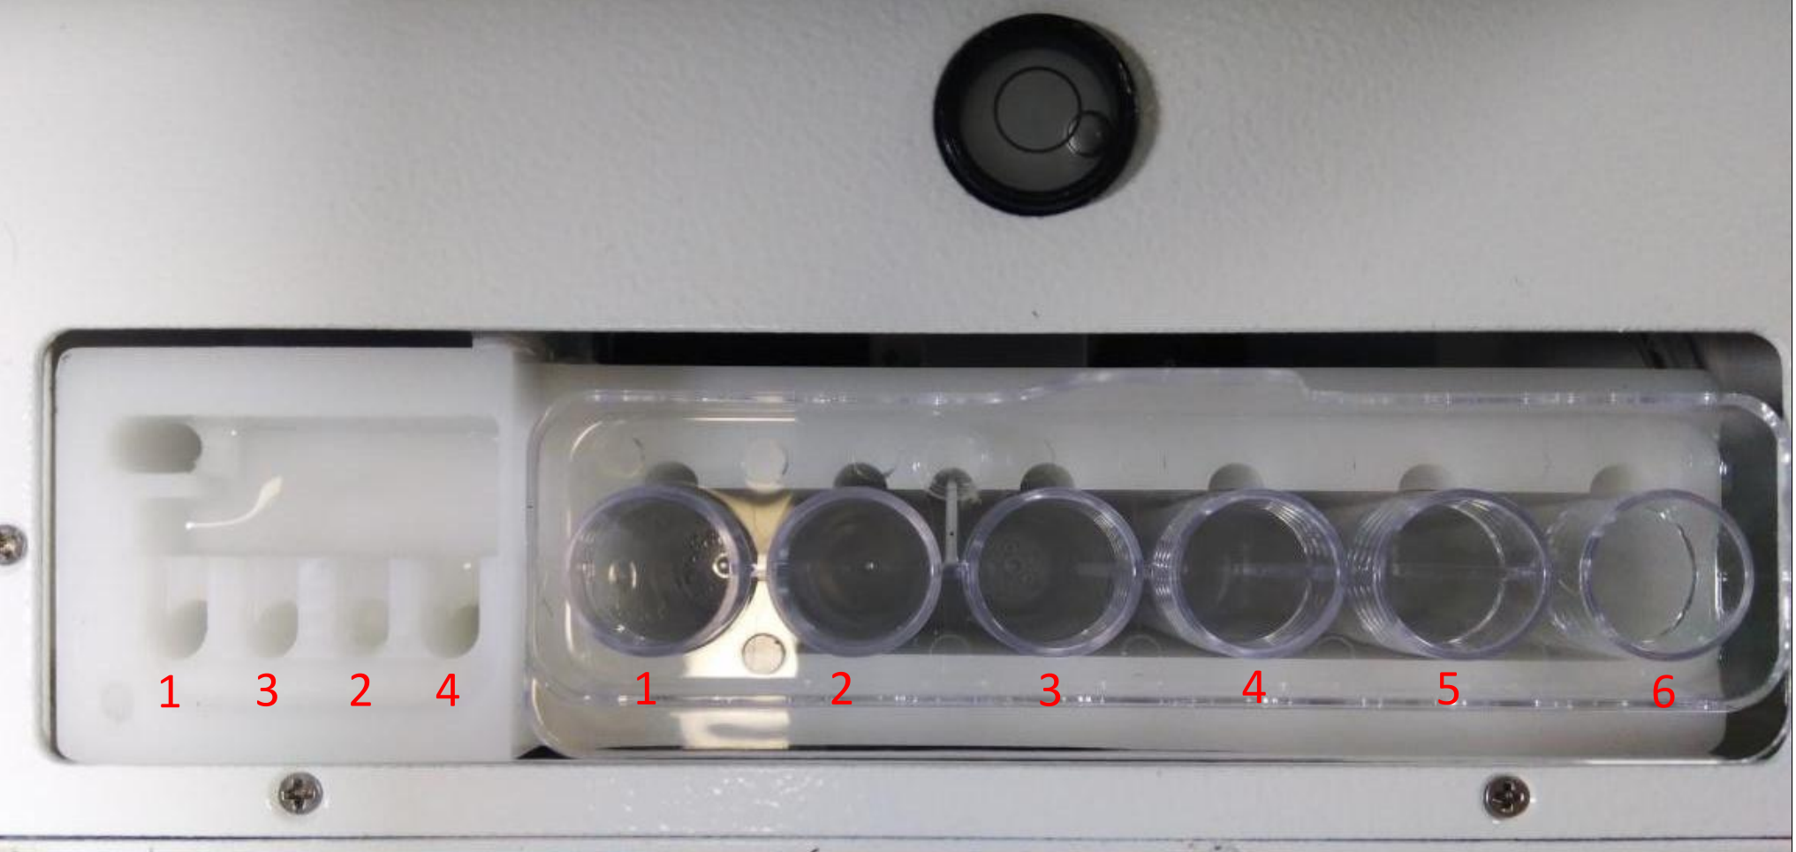
4. Position calibration
4.5 Washing area and mixing station

Slide 21
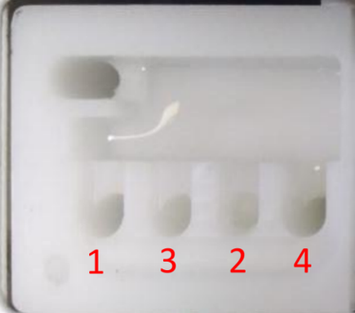
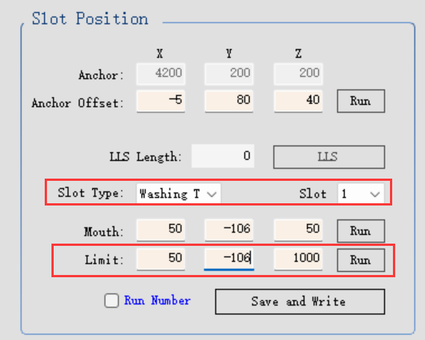
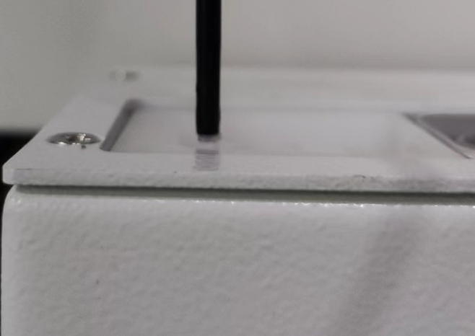
4. Position calibration
4.5 Washing area and mixing station
4.5.3 calibrate the slot mouth position of washing area
From left to right, slot 1, slot 3, slot 2, slot 4.
Select the Slot Type as “Washing Tank” and relevant slot to finish the mouth position calibration for the four slots. Refer to the below right picture, the probe head is on the same level of the washing area.
Notes:
updated on 18th July

Slide 22
4. Position calibration
4.5 washing area and mixing station
4.5.4 calibrate the slot limit position of washing area
After confirm the mouth position of the slots, please adjust the Z values of the limit position as the following：
1000 for slot 1,
150 for slot 2,
150 for slot 3,
500 for slot 4.
Repeat the 4.5.3 and 4.5.4 steps to finish all washing area slot position calibration.
Notes:
231106 modify the slot 2 and slot 3 limit position value from 200 to 150.

Slide 23
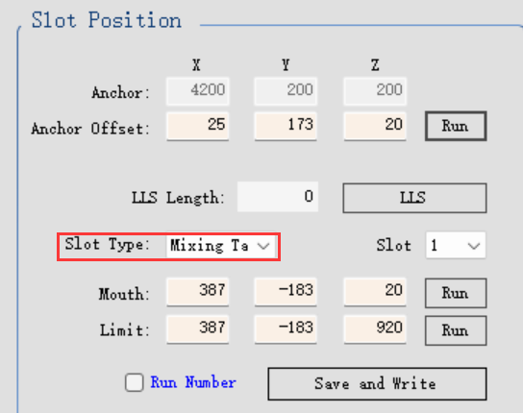
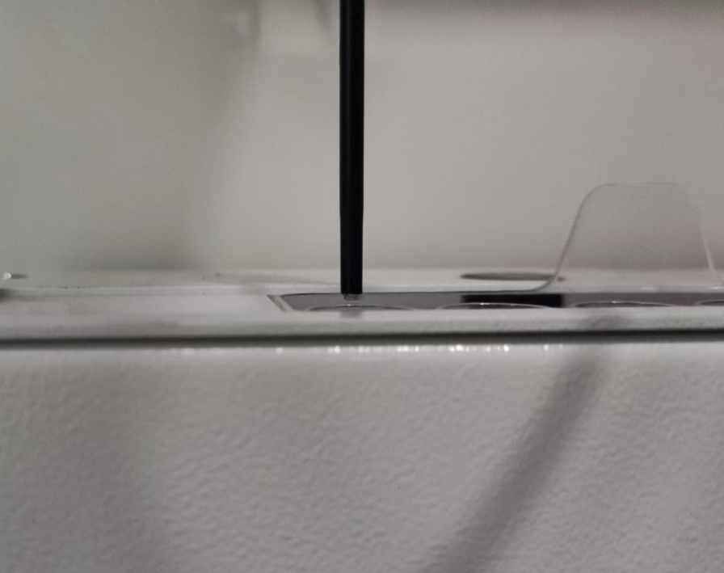
4. Position calibration
4.5 washing area and mixing station
4.5.5 calibrate the slot mouth position of mixing station
Insert the mixing vials into the mixing station, select the Slot Type as “Mixing Tank” and relevant slot to finish the mouth position calibration for the 6 slots.
(Put a slide on the mixing vials, adjust the probe to reach the slide surface as much as possible)

Slide 24
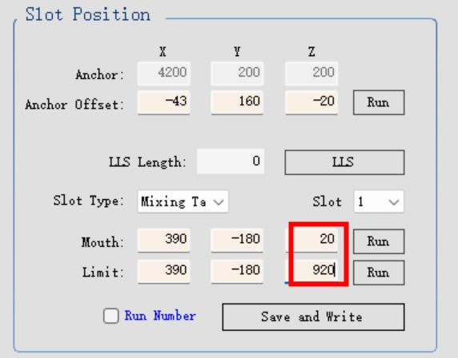
4. Position calibration
4.5 washing area and mixing station
4.5.6 calibrate the slot limit position of mixing station
For the limit Z value, if you use a slide for the reference, please set the offset as 900 with the mouth position. see the picture ,if the mouth Z value is 20, set the limit Z value as 920. then click “Run” to move the probe to the bottom. Check if the distance is about 1 mm from the bottom.
The distance between the probe tip and the bottom of bottle should less than 1 mm after clicking “Run” the limit position, but it should have a little space to avoid the probe to touch the bottom of the bottle. You can try to pull up the mixing station, it should be lifted up about 1 mm.
Repeat 4.5.5 and 4.5.6 steps to finish all 6 slot mouth and limit position calibration.
Notes:
231106: limit value of Z = mouth value of Z value + 900 ( based on a slide).

Slide 25
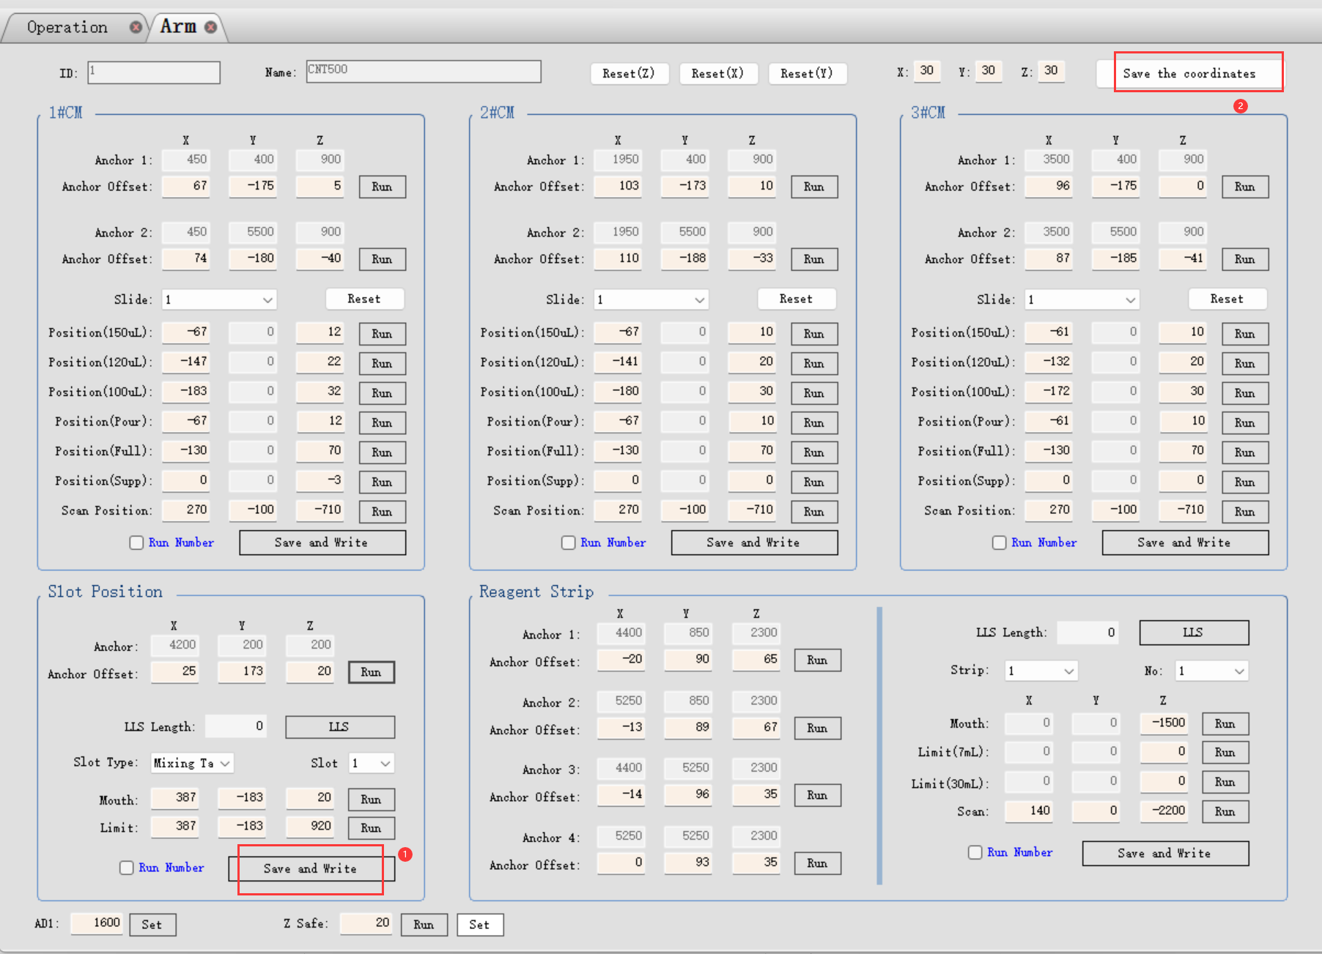
4. Position calibration
4.5 washing area and mixing station
4.5.7 Save the calibration parameters of the washing area and mixing station
Click “save and write” to save the slot position calibration parameter into the database and main board .
Then click “Save the coordinates” to save all arm position parameters into the database and main board.
Then click “Run” of the washing area anchor position to move the probe to the safe position.

Slide 26
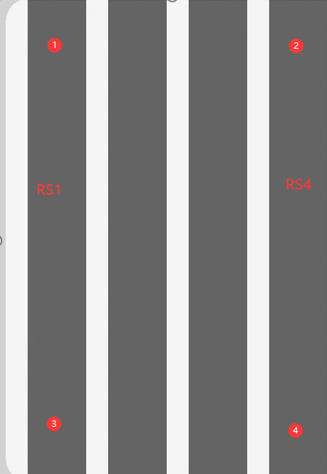
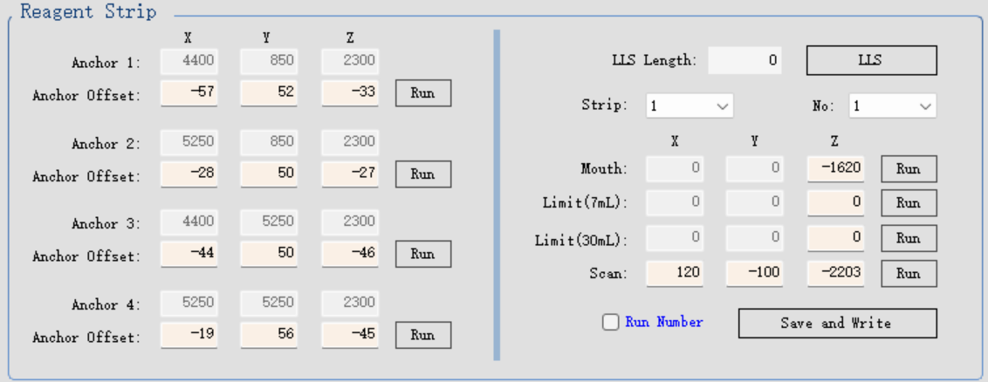
4. Position calibration
4.6 Reagent platform calibration
Anchor 1 ：No.1 reagent container of the RS1
Anchor 2 ：No.1 reagent container of the RS4
Anchor 3 ：No.9 reagent container of the RS1
Anchor 4 ：No.9 reagent container of the RS4

Slide 27
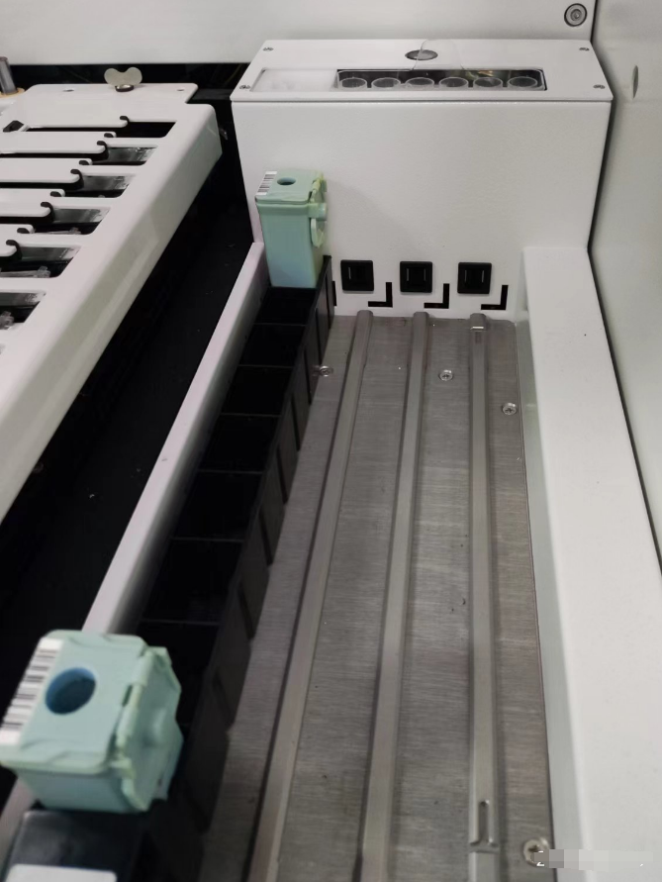
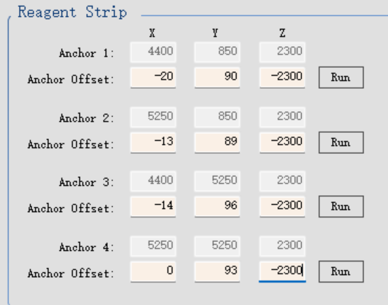
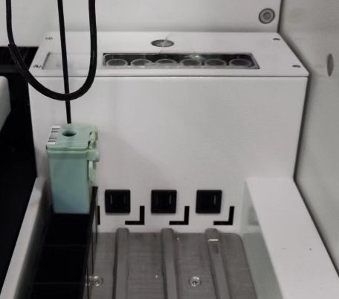
4. Position calibration
4.6 Reagent platform calibration
4.6.1 calibrate anchor 1,2,3,4 limit position
Notice, please move the probe to the safe position when to do next step operation or before inserting the reagent tray into the reagent platform.
step1. Place two reagent bottles in position 1 and 9 on the empty reagent tray and fill them with 1mL distilled water. insert it into the RS1 position. see the right picture. Failure to open the cover may result in the damage to the probe.
step2. Set Z value as -2300, then click Run to move the probe to the above of the position 1. (you can try to set the value as “ -1700”, move the probe to near the bottle mouth,easy to check the X,Y position)
step3. Adjust X, Y value to move the probe to the center position of the position 1.
step4. Adjust Z value to move the probe to reach the above of the mouth position.
Notes:
try to set Z value as -1700 to move the probe to be as close as possible with the mouth position, it is easy to check the X,Y position.

Slide 28
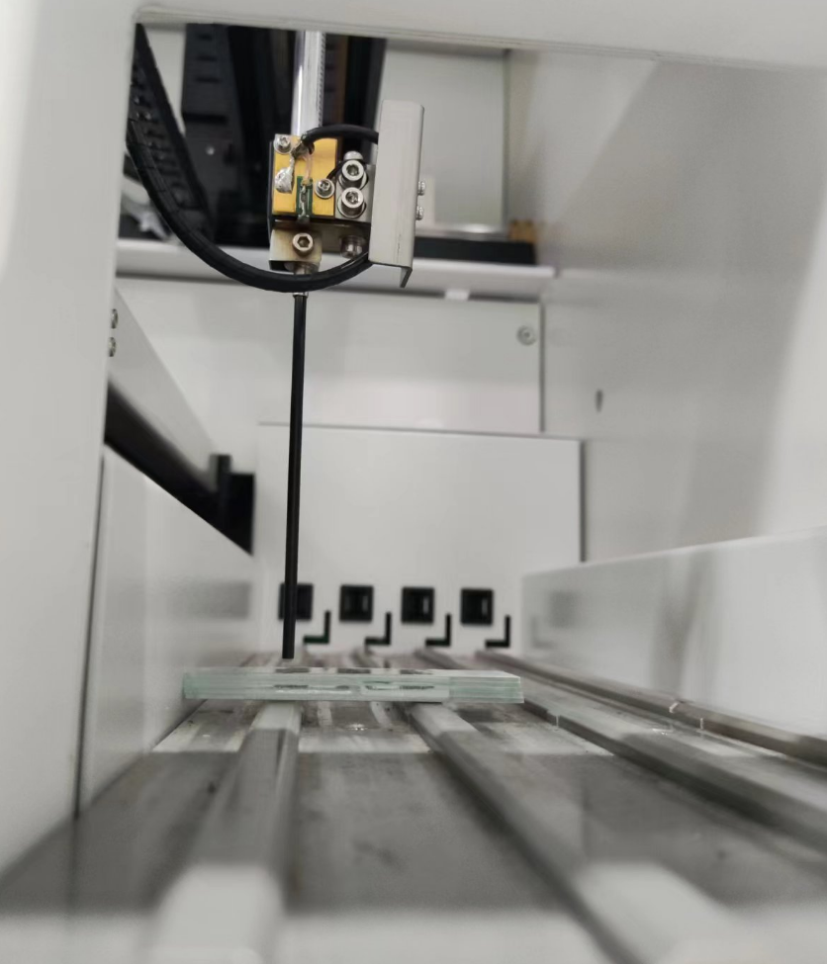
4. Position calibration
4.6 Reagent platform calibration
4.6.1 calibrate anchor 1,2,3,4 limit position
step5. Refer to the operation of position 1, position the probe to the above center of the anchor 3 reagent container.
step6. remove the reagent tray from RS1.
step7. Put 5 slides on top of each other, place it on the anchor 1 position, then adjust the Z value to move the probe to reach the surface of the top slide to finish the anchor 1 limit position calibration.
step8. Move the 5 slides to anchor 3 position to finish anchor 3 limit position calibration.
Step9. Refer to the above steps finish the anchor 2 and anchor 4 limit position calibration.
Notes:
for preventing the probe hit into the top slide, please do not directly put the slides under the probe，you can try to put it near the probe.

Slide 29
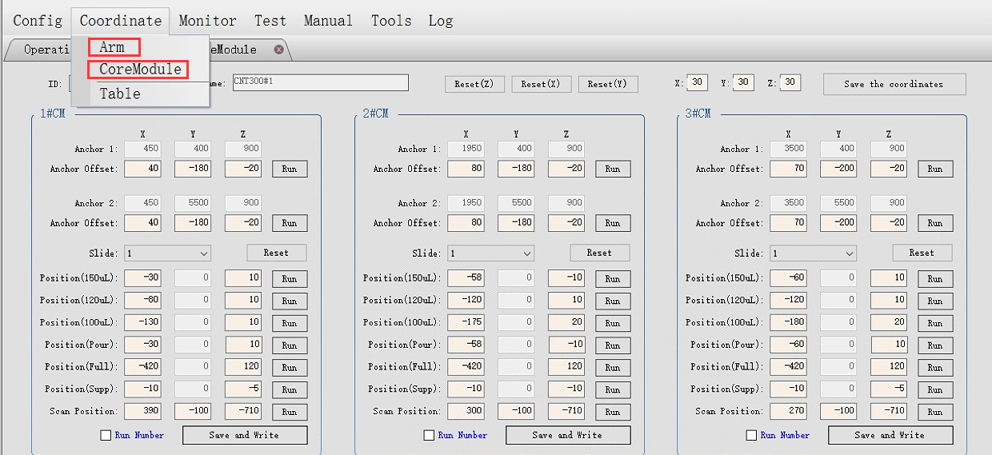
4. Position calibration
4.7 Slide staining unit, CM position calibration
CM position calibration needs to use two maintenance pages, Arm and CoreModule pages. Refer to the below picture,click them to open.
In this document, only show how to calibrate the 1#CM position. for 2#CM, 3#CM, please refer to the below steps to finish the position calibration. then click “save the coordinates” to save the parameters.

Slide 30
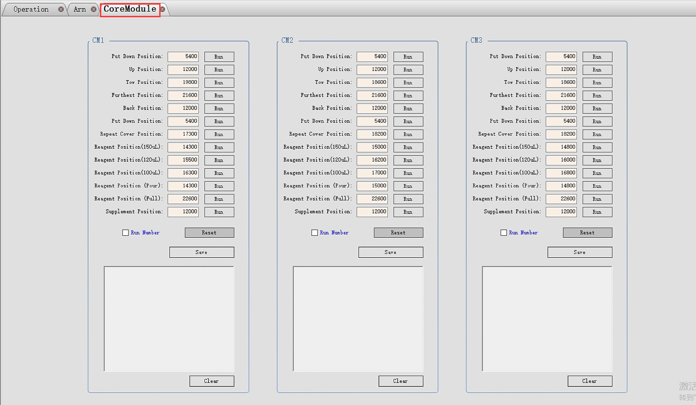
4. Position calibration
4.7 Slide staining unit, CM position calibration
CM position coordinate page, refer to the below picture.

Slide 31
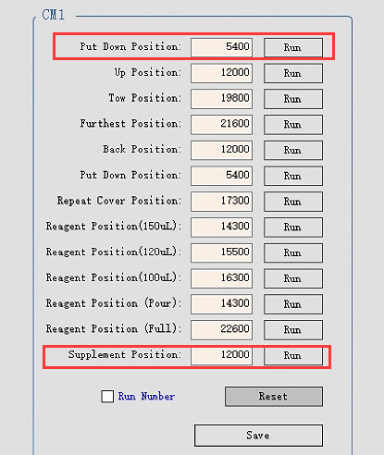
4. Position calibration
4.7 Slide staining unit, CM position calibration
4.7.1 anchor 1 and anchor 2 of CM1 position calibration
step 1. Place slides and liquid covers on position 1 and position 10 of the slide tray. insert the tray into the 1#CM.
step 2. click “Run” of Put Down Position to lock the 1#CM, wait until the running is done.
step 3. click “Run” of “Supplement Position” . wait until the running is done.

Slide 32
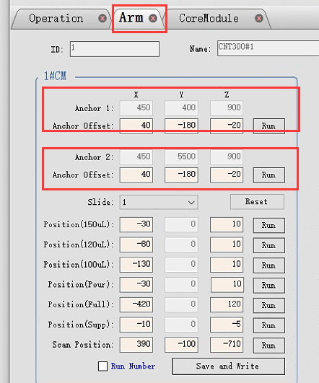
4. Position calibration
4.7 Slide staining unit, CM position calibration
4.7.1 anchor 1 and anchor 2 of CM1 position calibration
step 4. Return back “Arm” page to finish 1#CM anchor 1 and anchor 2 position calibration.
step 5. Click “Save and Write” to save the calibration parameters.

Slide 33
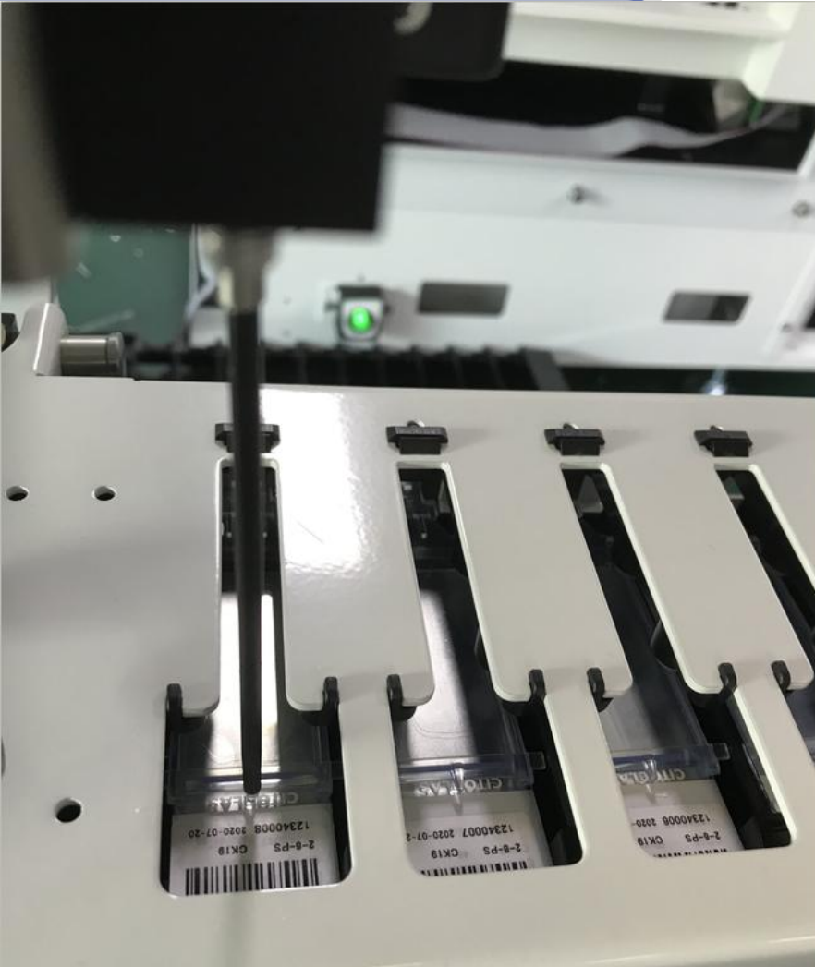
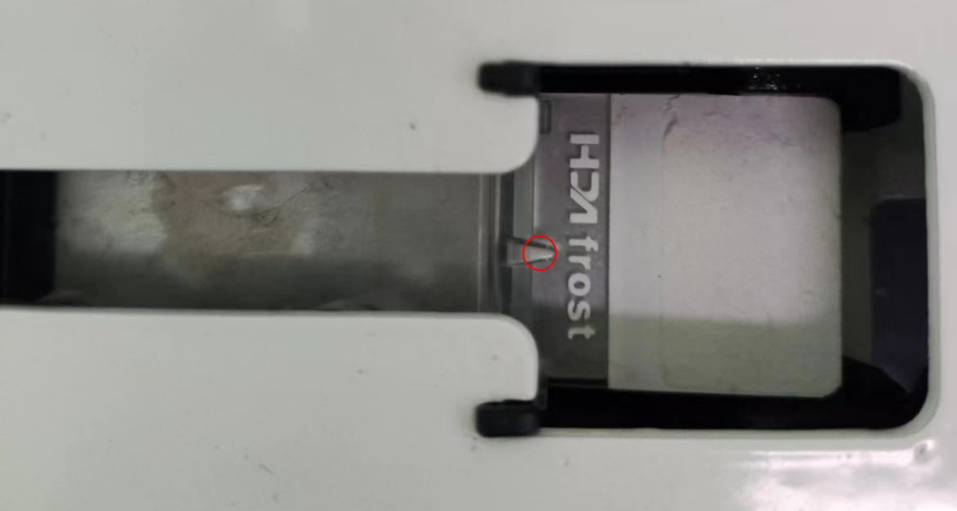
4. Position calibration
4.7 Slide staining unit, CM position calibration
4.7.1 anchor 1 and anchor 2 of CM1 position calibration
calibration position requirement:
X direction. the probe just reach the guide liquid tip of the liquid cover. The right edge of the probe aligns with the head of the liquid cover.
Y direction. the probe just is in the middle of the top plane slit.
Z direction. the probe height is about 2 mm to the guide liquid tip of the liquid cover.
Refer the above steps to finish the anchor 1 and anchor 2 position calibration of CM2 and CM3.
Do not forget to click “save and write” to save the calibration parameters.

Slide 34
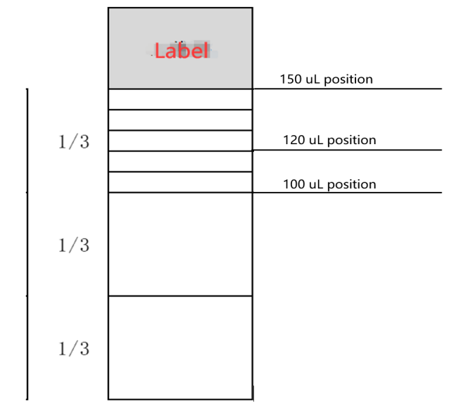
4. Position calibration
4.7 Slide staining unit, CM position calibration
4.7.2 dispense position calibration
See the picture, the relevant dispense positions for the 150uL, 120uL, and 100uL.

Slide 35
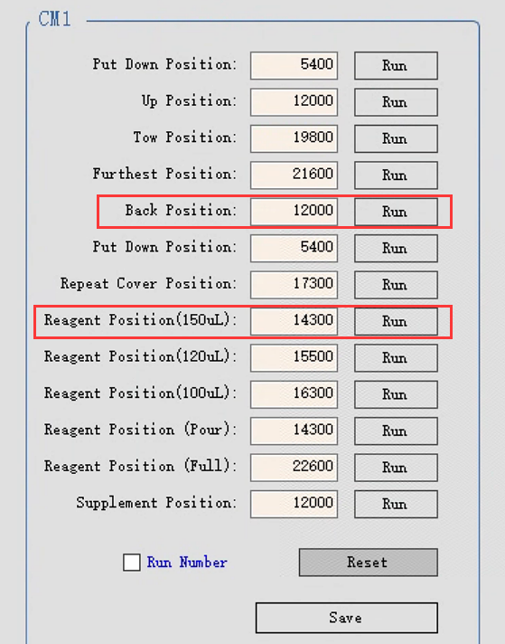
4. Position calibration
4.7 Slide staining unit, CM position calibration
4.7.3 calibrate the 150uL dispense position.
step 1. click “Reset(Z)” under “Arm” page to move the probe to Z home position to prevent the collision.
step 2. return “Coremodule” page, click “Run” of the Back Position, wait until the running is done.
step 3. click “Run”of the “Reagent Position(150uL)”, wait until running is done.

Slide 36
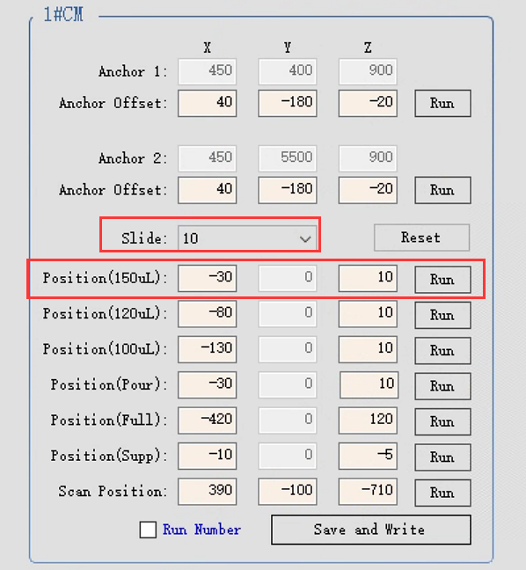
4. Position calibration
4.7 Slide staining unit, CM position calibration(only check #10 slide position)
4.7.3 calibrate the 150uL dispense position.
step 4. return “Arm” page. click “Run” of the “Position（150uL)”.
step 5. adjust X, Z value to move the probe until it meets the calibration position requirement.
refer to 4.7 calibration position requirement
step 6. select “10” under “Slide” down-list, repeat step 4 and step 5 to finish position 10 dispense position calibration. Here suggest using the #10 slide position to save the parameter, easy to check the position. If the #1 slide position does not meet the calibration position requirement after re-selecting #1 slide position, please return back “Anchor 1 ”position to adjust the anchor 1 X,Z value,you can take a compromise value to meet the dispensing position clibration positon requirement.
step 7. click “Save and Write “ to save the calibration parameters.
Refer the above steps to finish the 150uL dispense position calibration of CM2 and CM3.

Slide 37
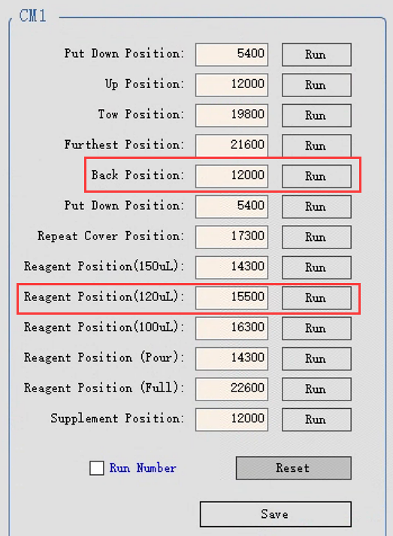
4. Position calibration
4.7 Slide staining unit, CM position calibration(only check #10 slide position)
4.7.4 calibrate the 120uL dispense position.
step 1. click “Reset(Z)” under “Arm” page to move the probe to Z home position to prevent the collision.
step 2. return “Coremodule”page, click“Run” of the Back Position, wait until the running is done.
step 3. click” Run”of the “Reagent Position(120uL)”, wait until running is done.

Slide 38
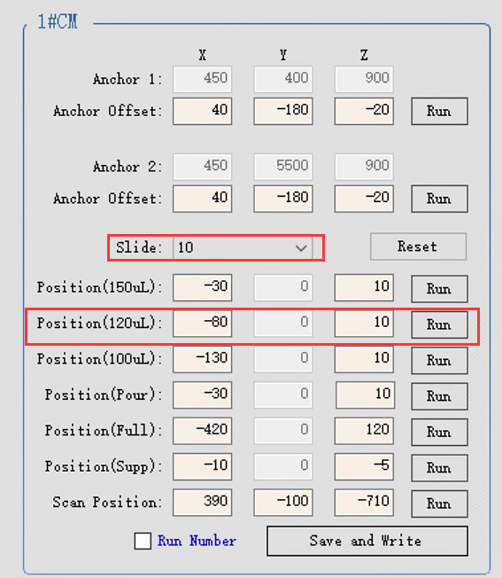
4. Position calibration
4.7 Slide staining unit, CM position calibration(only check #10 slide position)
4.7.4 calibrate the 120uL dispense position.
step 4. return “Arm” page. click “Run” of the “Position（120uL)”.
step 5. adjust X, Z value to move the probe until it meets the calibration position requirement.
refer to 4.7 calibration position requirement
step 6. select “10” under “Slide” down-list, repeat step 4 and step 5 to finish position 10 dispense position calibration.
step 7. click “Save and Write “ to save the calibration parameters.
Refer the above steps to finish the 120uL dispense position calibration of CM2 and CM3.

Slide 39
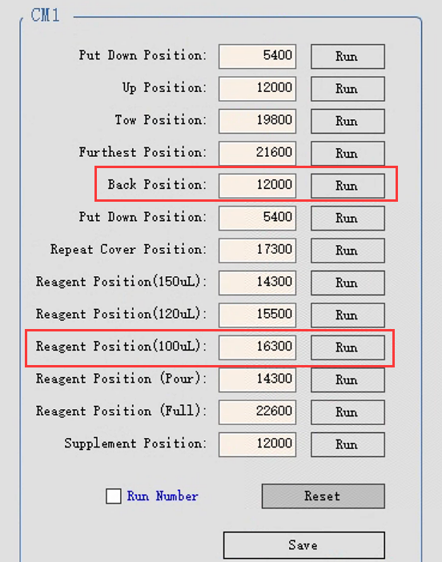
4. Position calibration
4.7 Slide staining unit, CM position calibration(only check #10 slide position)
4.7.5 calibrate the 100uL dispense position.
step 1. click “Reset(Z)” under “Arm” page to move the probe to Z home position to prevent the collision.
step 2. return “Coremodule”page, click“Run” of the Back Position, wait until the running is done.
step 3. click” Run”of the “Reagent Position(100uL)”, wait until running is done.

Slide 40
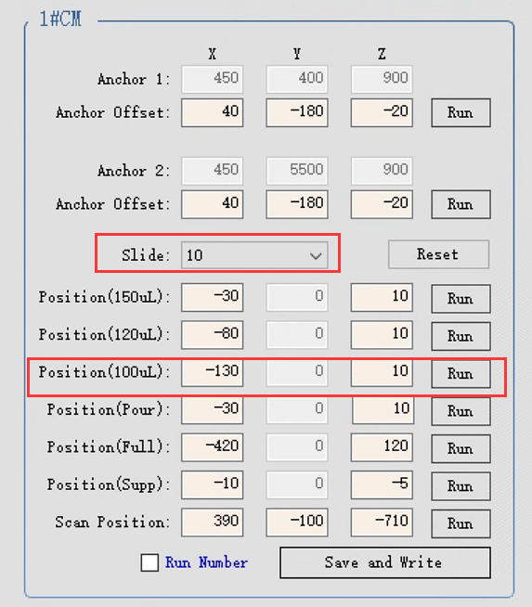
4. Position calibration
4.7 Slide staining unit, CM position calibration(only check #10 slide position)
4.7.5 calibrate the 100uL dispense position.
step 4. return “Arm” page. click “Run” of the “Position（100uL)”.
step 5. adjust X, Z value to move the probe until it meets the calibration position requirement.
refer to 4.7 calibration position requirement
step 6. select “10” under “Slide” down-list, repeat step 4 and step 5 to finish position 10 dispense position calibration.
step 7. click “Save and Write “ to save the calibration parameters.
Refer the above steps to finish the 100uL dispense position calibration of CM2 and CM3.

Slide 41
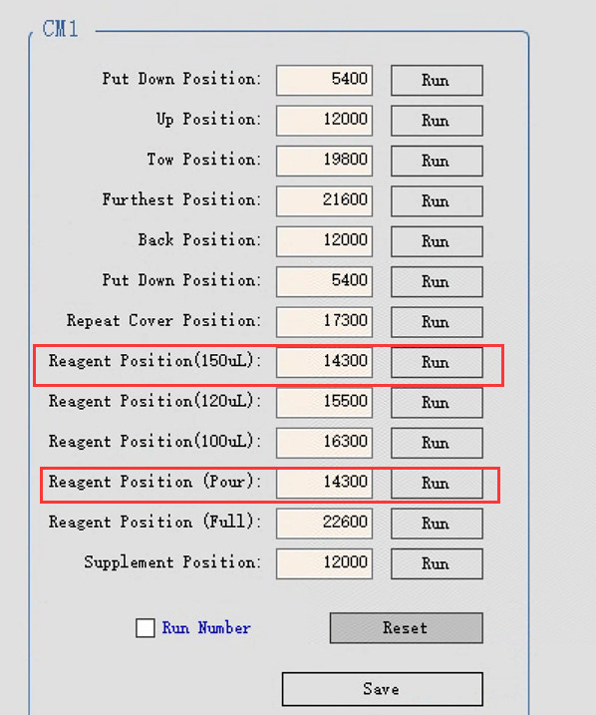
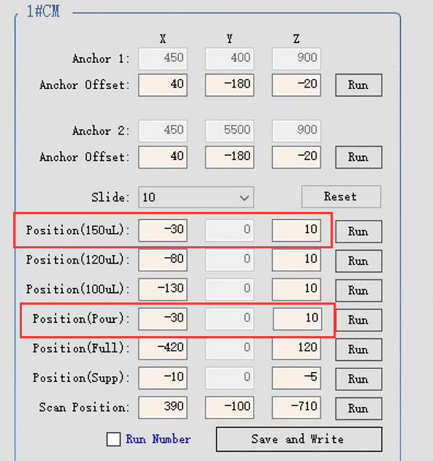
4. Position calibration
4.7 Slide staining unit, CM position calibration(only check #10 slide position)
4.7.6 the pour position, please keep the parameters same as the 150uL dispense position.

Slide 42
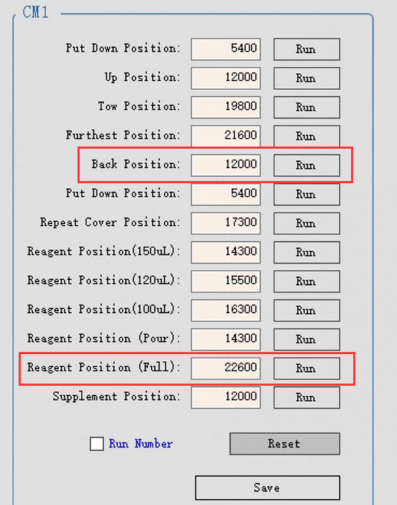
4. Position calibration
4.7 Slide staining unit, CM position calibration(only check #10 slide position)
4.7.7 Full-open position checking
step 1. click “Reset(Z)” under “Arm” page to move the probe to Z home position to prevent the collision.
step 2. return “Coremodule”page, click“Run” of the Back Position, wait until the running is done.
step 3. click” Run”of the “Reagent Position(Full)”, wait until running is done.
step 4. refer to step 2 and step 3, perform same operation for CM2 and CM3.
step 5. check to make sure the pull-push rods will not happen collision with the top plate.
Notes:
客户培训，全开位可以不包括，工厂出货已经校准好，不会有异常。

Slide 43
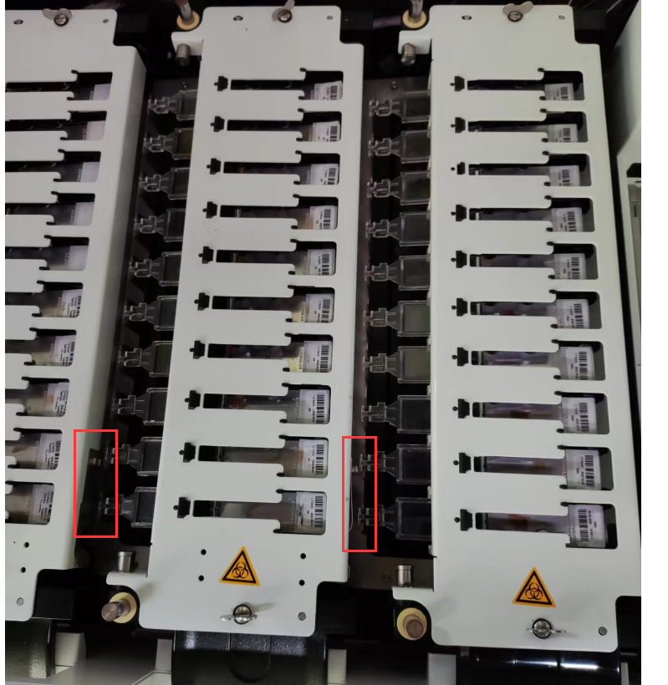
4. Position calibration
4.7 Slide staining unit, CM position calibration(only check #10 slide position)
4.7.7 Full-open position checking.
step 6. see the picture, if there is a collision, adjust “Reagent position(Full)” parameters and “Save” it.
step 7. Return “Arm” page. check if the X value of the “Position（Full)” is “-420”, the Z value of the “Position（Full)” is “120”.
Notes:
全开位：一般是抗原修复后，再加封闭剂前一个清洗步骤使用全开位

Slide 44
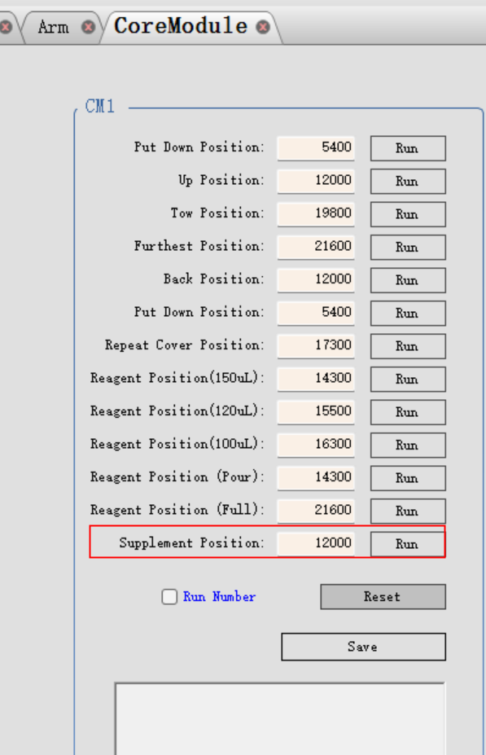

4. Position calibration
4.8 Supplyment position calibration
step 1. click “Reset(Z)” under “Arm” page to move the probe to Z home position to prevent the collision.
step 2. return “Coremodule”page, click“Run” of the Supplement Position, wait until the running is done.
step 3. return “Arm” page. click “Run” of the “Position（Supp）”.
step 4. adjust X, Z value to move the probe until it meets the calibration position requirement.
refer to 4.7 calibration position requirement
step 5. select “10” under “Slide” down-list, repeat step 4 and step 5 to finish supplyment position calibration.
step 7. click “Save and Write “ to save the calibration parameters.

Slide 45

4. Position calibration
4.9 Scan position calibration
4.9.1 click“Run” of the CM1 “Put down position” under CM page.
4.9.2 Return Arm page,click “Run” of the “Scan position”, then click “Open Scan Code” to check if the scanner can get thecode.
4.9.3 If can not, please adjust the X, Y, Z value of the scan position.

Slide 46
PART 4
Regularly clean and maintenance

Slide 47

Regularly clean and maintenance
Please inform the operator perform the regularly clean and maintenance task in order to maximize the performance of the instrument and extend the service life of the instrument.

Slide 48
THANKS!
汇报人： ####
部 门：###

